Slide 2
How has Scots settler Angus McMillan
been remembered?

Slide 3
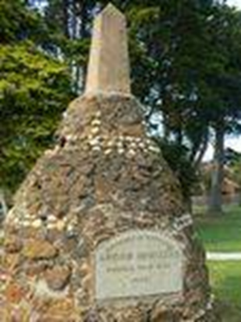
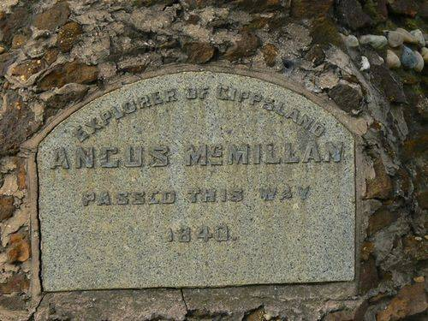
Starter activity
How much does this memorial tell us?
Who is being memorialised?
What might his name suggest?
What does the memorial tell us about him?
Does the amount of detail and the wording on the memorial strike you as unusual?
Memorials Australia, photographs supplied by Kent Watson

Slide 4
How has Angus McMillan been remembered?
Learning Intentions
Success Criteria
We will be learning what ‘interpretations of history’ means
We will be learning about the life of a famous Scottish settler in Australia – Angus McMillan
We will be learning some different ways that Angus McMillan has been remembered
You will be able to describe some details of Angus McMillan’s life
You will be able to describe some different ways that McMillan has been remembered
You will be able to explain how and why our view of McMillan has changed over time

Slide 5
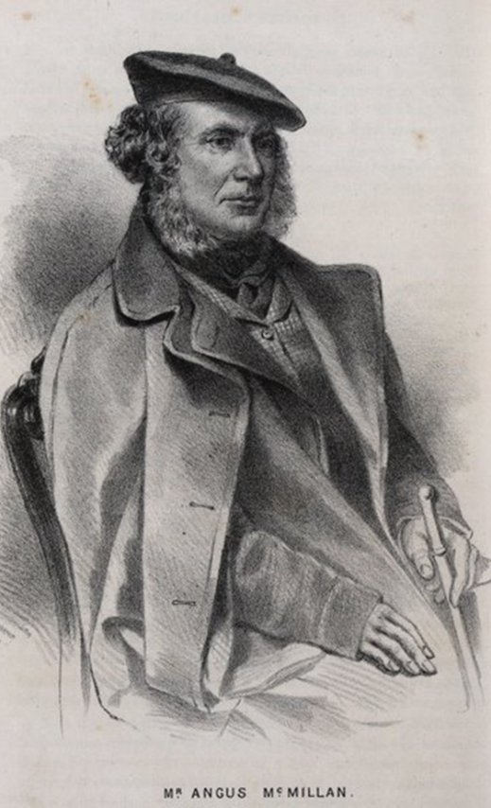
Who was Angus McMillan?
Angus McMillan was born in Glenbrittle on the Isle of Skye in 1810. As a young man, we has forced from his land in the Highland Clearances and moved to Australia in the 1830s. He died in 1865.
As we discovered from the memorial, McMillan played an important role in the colonisation of a part of Australia known as Gippsland (hard G) in the South East of Australia.
Victorian Collections
https://victoriancollections.net.au/items/575915f5d0cdd125103f0fb7

Slide 6
What do we mean by ‘interpretations’ of history?
People in the past have lived their lives and their lives cannot change. However, what does change is the way that people think about those people – this is called an interpretation of the person.
McMillan has been a very controversial figure – this means that people disagree strongly in their interpretation of him.
You will notice that we have not said a lot about what McMillan did in his life.
This is because different interpretations place different emphases on the different things he did.
Victorian Collections
https://victoriancollections.net.au/items/575915f5d0cdd125103f0fb7

Slide 7
How has the way McMillan has been interpreted changed over time?
Interpretation 1
Interpretation 2
McMillan is seen as a victim of the Highland Clearances whose skill and intelligence meant he succeeded in the colonies.
He did much to bring Gippsland under settler control and became a politician and President of the Caledonian Society of Victoria.
McMillan lost his land in the Highland Clearances only to then take the land of the Indigenous people of Gippsland.
He was responsible for a number of massacres of Gunaikurnai people, most notably at Warrigal Creek in July 1843 where some 150 people were killed

Slide 8
Analysing Interpretations of McMillan
 | Date produced | What type of source is it? | How does it portray McMillan?
1
2
3

Slide 9
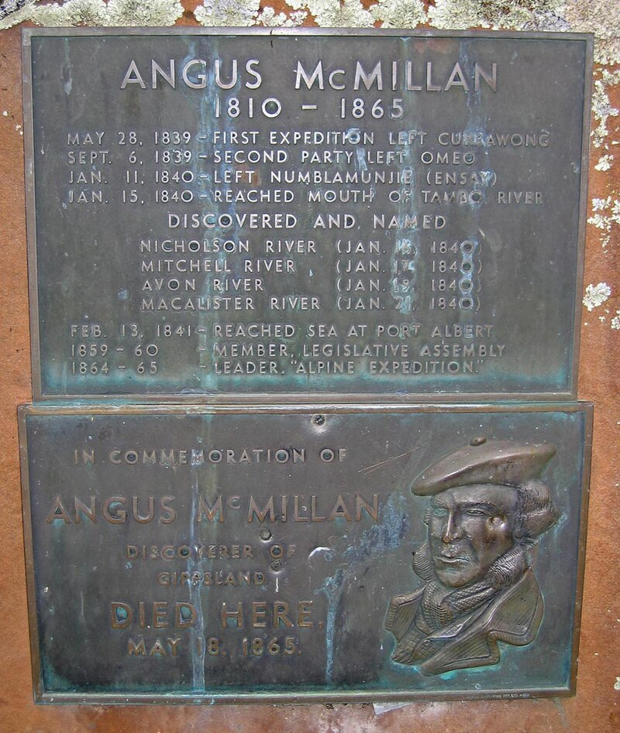
Interpretation 1
This is a bronze plaque attached to a cairn monument in Iguana Creek.
The plaque was produced in 1927.
The plaque has now been removed.
Discuss and complete row one of your Grid
https://commons.wikimedia.org/w/index.php?curid=1094275

Slide 10
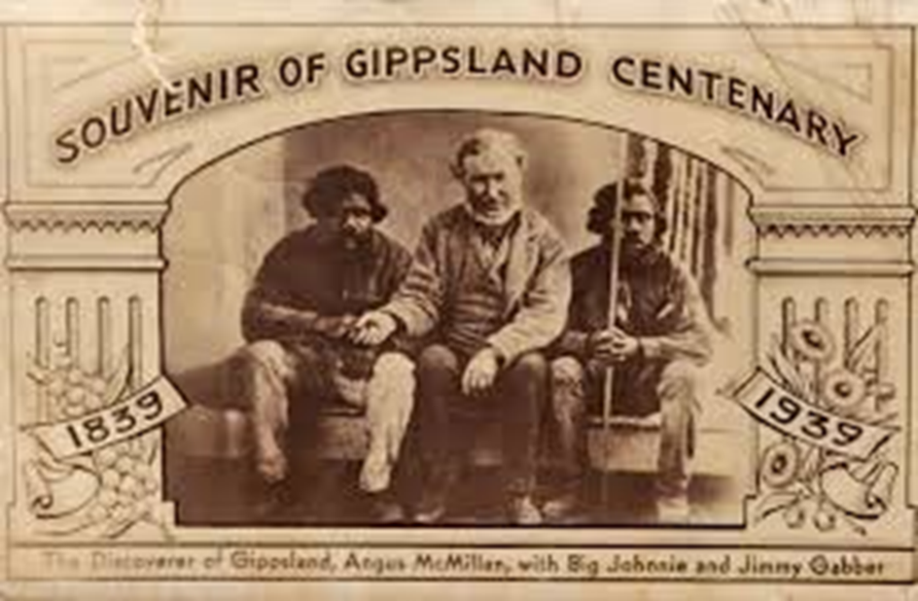
Interpretation 2
This postcard was produced in 1939 to celebrate the 100th anniversary of McMillan’s expedition in Gippsland. It uses an old photo of McMillan who had died in 1865.
According to historian Peter Gardner, the Aboriginal men are probably William Logan (whom McMillan had recently released from a murder charge) and Jimmy Raymond who accompanied McMillan on a trip into the bush.
How is McMillan described in the text? Does this word make sense?
How does McMillan look – what is the impression that this photo creates of him?
How does it show his relationship to Indigenous Australians?
Discuss and complete row two of your Grid

Slide 11
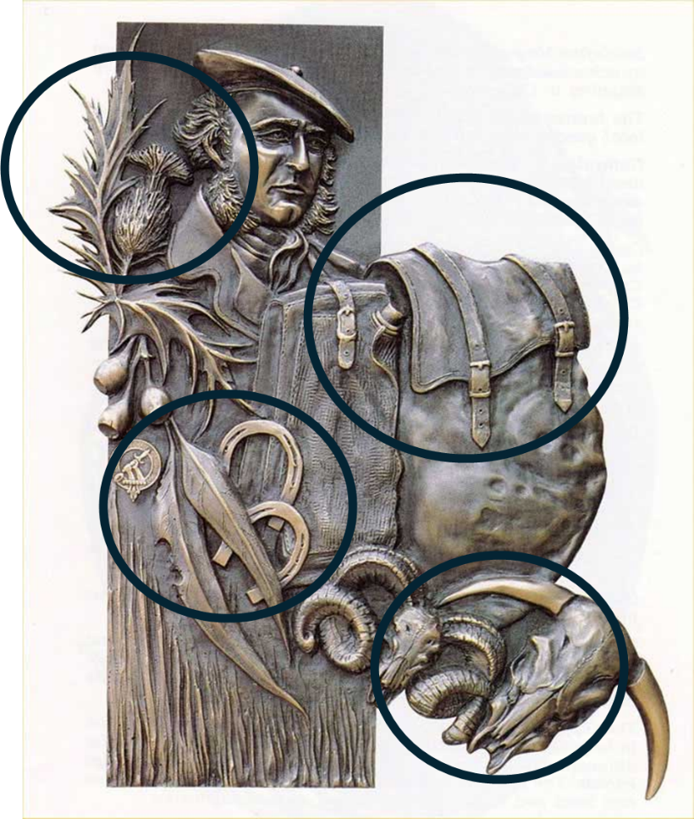
Interpretation 3
This is a photo of a bronze casting made by artist Annemieke Mein in 1984.
Artworks contain symbolism – this means that the images have meanings. What meaning might the symbols circled on the right hold?
Discuss and complete row three of your Grid
https://monumentaustralia.org.au/display/33336-angus-mcmillan

Slide 12
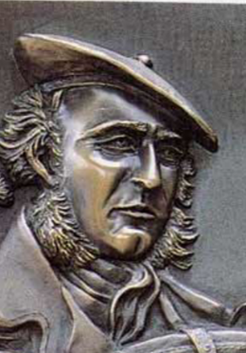
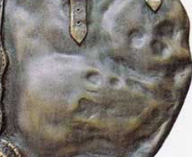
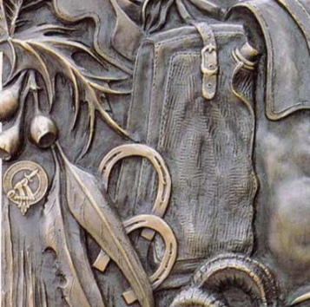
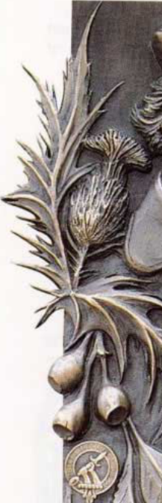
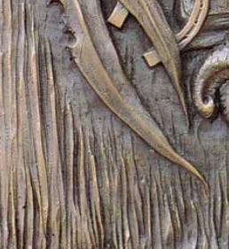
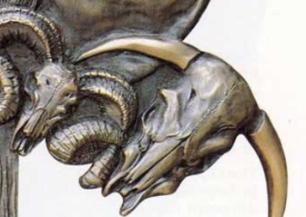
Skulls – death/ murder?
Saddlebags/horseshoes – Travelling/ exploring
Angus McMillan – in recognisably typical Scottish dress
Thistle/Clan Crest – Scotland
Hay/ barley/ feathers – land/ food
Animal skulls – survival, methodical killing?

Slide 13
What changed?
For a long time, interpretations of McMillan relied on the idea of Terra Nullius – that the land of Australia belonged to no one and, therefore, the settlers just occupied otherwise empty land.
In the 1970s, historian Peter Gardner drew attention to the violence that was committed during the colonisation of Gippsland.
In his 1984 book, Caledonia Australis, historian Don Watson named McMillan as the leader of the ‘Highland Brigade’, a group of Gaelic-speaking Scotsmen who led violent charges against the Gunaikurnai (the Indigenous community of the region). Watson was born in the town of Warragul, the site of McMillan’s worst massacre in 1843.

Slide 14
What happened at Warragul in July 1843?
‘The brigade, coming up to the Blacks camped around the Waterhole at Warrigal Creek, surrounded them and fired into them, killing a great number, some escaped into the scrub, others jumped into the waterhole, and, as fast as they put their heads up for breath, they were shot until the water was red with blood. I knew two Blacks, who though wounded, came out of the hole alive. One was a boy at the time about 12 or 14 years old. He was hit in the eye by a slug, captured by the whites, and made to lead the 'brigade' from one camp to another.
In July 1843, a man named Ronald Macalister was killed by Aboriginal men. McMillan led a group of around 20 Gaelic-speaking Scots colonists to attack and kill Aboriginal people across a number of days. Up to 150 Gunaikurnai people were killed.
These attacks were not secret and were well-known. The account on the left was written by an eyewitness and was recorded in 1925 in a factual magazine for young adults.
Gippslander (1925). "Experiences with Gippsland Blacks". The Gap. Cited in Centre For 21st Century Humanities

Slide 15

Plenary – How should McMillan be memorialised?
There are lots of monuments to McMillan still standing. The cairn on the left was erected in 1927 – when McMillan’s massacres were already known.
Wellington Shire Council has removed from display the Mein bronze plaque of McMillan, with the knapsack full of skulls. The council recently voted to keep, by one vote, two controversial cairns, dedicated to McMillan, on public land.
Would you remove the cairn?
Would you keep it but change the writing? If so, what would you change it to? Do you think this change would be popular?
Memorials Australia, photographs supplied by Kent Watson

Slide 16
For the teacher

Slide 17
Interpretations of McMillan Worksheewt
 | Date produced | What type of source is it? | How does it portray McMillan?
1
2
3

Slide 18
Lesson Plan
Enquiry Question: How has Angus McMillan been remembered?
Purpose | Understand that historical figures can be interpreted in different ways by different people at different times.
Objective | Understand that historical figures can be interpreted in different ways by different people at different times. Give students are secure specific example of settler colonial violence in Australia
Outcome | Pupils will answer the EQ by producing a data catcher which analyses three interpretations of McMillan. They will reach a judgement about how they think he should be remembered.
TIME | TEACHER IS | PUPILS ARE
0-10 | Sharing initial stimulus material of McMillan’ memorial Sharing LI and SCs | Drawing inferences about McMillan and the focus of the lesson
10-15 | Introducing McMillan and the concept of interpretations
15-20 | Exploring interpretation 1 | Exploring interpretation 1 and making inferences Completing Data Catcher
20-30 | Exploring interpretation 2 | Exploring interpretation 2 and making inferences Completing Data Catcher
30-40 | Exploring interpretation 3 | Exploring interpretation 2 and making inferences Completing Data Catcher
40-45 | Outlining the newer historiography of McMillan and the story of the Warragul Creek massacre.
45-50 |  | Pupils discuss existing memorials to McMillan and how the might be re-framed.

