Slide 1
Notes:
Describe how a possum skin cloak is made
Describe the negative consequences for the Aboriginal peoples of the arrival of European settlers.
Show you understand that European settlers saw Aboriginal societies as primitive and that this led to the destruction of these.
Show you understand that the negative consequences of white settlers on the Aboriginal and Torres Strait Islander people in Australia continues to this day.
Music – with research, relevant aboriginal/Indigenous Peoples music could be used in the background as the class comes in

Slide 2
Impact of Scots on Australia
What can the
possum skin cloak tell us
about the Aboriginal way of life and the
impact of Scottish settlers?

Slide 3
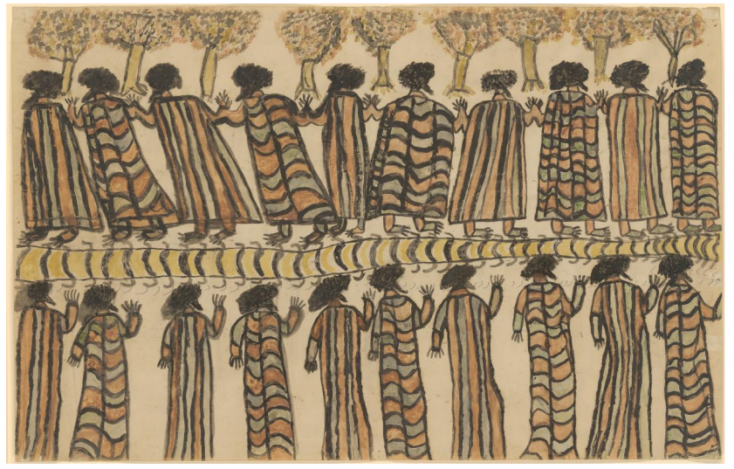
Starter Task
In pairs discuss this picture
What can you see?
What do you think is happening?
Describe the colours
of the clothing
Why do you think
it was drawn?
Beruk (William Barak), Figures in Possum Skin Cloaks (1898), NGV Naarm/Melbourne
Notes:
Discussion – cloak, rituals, legacy, culture, preserving heritage, aboriginal dress, earth colours, link to the environment
Additional question – what would you like to ask the artist?
William Barak - Figures in possum skin cloaks - Google Art Project.jpg
William Barak ((c. 1824) - 1903) ("Wurundjeri people, Aboriginal Australian")
Details on Google Art Project

Slide 4
Success Criteria​
Describe 3 negative consequences for Indigenous Peoples in areas of Australia where Scots settled.
Learning Intentions
Through a study of primary sources learn about Australian Aboriginal peoples' way of life
Through a study of the possum skin cloak learn that Australian Aboriginal peoples are highly skilled and their way of life is adapted to their environment
To understand that the arrival of European
settlers had negative consequences for the Aboriginal peoples of Australia in terms of land dispossession, culture, health and economy.
To understand the long-standing consequences of white settlers for the Aboriginal peoples.
Notes:
Additional Success Criteria
Show you understand that European settlers saw Aboriginal societies as primitive and that this led to the destruction of these.
Show you understand that the negative consequences of white settlers on the Aboriginal and Torres Strait Islander people in Australia continues to this day.

Slide 5
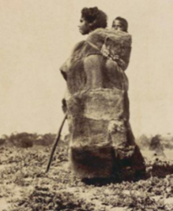
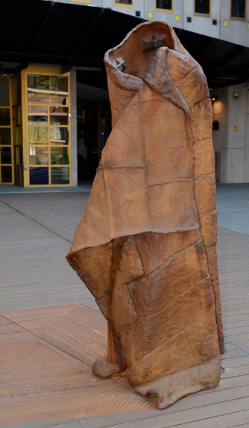
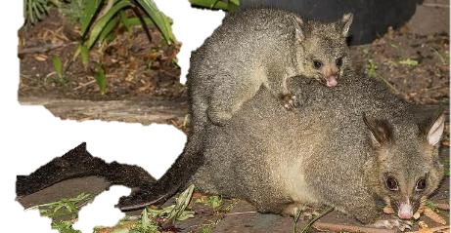
The Possum Cloak (Opossum Rug)
Modern Possum-skin cloak
Common Brushtail Possum
A Ngarrindjeri woman wearing a possum skin cloak
Modern Possum-skin cloak by Vicki Couzans
Common Brushtail Possum
Teenminne, a Ngarrindjeri woman, wearing a possum skin cloak carrying a child on her back, South Australia, ca.1870,
Notes:
Creative Commons Image
DescriptionEnglish: Common brushtail possum (Trichosurus vulpecula) with joey, Little Swanport near Triabunnae, TAS, Australia
Date16 November 2023, Source Own work, from Sharp Photography, sharpphotography.co.uk Author Charles J. Sharp (1951–)
Modern Possum-skin cloak by Vicki Couzans bhttps://australian.museum/learn/first-nations/possum-skin-cloaks-then-and-now/
Teenminne, a Ngarrindjeri woman wearing a possum skin cloak carrying a child on her back, South Australia, ca.1870, National Library of Australia, nla.obj-148825818

Slide 6
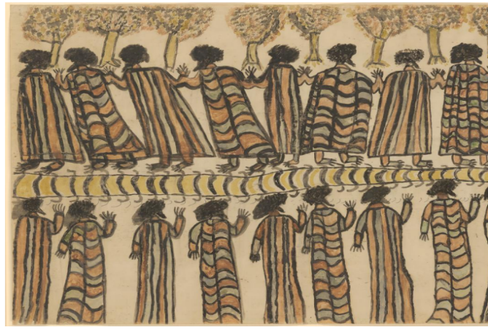
Possum skin cloak
Item of importance to Aboriginal cultures
Key piece of Aboriginal clothing – warmth, wrapping baby, mattress
Colour – the cloak is painted with natural pigments called ochre from the soil and minerals which give the cloak its earth colours – brown, yellow, red
Only a handful survive today
William Barak - Figures in possum skin cloaks
Notes:
Ppssum Skin Cloaks: Made from possums – particularly worn by Aboriginal peoples.
Item of important cultural culture. Often family heir looms passed down the generations. Form part of collective and communal identity of Aboriginal peoples.
Link to the environment - Colour – the cloak is painted with natural pigments called ochre from the soil and minerals which give the cloak its earth colours – brown, yellow, red. These are mixed with fat to make the cloak waterproof.
Only a handful of possum skin cloaks from before 1900 have survived. Today, people are making these to connect to previous Indigenous traditions.
See website: https://australian.museum/learn/first-nations/possum-skin-cloaks-then-and-now/

Slide 7
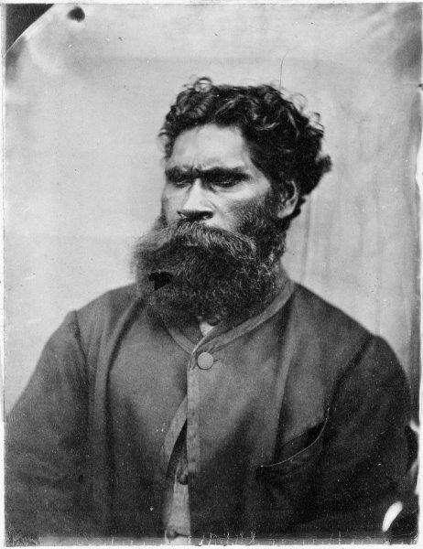
How do we know?
Beruk
‘William Barak’
Notes:
Wikipedia: ‘William Barak (c. March 1823 – 15 August 1903), named Beruk by his parents, the "last chief of the Yarra Yarra tribe", was the last traditional ngurungaeta (elder) of the Wurundjeri-willam clan, the pre-colonial inhabitants of present-day Melbourne, Australia. He became an influential spokesman for Aboriginal social justice and an important informant on Wurundjeri cultural lore.
In his later life, Barak painted and drew Wurundjeri ceremonies and carved weapons and tools. He is now considered a significant Aboriginal artist of the nineteenth century.

Slide 8



Task 1: - Recipe for a Possum Cloak
Components | Purpose (use) in making the possum cloak
Read Source A from writings of James Dawson's Australian Aborigines: the languages and customs of several tribes
in the western district of Victoria (1881)
Complete the table showing the components needed to create
a possum skin cloak.
Then add the steps to make the cloak.
Use the Glossary to help you
fully understand the source.

Slide 9
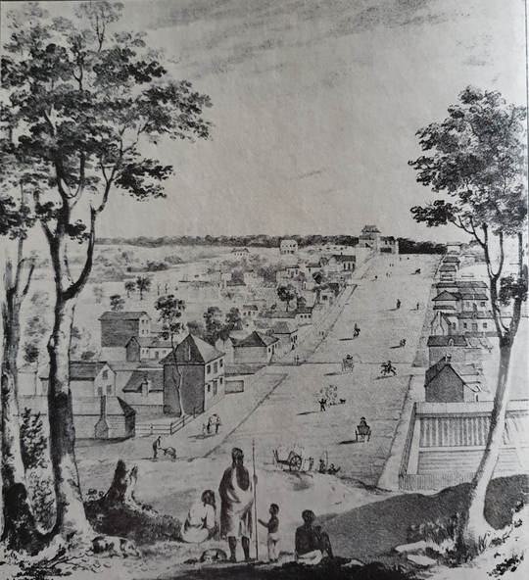
How do we know?
James
Dawson
‘Protector of the Aborigines’
Notes:
James Dawson was born in West Lothian and arrived in Naarm in 1840 (The settlement was officially named Melbourne by Governor Bourke in March 1837- 3 years before)
Dawson was appointed Protector of the Aborigines.
James Dawson was critical of colonial policy towards the Aboriginal peoples and the impact of it upon them.
Dawson made friends with Wombeetch Puyuun (c.1818-1883) a Djargurd Wurrung man who refused to move to the Framlingham Aboriginal Station.
Dawson's writings in the extracts used in this lesson show atypical sympathy towards Aboriginal people of Australia, even though he was affected by the racialised thinking of European colonists at this time.
Image in Public Domain: Victorian Collections
https://victoriancollections.net.au/items/5cd6a3d121ea6811c88cfeec
Image of Collins Street Melbourne in 1840, looking west towards Russell Street, from a drawing by Elisha Noyce and William Knight, August 1840. The original worko is held by the State Library of Victoria. A group of Aborigines stand in the foreground.
NAARM (MELBOURNE) Previously named Batmania
The dispossession of Wurundjeri took place not only through the massacres, frontier battles and displacements, but also through disconnection. Land was sold, bush was cleared for the creation of roads and buildings, and wetlands were drained.
Over time, even the course of the Yarra River was changed. The disruption of sacred sites might be termed desecration. For the Wurundjeri, who had a spiritual connection to the land, these changes had a devastating impact on all aspects of their health and well being.
Prior to Melbourne’s white land theft (settlement), European sealers and whalers had lived and worked along the Victorian coastline for decades, and the British had made attempts to establish settlements further out on Port Phillip Bay and Westernport Bay.
The arrival of settlers during the 1830s was considered illegal under British law, but settlers came anyway, unable to resist the fertile lands that were nurtured for many thousands of years through sustainable land management practices.
The settlement grew through the early thirties and by the end of 1836, the British government conceded it couldn’t stop it.
The settlement was officially named Melbourne by Governor Bourke in March 1837. During the ceremony Bourke used William Buckley, an escaped convict who had lived with Watha wurrung people for thirty-two years, to tell the Aboriginal people present that he would be a friend as long as they were peaceable and obeyed the invaders law.
As the settler population increased and their infrastructures and destruction increased, the European hold on the land was strengthened.
Aboriginal people were pushed further and further out, and freedom of movement across the land became increasingly difficult.
The settlers created new land boundaries with fences and often had guns to back them up. For the Wurundjeri, finding food within traditional clan boundaries became increasingly challenging. The settlers hunted wildlife on an unprecedented level, for sport as well as for food, reducing the amount that was available.
Introduced animals such as sheep and cattle trampled and killed vegetation, hardened the soils that had been a staple for sustainability and the Aboriginal diet.
This sometimes forced Aboriginal people onto the land of other clans – a breach of protocol which sometimes led to inter-clan violence.
Devastation from introduced diseases also influenced the willingness of Aboriginal people to return to former campsites, as happened at the confluence of the Yarra River and Merri Creek after the influenza epidemic of 1847.
The Wurundjeri-willam and other Aboriginal people of the Yarra and Melbourne area did not concede their land easily, but as the settlement grew and space to hunt and gather diminished, many of the dispossessed were eventually drawn to the settlement, where food was available.
As Melbourne developed into a town and then a city, there continued to be a strong Aboriginal presence in and around the settlement.
IMAGE:
View along Collins Street, Melbourne, looking west towards Russell Street. By Elisha Noyce and William Knight, August 1840. Chalk lithograph on buff paper.
From the State Library of Victoria's Pictures Collection. Accession number: H18111
REFERENCES:
A.G.L. Shaw, ‘Foundation and Early History’, in Andrew Brown-May and Shurlee Swain (eds), The Encyclopedia of Melbourne, online edition
Edmonds, Urbanizing Frontiers, 82
Bernard Barrett, The Inner Suburbs: The Evolution of an Industrial Area, Melbourne: Melbourne University Press, 1971, 14
Ibid, 20; Shaw, ‘Foundation and Early History’
Christie, Aborigines in Colonial Victoria, 42
Richard Broome, ‘Aboriginal Melbourne’, in Brown-May and Swain, The Encyclopedia of Melbourne
Clark and Kostanski, , ‘An Indigenous History of Stonnington’, 83-4

Slide 10
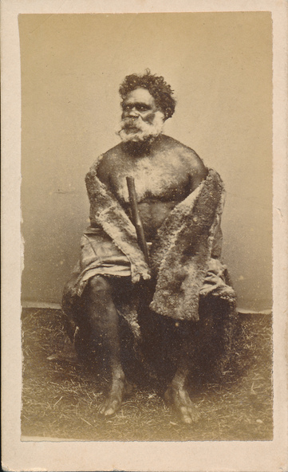
How do we know?
Wombeetch
Puyuun
Wombeetch Puyuun wearing traditional possum skin cloak
Notes:
Dawson made friends with Wombeetch Puyuun (c.1818-1883) a Djargurd Wurrung man who refused to move to the Framlingham Aboriginal Station.
James Dawson relied significantly on Wombeetch Puyuun’s knowledge—and that of other local Aboriginal people—to write his 1881 ethnographic work, Australian Aborigines: The Languages and Customs of Several Tribes of Aborigines in the Western District of Victoria, Australia. While Dawson deserves some credit for attempting to preserve Aboriginal culture in a colonial context, the book's content and Dawson's own acknowledgements reveal that he was deeply dependent on Indigenous informants, particularly Wombeetch Puyuun.
Image in Public Domain: Victorian Collections
https://victoriancollections.net.au/items/6540726f9851d45509f823fe
Image of Wombeetch Puyuun (Camperdown George) wearing traditional possum skin cloak and holding a walking stick
When he died at Camperdown in February 1883, Wombeetch Puyuun, also known as 'Camperdown George', was the last member of the Liwira Gundidj clan of the Djargurd Wurrung still living on Country.

Slide 11
The ring-tailed opossums were more plentiful than the common kind, but the skins were less esteemed. Rugs were also made of the skins of the wallaby and of the brush kangaroo, which are likewise inferior to the common opossum. A good rug is made of from fifty to seventy skins which are stripped off the opossum, pegged out square or oblong on a sheet of bark and dried before the fire. [It is] then trimmed with a reed knife and sewn together with the tail sinews of the kangaroo, which are always pulled out of the tail and carefully dried and saved for thread…
Task
Complete the table showing the components (items) needed to create a possum skin cloak.
Then add the steps to make the cloak.
Source A: James Dawson's Australian Aborigines
Notes:
The ring-tailed opossums were more plentiful than the common kind, but the skins were less esteemed. Rugs were also made of the skins of the wallaby and of the brush kangaroo, which are likewise inferior to the common opossum. A good rug is made of from fifty to seventy skins which are stripped off the opossum, pegged out square or oblong on a sheet of bark and dried before the fire. [It is] then trimmed with a reed knife and sewn together with the tail sinews of the kangaroo, which are always pulled out of the tail and carefully dried and saved for thread. [Before] sewing the skins together, diagonal lines, about half-an-inch apart, are scratched across the flesh side of each with sharpened mussel shells. This is done to make them soft and pliable. The only addition to this kind of ornamentation is occasionally the figure of an emu in the centre skin of the rug
Extract from James Dawson's Australian Aborigines: the languages and customs of several tribes of Aborigines in the western district of Victoria
(Melbourne: George Robertson 1881)
Available via Trove, National Library of Australia:
https://nla.gov.au/nla.obj-52770478

Slide 12
Using Source A from writings of James Dawson's Australian Aborigines
Task 1: - Complete the instruction guide to make a Possum Cloak
Components | Purpose (use) in making the possum cloak
Common Possum (preferable to ringed tailed possum) | Skin needed for cloak – around 50-70 skins
Bark | To pin the possum skin onto so it will dry
Reed | To make a knife to trim the possum skin to the right size
Kangaroo | Need sinews from the tail to make thread to sew the possum skins together. They are dried before use.
Mussel shell | Sharpened to scratch the flesh side of the possum skin to make it softer and more flexible. Scratch diagonal lines about half an inch apart.

Slide 13


Thinking Points
With a partner compare your possum skin cloak instructions
What does the possum skin cloak tell us about the Aboriginal peoples of Australia?
Notes:
-Skilled
-Living in harmony with the land
-Dependence on the environment for their way of life

Slide 14
Thinking Points
What can we learn about the Aboriginal way of life through the possum skin cloak?
The making of the possum skin cloak shows a close relationship between Aboriginal society and the environment.
The making of the possum skin cloak is a highly skilled task.
Aboriginal society relies on local flora and fauna
– in delicate balance and equilibrium
Notes:
-Skilled
-Living in harmony with the land
-Dependence on the environment for their way of life

Slide 15
Task 2: The impact of European settlers on Aboriginal society
A [change] from this primitive mode of covering, and the adoption of the white man’s costume, have weakened the constitution of the aborigines, and [made] them very [likely to get] colds and pulmonary diseases, more particularly as – though they overload themselves with European clothes during the daytime – they seldom sleep under their rugs, except in the cold season of the year.
Source B
Read extracts from Dawson’s writings in sources B, C and D
Answer the questions on your worksheet.
Source B: James Dawson's Australian Aborigines

Slide 16
Task 2: The impact of European settlers on Aboriginal society
Fur rugs were very scarce and valuable before the white man destroyed the wild dogs, the natural enemies of the opossum and kangaroo, as it took a year to collect opossum skins sufficient to make one.
Source C
Read extracts from Dawson’s writings in sources B, C and D
Answer the questions on your worksheet.
Source C: James Dawson's Australian Aborigines

Slide 17
Task 2: The impact of European settlers on Aboriginal society
It may be stated that, although many of the opossum rugs of the aborigines are now ornamented with a variety of designs, some of which are coloured, nothing but the simple pattern with the occasional figure of an emu, was used before the arrival of the white man. The figures of human beings, animals, and things, now drawn by the natives and represented in works on the aborigines of the colony of Victoria as original, were[previously] unknown to the tribes, and are considered by them as of recent introduction by Europeans.
Source D
Read extracts from Dawson’s writings in sources B, C and D
Answer the questions on your worksheet.
Source D: James Dawson's Australian Aborigines

Slide 18
Summarise the impact of white settlers on the Aboriginal peoples' way of life
Notes:
What do Source B, C and D tell us about the impact of white settlers on the Aboriginal peoples of Australia?
Provide evidence from the extracts to support your answer.
Source B
Source C
Source D

Slide 19
The consequences for the Aboriginal peoples of adopting European dress
in terms of illness, changes to culture and loss of culture
Key Points
Source B – illness and disease as a result of adopting Western clothing that is not adapted to the Australian environment
Source C – economic impact – they have decreased the value of possum skins (and items made from them).
Source D – Impact of white settlers on the environment – destroying species and flora and fauna – which upset the delicate balance needed for a flourishing Aboriginal society.
They are changing the culture of the Aboriginal peoples. Seen in the decoration of possum skin cloaks becoming more elaborate compared to the simple decorations before white settlement.
What do the sources suggest about the impact of European settlers on the Aboriginal way of life?
Notes:
Option to discuss Dawson’s description of Aboriginal dress as ‘primitive’ (see lesson plan for more detail).

Slide 20
From AIATSIS: - Australia’s National institution focused on the diverse history, culture and heritage of the Aboriginal People and Torres Strait Islanders.
“In the mid-1800s, British colonies across the south-east distributed woollen blankets to local Aboriginal people. Many began using government issued blankets rather than their possum skin cloaks. Woven wool blankets, however, were not as effective as possum skin cloaks. They were not as warm nor were they waterproof and offered little protection from the cold and wet winters of south-eastern Australia. During this time, many Aboriginal people became ill and died from common European colds and flu viruses.
Only a handful of possum skin cloaks made prior to 1900 still exist today, preserved in museum collections held in Australia and overseas. The scarcity of old cloaks is due both to their fragility and purpose; they were designed to be used during the lifetime of their owner and often as a burial wrapping.
Today, possum skin cloaks remain important to Aboriginal people across the south-east of Australia with new uses and contemporary ways of making”.
Notes:
Bullet Points from AIATSIS website https://aiatsis.gov.au/explore/possum-skin-cloak#:~:text=Once%20an%20everyday%20item%20for,together%20to%20wrap%20a%20baby.

Slide 21
Success Criteria​
Describe 3 negative consequences for Indigenous Peoples in areas of Scottish Settlement
Learning Intentions
Through a study of primary sources learn about Australian Aboriginal peoples' way of life
Through a study of the possum skin cloak learn that Australian Aboriginal peoples are highly skilled and their way of life is adapted to their environment
To understand that the arrival of European
settlers had negative consequences for the Aboriginal peoples of Australia in terms of land dispossession, culture, health and economy.
To understand the long-standing consequences of white settlers for the Aboriginal peoples.
Notes:
Additional Success Criteria
Show you understand that European settlers saw Aboriginal societies as primitive and that this led to the destruction of these.
Show you understand that the negative consequences of white settlers on the Aboriginal and Torres Strait Islander people in Australia continues to this day.

Slide 22
Impact on Australia
For the Teacher
Lesson Plans

Slide 23
Lesson Level Enquiry Question: What can the Possum skin cloak tell us about the Aboriginal way of life and the impact of white settlers?
Purpose: | To learn about the Australian Aboriginal people’s way of life and the impact of white settlers through a study of two primary sources relating to the Aboriginal possum skin cloak. The aim is to demonstrate that the Aboriginal people’s way of life is intimately connected to their environment and that the arrival of white setters had negative consequences for the Aboriginal people in terms of their culture, health, environment and economy. These negative impacts remain to this day.
Objective: | To use two primary sources [Aboriginal image Figures in Possum Skin Cloaks (1898) by William Barak and extracts from white settler James Dawson’s Australian Aborigines: the languages and customs of several tribes of Aborigines in the western district of Victoria (1881)] to investigate the Aboriginal people’s way of life and the impact of white settlers. Through a study of the possum skin cloak learn that the Aboriginal people's way of life is intimately connected to the land and its flora and fauna. Through a study of the possum skin cloak learn that Australian Aboriginal people are highly skilled, and their way of life is adapted to their environment. To understand that the arrival of white settlers had negative consequences for the Aboriginal people of Australia in terms of dress, culture, health and economy.
Outcome: | Pupils will demonstrate their ability to answer the Enquiry Question by… Using two primary sources relating to the possum skin cloak Describing how a possum skin cloak is made and being able to explain that this requires skill and is dependent upon resources from the environment (flora and fauna). Being able to describe the negative consequences for the Aboriginal people of the arrival of white settlers. This can be explained in terms of the Aboriginal adoption of European clothes and the negative consequences in terms of Aboriginal health and culture. The destruction of the environment by white settlers led to negative economic consequences for Aboriginal people. Showing an understanding that white settlers often regarded Aboriginal societies as ‘primitive’ and less skilled, and their sense of white superiority often underpinned the destruction of the Aboriginal way of life. Understand that the negative consequences of white settlers on the Aboriginal people of Australia continues to this day.
Time | Teacher is… | Pupils are… | Checking learning
0-5 | Display starter task on the board: a painting of Figures in Possum Skin Cloaks by Aboriginal artist William Barak. Teacher explains the starter task: a discussion exercise in pair. Questions are given to prompt pupils in their thinking. There is an alternative starter which can be used if students have access to pencils to colour in the image. This could be started as students enter the classroom so it doesn’t use up too much time. | Discussing the questions, noting down ideas and getting ready to feed back in whole class discussion. The colouring task will highlight the earth colours. This will be linked to discussion as the colours of the cloaks are due to earth pigments being used. Links possum cloak to the environment. | Teacher gathers responses from groups/pairs. Link to next slide for discussion.

Slide 24
5-10 | With feedback from students from starter, teacher should move to slide 6 showing images of the possum skin cloak. Teacher gives information and gathers information from pupils from looking at images. They can learn that the cloak is (also on slide 7): - Made from possums Key piece of Aboriginal clothing – many uses – keeping warm, wrapping/carrying babies, blanket, mattress. Particularly worn by Aboriginal people living in South East Australia. Important part of Aboriginal culture. Often family heir looms passed down the generations. Colour – the cloak is painted with natural pigments called ochre from the soil and minerals which give the cloak its earth colours – brown, yellow, red. These are mixed with fat to make the cloak waterproof (link with environment) Only a handful of possum skin cloaks from before 1900 have survived. | Listening to teacher. No note taking required (unless teachers want them to have certain definitions in notes).
10-15 | Teacher introduces Task 1. To devise a recipe for making a possum skin cloak. There is a slide to demonstrate what a recipe is, to helps pupils understand the task. Teacher goes through slides 8-10 before issuing worksheets (including glossary) | Listening to brief introduction. Note taking not required as worksheets will be issued.
15-30 | Students start Task 1: This can be done individually or in pairs The glossary should be used (slide 34) | Pupils are to be completing the task individually (or in pairs – teacher’s choice). | Teacher should be circulating room to see progress. The task should be followed by a class discussion. Teacher can invite responses from pupils. Completed table shown on slide 11 Discussion about the skill of the Aboriginal people and link the making of possum skin cloaks to the environment is important (slides 12-13)
30-45 | Teacher introduces Task 2 on slides 14-16 Pupils look at the writings of James Dawson to investigate the impact of white settlers on the Aboriginal way of life. They will examine three sources which show the negative impact of white settlers on the Aboriginal way of life in terms of culture, dress, health, environment and economy. | Students complete three questions using three sources. This can be done individually or in pairs. | Feed back findings as whole class discussion. Slide 17 gives findings from source analysis.
45-50 | Plenary: Teacher introduces plenary task. This links the pupil learning back to the overall enquiry question. Students are to write down or name one thing the possum skin cloak as taught them about the Aboriginal people, and one thing they have learnt about the impact of white settlers for the Aboriginal people. (slide 18) | Pupils can either write down their answer, or express it verbally. Alternatively they could write it on a post-it note and post it on the wall before they leave the classroom.
Home learning: (if necessary/ appropriate) Home learning: (if necessary/ appropriate) A home or extension task could be to further explore the possum skin cloak through the AIATSIS website https://aiatsis.gov.au/explore/possum-skin-cloak#:~:text=Once%20an%20everyday%20item%20for,together%20to%20wrap%20a%20baby. This is Australia’s National institution focused on the diverse history, culture and heritage of the Aboriginal people and Torres Strait Islanders. [slide 19]

Slide 25
Impact on Australia
For the Teacher
Learner Worksheets

Slide 26
Glossary
Bark - tough outer layer of a tree trunk or plant.
Brush kangaroo - a type of wallaby
Constitution - the body’s health and strength
Esteemed - highly regarded or respected
Emu - A large flightless bird found in Australia. Similar to a small ostrich.
Flesh side - the side of the skin that does not have fur on it
Inferior - lower in quality or status
Mussel shells - The shell of a sea creature (molluscs). The shell is hard.
Opossum - is the same as possum; an Australian animal (marsupial) that lives in trees.
Ornamentation - decoration
Pliable - flexible
Primitive - simple, unsophisticated, less skilled.
Pulmonary - lung
Reed - a grass-like plant that is tough and can be used to make tools and utensils.
Rug - cloak
Sinew - a tough band of fibrous tissue linking muscle to bone
Thread - a long strand of fibre used in sewing (usually to sew items together)
Wallaby - Australian marsupial that is similar to a small kangaroo

Slide 27
Source A, James Dawson’s book ‘Aborigines’, 1881​
TASK 1: RECIPE FOR A POSSUM SKIN CLOAK​
The ring-tailed opossums were more plentiful than the common kind, but the skins were less esteemed. Rugs were also made of the skins of the wallaby and of the brush kangaroo, which are likewise inferior to the common opossum. A good rug is made of from fifty to seventy skins which are stripped off the opossum, pegged out square or oblong on a sheet of bark and dried before the fire. [It is] then trimmed with a reed knife and sewn together with the tail sinews of the kangaroo, which are always pulled out of the tail and carefully dried and saved for thread. [Before] sewing the skins together, diagonal lines, about half-an-inch apart, are scratched across the flesh side of each with sharpened mussel shells. This is done to make them soft and pliable. The only addition to this kind of ornamentation is occasionally the figure of an emu in the centre skin of the rug.
Ingredient | Use in the creation of a Possum Skin Cloak
An extract from James Dawson’s Aborigines; the languages and customs of several tribes of Aborigines in the western district of Victoria. (Melbourne: George Robertson 1881). Available via Trove, National Library of Australia: https://nla.gov.au/nla.obj-52770478 ​
Use the glossary provided to help you fully understand the source.

Slide 28
TASK 2: THE IMPACT OF EUROPEAN SETTLERS ON ABORIGINAL PEOPLES
Source B
A [change] from this primitive mode of covering, and the adoption of the white man’s costume, have weakened the constitution of the aborigines, and [made] them very [likely to get] colds and pulmonary diseases, more particularly as – though they overload themselves with European clothes during the daytime
Source B tells us that the impact was...
Source C tells us that the impact was...
Source D tells us that the impact was...
Taken together, the three sources tell us that the impact was
Source C
Fur rugs were very scarce and valuable before the white man destroyed the wild dogs, the natural enemies of the opossum and kangaroo, as it took a year to collect opossum skins sufficient to make one.
Source D
It may be stated that, although many of the opossum rugs of the aborigines are now ornamented with a variety of designs, some of which are coloured, nothing but the simple pattern with the occasional figure of an emu, was used before the arrival of the white man. The figures of human beings, animals, and things, now drawn by the natives and represented in works on the aborigines of the colony of Victoria as original, were [previously] unknown to the tribes, and are considered by them as of recent introduction by Europeans. .
All extracts from James Dawson’s Aborigines; the languages and customs of several bribes of Aborigines in the western district of Victoria. (Melbourne: George Robertson 1881). Available via Trove, National Library of Australia: https://nla.gov.au/nla.obj-52770478 ​
Use the glossary provided to help you fully understand the sources.

Slide 29
Impact on Australia
For the Teacher
Additional Materials

Slide 30
Lesson Objectives and Outcomes
Learning Objectives
Outcomes
Through a study of primary sources relating to the possum skin cloak, learn that the Australian Aboriginal peoples' way of life is intimately connected to the land and its flora and fauna.
Through a study of the possum skin cloak learn that Australian Aboriginal peoples are highly skilled and their way of life is adapted to their environment
To understand that the arrival of European settlers had negative consequences for the Aboriginal peoples of Australia in terms of dress, culture, health and economy.
To understand the long-standing consequences of European settlers for the Aboriginal and Torres Strait Islander peoples.
Can describe how a possum skin cloak is made and are able to explain that this requires skill and is dependent upon resources from the environment (flora and fauna).
Can describe the negative consequences for the Aboriginal people of the arrival of European settlers. This can be explained in terms of the Aboriginal adoption of European clothes and the negative consequences in terms of health and culture. Also the destruction of the environment by European settlers led to negative economic consequences for Aboriginal peoples.
Can demonstrate an understanding that European settlers often regarded Aboriginal societies as ‘primitive’ and less skilled, and settlers' sense of white superiority underpinned the destruction of the Aboriginal way of life.
Understands that the negative consequences of European settlers on the Aboriginal and Torres Strait Islander peoples in Australia continues to this day.

Slide 31
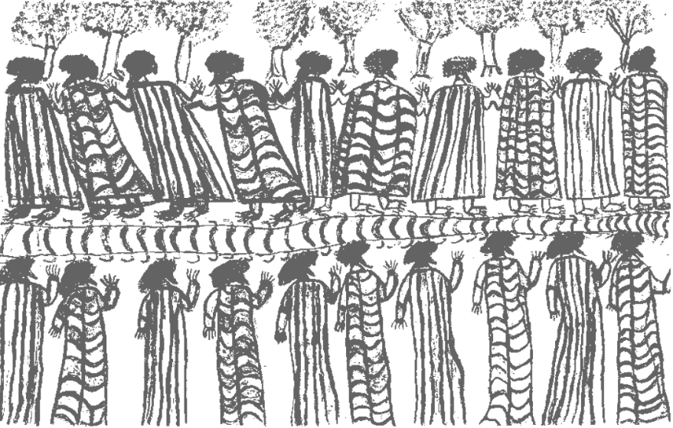
Colouring Time!
Colour in your own copy of the image using the image on the board for guidance.
What can you see?
What do you think is happening?
Describe the colour of the clothing.
Why was it drawn?
William Barak, Figures in Possum Skin Cloaks (1898), NGV Naarm/Melbourne
Notes:
Optional Starter
To be done with a full colour image on display at the front of the classroom
Colour pencils will need to be available
Discussion about clothing, culture, colours linking to natural earth tones (link to the land)
Could play aboriginal music in the background whilst completing this task

Slide 32
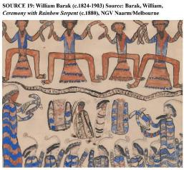
Source Information: William Barak
William 'Beruk' Barak, a Wurundjeri man, lived through the initial invasion of white settlers and the subsequent occupation of the sovereign lands of the Kulin nation, beginning with John Batman's attempted treaty in 1835.
Surviving the initial dispossession of the Wurundjeri and Boonwurrung people of the Kulin nation resulting from the imposition of the British colonial town of Melbourne, Barak worked to establish and then lived at the Coranderrk Reserve from 1863.
An important spokesperson and activist for the Kulin nation, Barak's paintings represent Indigenous art of the post-invasion era.
Barak is one of Australian's most important artists.
See NGV ‘William Barak’ website for six other Bark paintings: https://.ngv.vic.gov.au/explore/collection/artist/172/
See also this video from NGV Melbourne, ‘William Barak’s Ceremony with Rainbow Serpent’. Also useful for discussion of possum skin cloak https://youtu.be/4vUtuAeT32M?feature=shared

Slide 33
Lesson by Gill Akhtar

