Slide 1
The impact of Scots settlers on the environment, agriculture and landscape of Australia

Slide 2
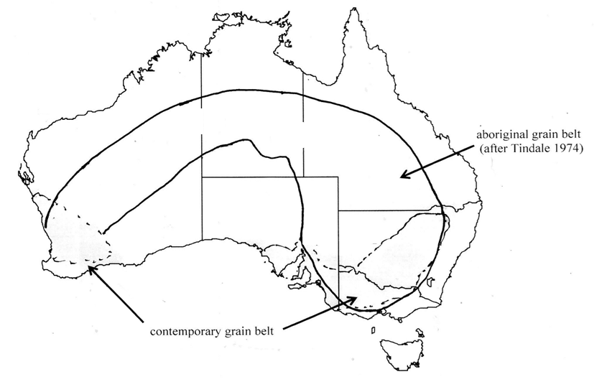




Starter Task
Colour, cut and stick your map following the instructions on
your handout.
Write a short response
to the question:
What does this map suggest about the impact of Europeans on Australian agriculture?
Notes:
Discussion – cloak, rituals, legacy, culture, preserving heritage, aboriginal dress, earth colours, link to the environment
Additional question – what would you like to ask the artist?
William Barak - Figures in possum skin cloaks - Google Art Project.jpg
William Barak ((c. 1824) - 1903) ("Wurundjeri people, Aboriginal Australian")
Details on Google Art Project

Slide 3
Did the introduction of
Merino Sheep to Australia
by Eliza Forlong represent progress?

Slide 4
Impact of Scots on Australia
Learning Intention
Explore the impact of Scottish settlers on the environment, agriculture and landscape of Australia
Success Criteria
How fully does Source A explain the impact of Scots on Australia?
Notes:
Teacher questions can include:
Is, or was, land being used productively by Australians?
What does this map tell us about who owns, or owned, land in Australia
Is, or was, farming sustainable in Agriculture?
What other questions does this map raise in you?

Slide 5
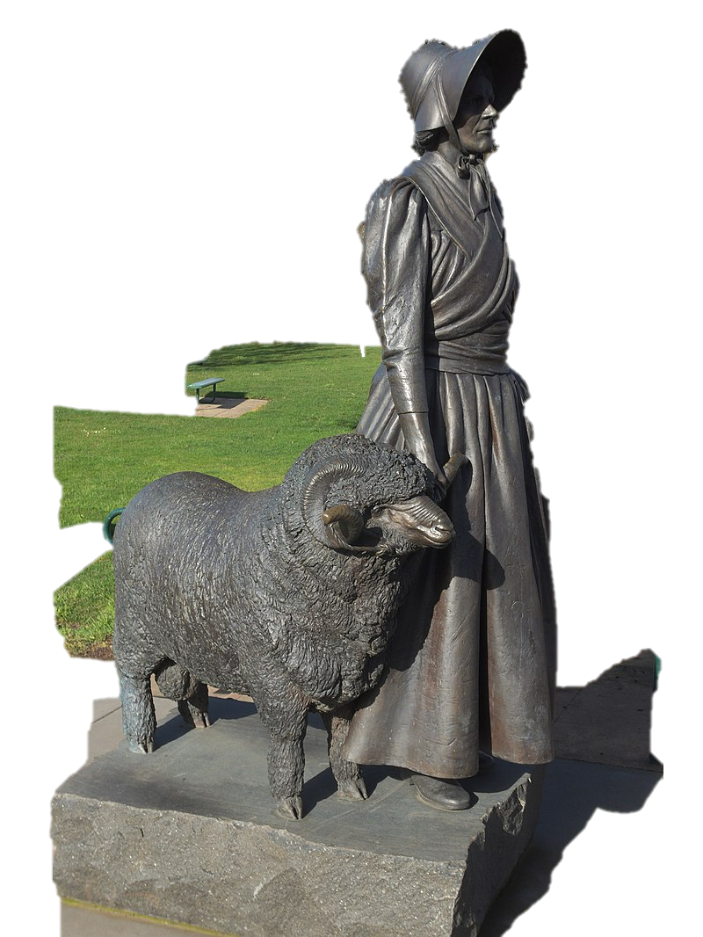
Task 2
In three words summarise how Eliza Forlong and her family contributed to the development of Australia
Eliza Forlong, pastoralist, is often regarded as the ‘mother of the Australian fine wool industry’. Aware that fine wool from merino sheep in the German kingdom of Saxony was bringing the highest prices, Forlong went to Leipzig to study methods of sheep rearing and wool preparation. In 1828-30 Eliza walked through Saxony selecting and buying sheep for shipping to Australia. In 1831 Eliza settled with her husband and children in Van Diemen's Land at Kenilworth, near Campbell Town. They built sheep houses in the Saxon style, wells, a farmhouse and outbuildings. Their expertise was enhanced by the use of an instrument to measure wool. Never content with the size and situation of their land grants, the family conducted a war of letters with colonial officials. Although Eliza's pioneering and managerial skills were outstanding, it was her ability to select sheep that was special. The Forlongs' Saxon merinos were greatly sought after by breeders of fine-wooled sheep.
Source A: Australian Dictionary of Biography (2005)
Notes:
Eliza Forlong introduces merino sheep
The source is adapted from the Australian Dictionary of Biography, which is published by the Australian National University. The full article text is at the following web address and copied below: https://adb.anu.edu.au/biography/forlong-eliza-12921
Eliza Forlong (1784–1859)
by Mary S. Ramsay
This article was published:
in the Australian Dictionary of Biography, Supplement , 2005
online in 2006
Eliza Forlong (1784-1859), pastoralist, was baptized as Betty on 21 October 1784 at Glasgow, Scotland, daughter of Alexander Jack, teacher, and his wife Jean, née Mackinnon. On 26 November 1804 Eliza married John Forlonge (Forlong or Furlong), a Glasgow merchant. Although she bore at least six children, by the mid-1820s consumption had reduced the family to two sons William and Andrew. Farming in a warmer climate appeared desirable.
Aware that fine wool from merino sheep in the German kingdom of Saxony was bringing the highest prices, the Forlongs went to Leipzig to study methods of sheep rearing and wool preparation. Their expertise was enhanced by the use of an instrument to measure wool. In 1828-30 Eliza walked through Saxony buying sheep. She identified each animal for later collection and drove them to Hamburg for shipping to Britain. She selected the sheep that came to Australia with William in the Clansman in 1829 as well as those accompanying the Templeton and Forlonge families in the Czar in 1831. Eliza also visited Rambouillet in France.
In January 1831 Eliza, John and Andrew joined William in Van Diemen's Land at Kenilworth, near Campbell Town. They built sheep houses in the Saxon style, wells, a farmhouse and outbuildings. Never content with the size and situation of their land grants, the family conducted an 'epistolary war' with colonial officials, and in April 1834, in an attempt to influence English authorities, Eliza, her husband and younger son went back in the Norval to Britain. John died there in November 1834.
Mrs Forlonge soon returned to Van Diemen's Land where she found that William planned a move to the Port Phillip District. They sold Kenilworth and part of their flock in 1838 to the Taylor family. Eliza made further voyages to Scotland (in 1840 and 1844) and assisted bounty emigrants. After some years squatting, Andrew moved to the United States of America. Eliza lived with William and his family at Woodstock, Merri Creek, near Whittlesea. They moved to Euroa in 1853 and eventually settled at Seven Creeks station. Eliza ran the house and managed station affairs in the frequent absences of William and his wife.
William Howitt described her as 'one of the pleasantest and most energetic ladies I have ever met with', but Nancy Adams portrayed her unfavourably in the novel Saxon Sheep (Melbourne, 1961). Sally Wilde claimed that her actions suggested 'a strong willed, not to say positively eccentric, woman'. Although Eliza's pioneering and managerial skills were outstanding, it was her ability to select sheep that was special. David Taylor of Winton and T. and S. Learmonth of Ercildoun(e), Victoria, founded their studs on the Forlonges' Saxon merinos, which were greatly sought after by breeders of fine-woolled sheep.
Eliza died on 5 August 1859. A memorial, in the shape of a wool bale, stands near her grave at Euroa. Other memorials include a sundial at the new Kenilworth house and a mural by Tom Thompson at TAFE Sydney Institute, Ultimo.

Slide 6
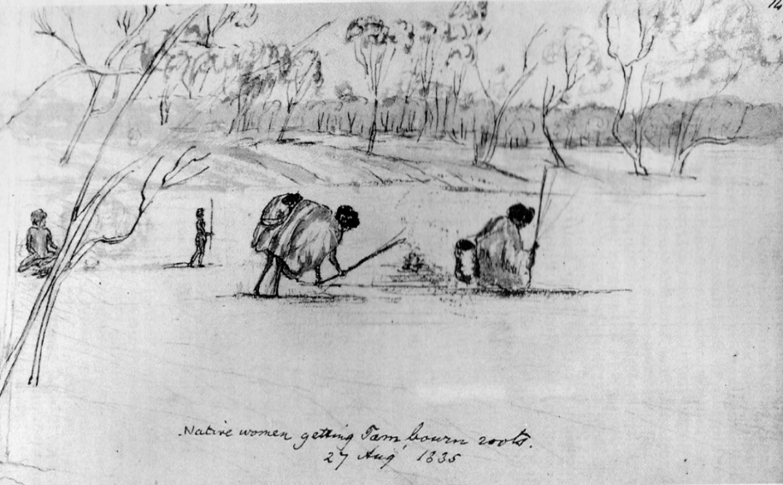






Task 1: GUIDED READING
George Grey was an explorer in
Western Australia in the 1830s.
He recorded his observations of Aboriginal settlements and Aboriginal agriculture.
Read the extract from Grey’s Journals.
Highlight key information and annotate
the margins as instructed as you read
.
Summarise in your own words what this source tells us about the Scottish perception of Aboriginal agriculture and settlements in Australia in the 1830s.
Notes:
Students to identify features of the Scottish perception of Aboriginal agriculture
Permanence
Sophisticated agricultural methods
Role of women
Sustainability

Slide 7
Worksheet 1:
“We fell in with the native path we quitted yesterday; which now became quite wide, well beaten and differing altogether by its permanent character, from any I had seen in the southern part of this continent … And as we wound along the native path my wonder augmented [grew]; the path increased in breadth and its beaten appearance, whilst along the side we found frequent wells, some of which were ten and twelve feet [3-4 metres] deep, and were altogether executed in a superior manner.
What evidence of developed agriculture among Indigenous Australians has the writer, Grey, found?
Source B: Adapted from George Grey, Journals of Two Expeditions of Discovery in Northwest and Western Australia During the Years 1837, 38, and 39 (1841).

Slide 8
“We now crossed the dry bed of a stream, and from that emerged upon a tract of light fertile soil quite overrun with yam plants, the root of which is a favourite article of food with the natives. This was the first time we had seen this plant on our journey and now for three and a half consecutive miles traversed a piece of land, literally perforated with holes the natives made to dig this root; indeed we could with difficulty walk across it on that account whilst the tract extended east and west as far as we could see.
It was now evident that we had entered the most thickly populated district of Australia that I had yet observed, and … more had been done to secure provision from the ground by hard manual labour than I could believe it in the power of uncivilized man to accomplish.
Grey has found more evidence of Aboriginal Agriculture but says,
“more had been done… than I could believe it was in the power of uncivilised man to accomplish.”
Why do you think he finds it so hard to believe the evidence of his own eyes?
Source C: Adapted from George Grey, Journals (1841).
Notes:
- a farm

Slide 9
“After crossing a limestone range we came upon another equally fertile yam ground and passed two native villages, or as the men termed them, towns – the huts of which were very nicely plastered over the outside with clay and clods of turf, so that although now uninhabited they were evidently intended for fixed places of residence.”
What do they mean by ‘fixed places of residence’?
Source D: Adapted from George Grey, Journals (1841).

Slide 10
There is a puzzle here:
The settlers recognise that the Aboriginal Australians
are farming and developing the land,
but they find it hard to admit this.
Why might this be?

Slide 11
Terra Nullius
Settlers argued that Australia was ‘Terra Nullis’ which is Latin for ‘land belonging to no one.’ They made this claim because, unlike Europeans, Aboriginal Australians did not keep paper records of who owned which land.
Based on what you have learned – do you think Terra Nullius was an accurate description of Australia when the settlers arrived? If it was not true, why did Europeans claim it to be?

Slide 12
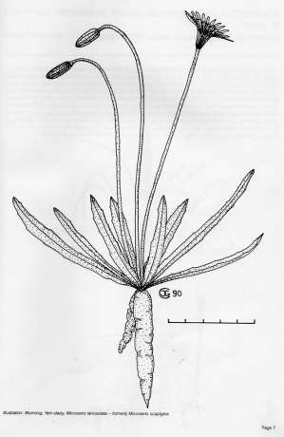
Dark Emu,
2014
Worksheet 2:
In the book, Dark Emu, Bruce Pascoe offers evidence that Aboriginal people right across the continent were using domesticated plants, sowing, harvesting, irrigating and storing crops. Pascoe uses accounts from settlers and explorers like the one you have just read.
He argues that Europeans claimed that Aboriginal Australians were ‘hunter-gathers’ who were not using the land ‘properly’ and so had no right to it).
Notes:
Bruce Pascoe
In the book, Dark Emu, Bruce Pascoe ‘puts forward an argument for a reconsideration of the hunter-gatherer tag for pre-colonial Aboriginal Australians. The evidence insists that Aboriginal people right across the continent were using domesticated plants, sowing, harvesting, irrigating and storing - behaviours inconsistent with the hunter-gatherer tag. Pascoe challenges the hunter-gatherer tag as a convenient lie (a convenient lie because it allowed the settlers to say that the Aboriginal people were not using the land ‘properly’ and so had no right to it). Almost all the evidence comes from the records and diaries of the Australian explorers’

Slide 13
So where did the idea of Terra Nullius
come from?
Pascoe suggests that, by the time later settlers arrived in Australia, the land had become unproductive, but it had not always been so.
We will now look at the settler accounts that Pascoe offers to support this view…

Slide 14
Isaac Batey’s account
Colonist Isaac Batey, writing in 1846, compared the Australia he saw around him with the one he remembered as a young man. He remembered the women harvesting and cleaning the tubers in vast quantities but he noted the disappearance of the yam and its cause:
  It has been intimated that our domestic animals had eaten them out, yet there was another factor of destruction in the soil becoming hardened with the continuous tramping of sheep, cattle or horses .... When I first came here I started a vegetable garden, the soil dug like ashes.
Notes:
Isaac Batey and G. T. Lloyd were colonisers in Australia in the 1840s. Their written reports detail the introduction of British forms of agriculture to Australia and remark upon the impacts of these methods on the environment. Read the extracts on the next slide from Dark Emu (2014) and respond to the questions.
- What trends do you observe about Aboriginal agriculture and European agriculture in Australia when compared to the other sources you have looked at in this lesson?
Image: Victorian Collections
https://victoriancollections.net.au/items/5bf1ffcab182d20b34db63c5

Slide 15
G. T. Lloyd’s account
  [In the past] ‘the ground had been so protected by mosses and lichen so thick that it was difficult to ride across the country at any pace exceeding the “farmers” jog trot … With the onslaught of the sharp little hooves and teeth of herbivore sheep, goats, pigs and cattle driven in by the settlers, the ground covers were destroyed and the dews ceased’.
Notes:
Isaac Batey and G. T. Lloyd were colonisers in Australia in the 1840s. Their written reports detail the introduction of British forms of agriculture to Australia and remark upon the impacts of these methods on the environment. Read the extracts on the next slide from Dark Emu (2014) and respond to the questions.
- What trends do you observe about Aboriginal agriculture and European agriculture in Australia when compared to the other sources you have looked at in this lesson?
Image: Victorian Collections
https://victoriancollections.net.au/items/5bf1ffcab182d20b34db63c5

Slide 16
Thinking Points
How were Aboriginal peoples affected by these changes?
How do these sources align with the map in the starter task?
Notes:
‘There is still much to be learnt about Australian soils and how they were managed, but the explorers’ journals suggest that colonial settlers ignored the Aboriginal methods and contemporary Australians still suffer from the result’
Pascoe, 2014 Dark_Emu

Slide 17
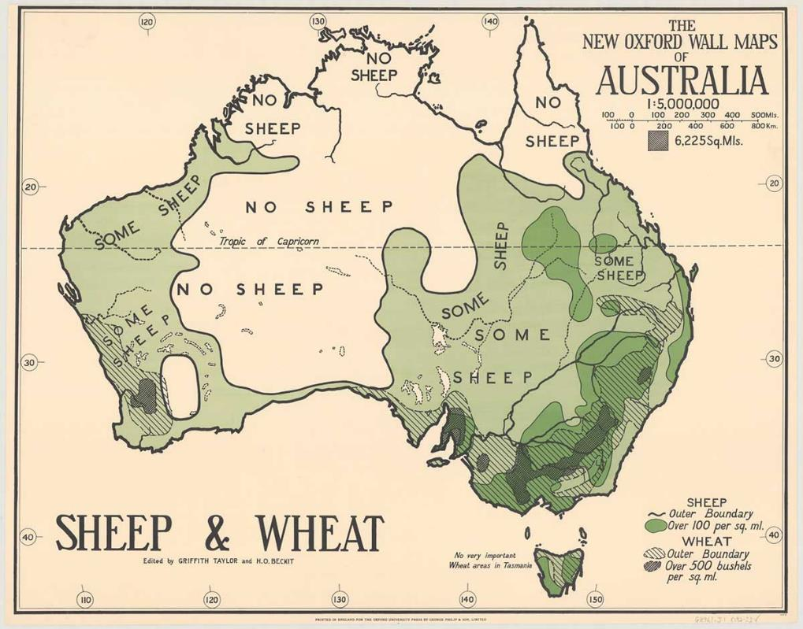
Plenary task
Compare this map with the map shown in the starter task. Do you think the introduction of the Merino sheep represents progress?
Answer Yes or No and give a supporting reason
The new Oxford wall maps of Australia, 1920s
Notes:
identify that the vast proliferation of sheep and wheat across much of Australia was at the expense of indigenous agriculture and had a profound and irreversible impact on the environment and landscape of Australia.
The new Oxford wall maps of Australia. Sheep & wheat. Edited by Griffith Taylor and H.O.Beckit.
Out of Copyright: Source National Library of Australia, obj-234331946

Slide 18
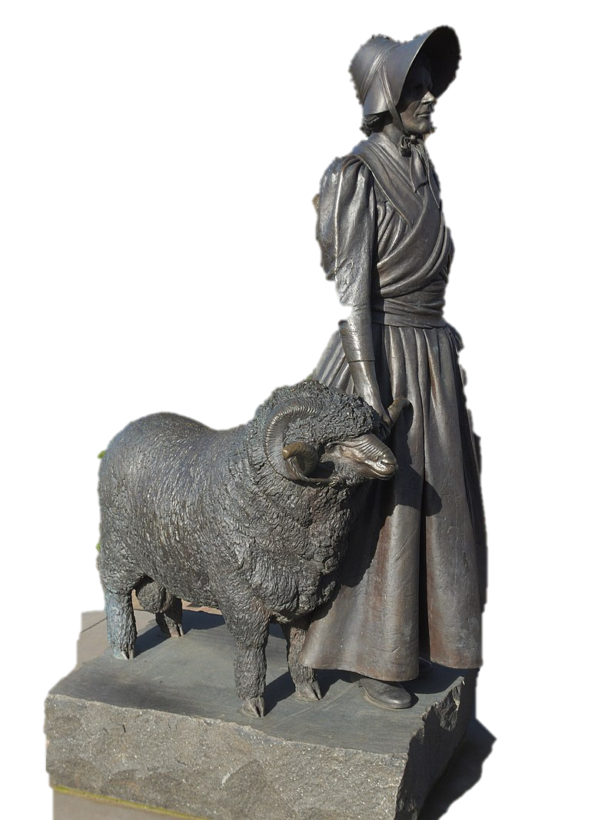
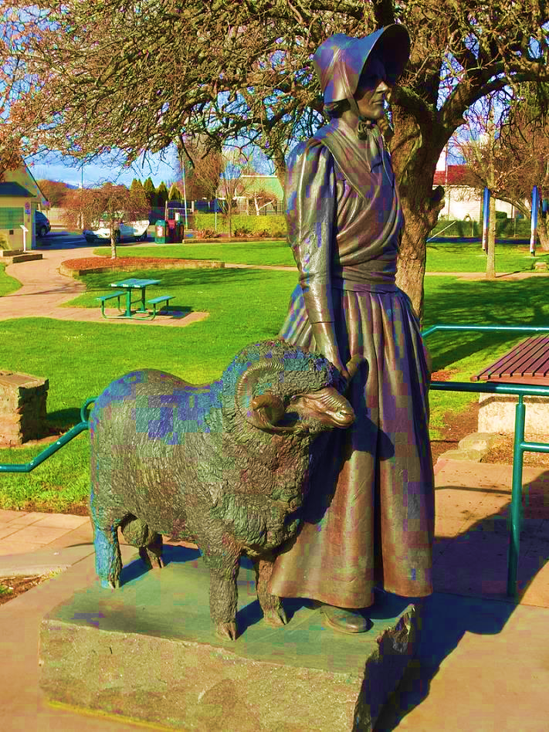
Did the introduction of Merino sheep to Australia by Eliza Forlong represent progress?
Notes:
Suggested extension: See also Scottish explorer and surveyor, Thomas Mitchell's description of the impact of cattle
https://www.cambridge.org/core/books/abs/scots-in-australia-17881938/scottish-migrants-and-indigenous-australians/F430490E8D0CF2DC84E7CADE1656F89A

Slide 19
HIGHER HISTORY: HOW FULLY
Migration and empire, 1830-1939
Source A is from the Australian Dictionary of Biography (2005).
Eliza Forlong, pastoralist, is often regarded as the ‘mother of the Australian fine wool industry’. Aware that fine wool from merino sheep in the German kingdom of Saxony was bringing the highest prices, Forlong went to Leipzig to study methods of sheep rearing and wool preparation. In 1828-30 Eliza walked through Saxony selecting and buying sheep for shipping to Australia. In 1831 Eliza settled with her husband and children in Van Diemen's Land at Kenilworth, near Campbell Town. They built sheep houses in the Saxon style, wells, a farmhouse and outbuildings. Their expertise was enhanced by the use of an instrument to measure wool. Never content with the size and situation of their land grants, the family conducted a war of letters with colonial officials. Although Eliza's pioneering and managerial skills were outstanding, it was her ability to select sheep that was special. The Forlongs' Saxon merinos were greatly sought after by breeders of fine-wooled sheep.
How fully does Source A explain the impact of Scots on Australia before 1939?
Use the source and recalled knowledge. [10 marks]

Slide 20
Impact on Australia
For the Teacher
Lesson Plans
Notes:
For Scottish explorer and surveyor, Thomas Mitchell

Slide 21
Lesson Level Enquiry Question Why was the concept of terra nullius useful for Scottish settlers?
Purpose: | Do not link to syllabus If a pupil asks, ‘Why do I need to know this?’, what will you reply? To explore the contradiction of the view of land from settler and indigenous eyes To frame indigenous agriculture as sophisticated and sustainable; to juxtapose sustainability and sophistication of aboriginal practices against the impacts of imported Scottish agricultural practices. To highlight the role of profitable land-use in framing of civilisation and civilised peoples – how this was utilised by Scots, despite evidence to the contrary, to legitimise land appropriation. To draw links between colonialism, climate and sustainability. The legacy of imported agricultural techniques on the environment of contemporary Australia
Objective: | The learning in this lesson links to the syllabus by What is the takeaway? The impact of Scottish settlers on the environment, agriculture and landscape of Australia
Outcome: | Pupils will demonstrate their ability to answer the Enquiry Question by… Completing a How Fully Question on the impact of Merino Sheep being introduced to Australia. Students should offer recalled knowledge on the impact of Scottish settlers on the environment and agriculture of Australia.
Time | Teacher is… | Pupils are… | Checking learning
0-10 | Aboriginal Grain Belt map (after Tindall 1974) Questioning (can include): Is, or was, land being used productively by Australians? What does this map tell us about who owns, or owned, land in Australia Is, or was, farming sustainable in Agriculture? What other questions does this map raise in you? | Cutting and sticking map Colouring in their map (Overlaps one colour; Aboriginal agriculture another colour; Western agriculture another) Speculating and discussing questions. Annotating their map. | Formative; pupil responses; circulate class; check jotters.
10-15 | Introduce Eliza Forlong and the introduction of the Merino Sheep to Australia. Furlong originally settled in Tasmania where she acquired land and established sheep farms. She went on to replicate this process on continental Australia in the area north of Melbourne. | Identifying and summarising briefly (three words) the impact Forlong had on Australia. Students can refer to the text on their homework task sheets, but should not mark these. They can also read from the powerpoint presentation. | Class discussion Jotter notes.
15-30 | Introduce Task 1 Guided Reading of George Grey, Explorer in Western Australia "more had been done to secure provision from the ground by hard manual labour than I could believe it in the power of uncivilized man to accomplish"; and that there were "two native villages ... Evidently intended for fixed places of residence" | Reading and highlighting the source. Articulating their understanding of a Scottish perception of Aboriginal agriculture and supporting with evidence from the source. | Work sheet 1: guided reading worksheet
30-35 | Terra Nullius Definition profitable land use (Agriculture) Can make the connection between civilised societies on the basis of permanent settlements and planned agriculture; and by extension the insinuation by Scottish settlers that Aboriginal people were not civilised and this legitimised land appropriation and even atrocities. | Discussing why it was useful for Scottish settlers civilised practitioners (permanent dwellings) Justification for land appropriation | class discussion
35-45 | Introduce Dark Emu source and impact of introduction of sheep on soil and concomitant impact on growing of indigenous crops | Articulating their perception of Scottish agricultural methods Identifying similarities between Scots and Aboriginal Is there a lack of sensitivity to the success of the Aboriginal system? What are the consequences of the importation of Scottish methods? Could these be deliberate? | Add to worksheet; tiered system?
45-50 | Plenary | 1920s ‘Sheep and Wheat’ map of Australia. | Students can hopefully identify that the vast proliferation of sheep and wheat across much of Australia was at the expense of indigenous agriculture and had a profound and irreversible impact on the environment and landscape of Australia.
HOMEWORK | How Fully question Source A discusses the introduction of the Merino sheep to Australia by

Slide 22
Impact on Australia
For the Teacher
Learner Worksheets

Slide 23
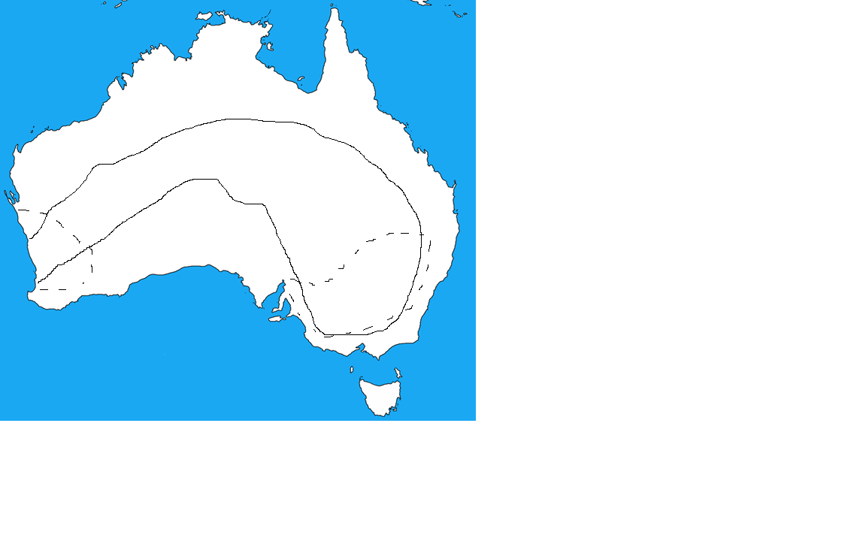
You will need two pens/ pencils, one in a light colour and one in a dark
Look at the map of Australia. It shows you areas of the continent that were cultivated by Aboriginal people before the arrival of Europeans and areas that are cultivated today.
With the lighter colour, shade the area where Aboriginal Australians grew grain (the solid line)
In the darker colour, shade the area where grain is now grown (the dotted line).
Cut out your map and glue it into your jotter.
Beneath your map, write down in a sentence or two your initial impression of the impact Europeans had on agriculture.
You will need two pens/ pencils, one in a light colour and one in a dark
Look at the map of Australia. It shows you areas of the continent that were cultivated by Aboriginal people before the arrival of Europeans and areas that are cultivated today.
With the lighter colour, shade the area where Aboriginal Australians grew grain (the solid line)
In the darker colour, shade the area where grain is now grown (the dotted line).
Cut out your map and glue it into your jotter.
Beneath your map, write down in a sentence or two your initial impression of the impact Europeans had on agriculture.

Slide 24
What evidence of developed agriculture has Grey found? | What evidence of developed agriculture has Grey found? Why do you think he finds it so hard to believe that Indigenous Australians have done this? | What evidence of developed agriculture has Grey found? What evidence is there that Grey is downplaying Indigenous accomplishments? | What does this source tell us abou tAboriginal agriculture and the way that settlers viewed it?
Extract 1 We fell in with the native path we quitted yesterday; which now became quite wide, well beaten and differing altogether by its permanent character, from any I had seen in the southern part of this continent … And as we wound along the native path my wonder augmented [grew]; the path increased in breadth and its beaten appearance, whilst along the side we found frequent wells, some of which were ten and twelve feet [3-4 metres] deep, and were altogether executed in a superior manner. | Extract 2 “We now crossed the dry bed of a stream, and from that emerged upon a tract of light fertile soil quite overrun with yam plants, the root of which is a favourite article of food with the natives. This was the first time we had seen this plant on our journey and now for three and a half consecutive miles traversed a piece of land, literally perforated with holes the natives made to dig this root; indeed we could with difficulty walk across it on that account whilst the tract extended east and west as far as we could see. It was now evident that we had entered the most thickly populated district of Australia that I had yet observed, and … more had been done to secure provision from the ground by hard manual labour than I could believe it in the power of uncivilized man to accomplish. | Extract 3 After crossing a limestone range we came upon another equally fertile yam ground and passed two native villages, or as the men termed them, towns – the huts of which were very nicely plastered over the outside with clay and clods of turf, so that although now uninhabited they were evidently intended for fixed places of residence.
George Grey, Journals of Two Expeditions of Discovery in Northwest and Western Australia During the Years 1837, 38, and 39 (1841).

Slide 25
 |  |  | Yam: An edible root crop and a vital source of carbohydrates to Aboriginal societies. Tramping: Stamping and treading. Dug like ashes: Light, fertile soil Mosses and lichen: Non-flowering plant-like organisms. They play significant ecological roles such as soil formation indicating environmental health. Herbivore: Plant-eating animals. Dews: Morning moisture on plants which can support plant health, particularly during drought. | THINK – How does this information link back to the map you coloured at the start of the lesson
Colonist Isaac Batey, writing in 1846, compared the Australia he saw around him with the one he remembered as a young man. He remembered the women harvesting and cleaning the yams in vast quantities but he noted the disappearance of the yam and its cause: It has been intimated that our domestic animals had eaten them out, yet there was another factor of destruction in the soil becoming hardened with the continuous tramping of sheep, cattle or horses .... When I first came here I started a vegetable garden, the soil dug like ashes. | [In the past] ‘the ground had been so protected by mosses and lichen so thick that it was difficult to ride across the country at any pace exceeding the “farmers” jog trot … With the onslaught of the sharp little hooves and teeth of herbivore sheep, goats, pigs and cattle driven in by the settlers, the ground covers were destroyed and the dews ceased’. | Once the soil hardened, rains ran off the compacted surfaces, and rivers flooded higher than the Aboriginals had ever seen. This created a new management problem for the soils of this district and others.
Adapted from ‘Dark Emu (2014) by Bruce Pascoe

Slide 26
HOMEWORK TASK
HOMEWORK TASK
HIGHER HISTORY: HOW FULLY
HIGHER HISTORY: HOW FULLY
Migration and empire, 1830-1939
Source A is from the Australian Dictionary of Biography (2005).
How fully does Source A explain the impact of Scots on Australia before 1939?
Use the source and recalled knowledge. [10 marks]
Migration and empire, 1830-1939
Source A is from the Australian Dictionary of Biography (2005).
How fully does Source A explain the impact of Scots on Australia before 1939?
Use the source and recalled knowledge. [10 marks]
Eliza Forlong, pastoralist, is often regarded as the ‘mother of the Australian fine wool industry’. Aware that fine wool from merino sheep in the German kingdom of Saxony was bringing the highest prices, Forlong went to Leipzig to study methods of sheep rearing and wool preparation. In 1828-30 Eliza walked through Saxony selecting and buying sheep for shipping to Australia. In 1831 Eliza settled with her husband and children in Van Diemen's Land at Kenilworth, near Campbell Town. They built sheep houses in the Saxon style, wells, a farmhouse and outbuildings. Their expertise was enhanced by the use of an instrument to measure wool. Never content with the size and situation of their land grants, the family conducted a war of letters with colonial officials. Although Eliza's pioneering and managerial skills were outstanding, it was her ability to select sheep that was special. The Forlongs' Saxon merinos were greatly sought after by breeders of fine-wooled sheep.
Eliza Forlong, pastoralist, is often regarded as the ‘mother of the Australian fine wool industry’. Aware that fine wool from merino sheep in the German kingdom of Saxony was bringing the highest prices, Forlong went to Leipzig to study methods of sheep rearing and wool preparation. In 1828-30 Eliza walked through Saxony selecting and buying sheep for shipping to Australia. In 1831 Eliza settled with her husband and children in Van Diemen's Land at Kenilworth, near Campbell Town. They built sheep houses in the Saxon style, wells, a farmhouse and outbuildings. Their expertise was enhanced by the use of an instrument to measure wool. Never content with the size and situation of their land grants, the family conducted a war of letters with colonial officials. Although Eliza's pioneering and managerial skills were outstanding, it was her ability to select sheep that was special. The Forlongs' Saxon merinos were greatly sought after by breeders of fine-wooled sheep.
Notes:
New South Wales Corps = 100th Regiment of foot in the British Army, formed in 1789. In Australia it was notorious for its trade in rum and its mutinous behaviour!

Slide 27
Lesson by Dr Kieran German
Lesson by Gill Akhtar

