Slide 1
James Dawson’s report on Aboriginal peoples

Slide 2
What does James Dawson’s report reveal about colonial attitudes towards Aboriginal peoples?

Slide 3
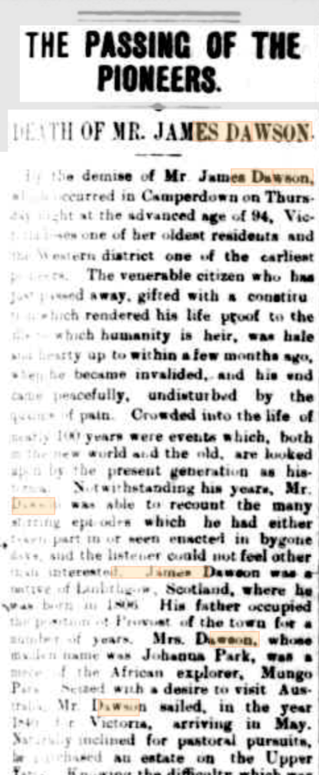
STARTER TASK
Obituary text
By the demise of Mr. James Dawson,
which occurred in Camperdown…
Victoria loses one of her oldest
residents… The appointment of
Protector of Aborigines was
conferred upon Mr. Dawson,
and a better friend to the natives
it would have been impossible
to find.
Look at the Obituary on the right.
Summarise what it says about James Dawson:
This obituary says that…
This tells us that he was…
Keyword: Obituary - a notice, usually in a newspaper, informing readers of a death.

Slide 4
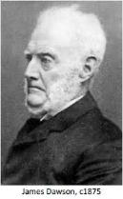
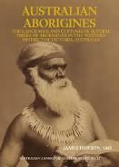
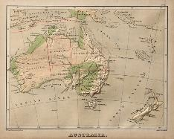
What does Dawson’s report reveal to us about colonial attitudes towards the Aboriginal peoples?
Summary of James Dawson
THE QUESTION IS ASKING ME TO…
Extracts from James Dawson’s Australian Aborigines: the languages and customs of several tribes of Aborigines in the Western district of Victoria, 1881
Timing
Type
Author
Source Content | Put into your own words (interpret what this means) | What does this REVEAL to us about attitudes towards Aboriginal people
Great care has been taken in this work not to state anything on the word of a white person; and, in obtaining information from the aborigines, suggestive or leading questions have been avoided as much as possible
All information contained in this book has been obtained from the united testimony of several very intelligent aborigines, and every word was approved of by them before being written down
I found my previous good opinion of the natives fell far short of their merits. Their general information and knowledge of several distinct dialects – in some instances four, besides fair English – gratified as well as surprised me, and naturally suggested a comparison between them and the lower classes of white men
Indeed, it is very questionable if even those who belong to what is called the middle class, notwithstanding their advantages of education, know as much of their own laws, of natural history… as the aborigines;
It must be borne in mind, also, that many of their present vices were introduced by the white man, whose contact with them has increased their degradation, and will no doubt ultimately lead to their extinction
In censuring customs and practices which we may regard as repugnant to our notions and usages, we should bear in mind that these may appear right and virtuous from the stand point of the aborigines

Slide 5
What does James Dawson’s report reveal about colonial attitudes towards Aboriginal peoples?
Learning intentions
Success criteria
The role of James Dawson in the colonisation of Australia.
The importance of primary sources in investigating the past.
Different colonial perspectives from the nineteenth century.
I will be able to explain the importance of James Dawson in Australia.
I will be able to describe some historical nuance regarding attitudes towards Aboriginal peoples.
Notes:
Students should copy down enquiry question: HOW DO ECONOMIC MOTIVATIONS OR RACIAL BIAS IMPACT HISTORICAL ACCOUNTS?

Slide 6
What does Dawson’s report reveal to us about colonial attitudes towards Aboriginal peoples?
Take 45 seconds to think independently about what the question is asking you do do
Share with your shoulder partner what the question is asking.
Make sure you are listening to what your partner has said! Your teacher will pick some students to share your discussions
The question asks us to identify what Dawson’s book tells us about how settlers viewed the Indigenous peoples of Australia…
Settlers are Europeans who moved to Australia, settled there and created new communities with European structures.
Indigenous peoples are the peoples who were the original inhabitants of Australia
Notes:
The word ‘native’ was previously used as an alternative to ‘Indigenous’ but it has pejorative, colonial overtones and should be avoided..

Slide 7
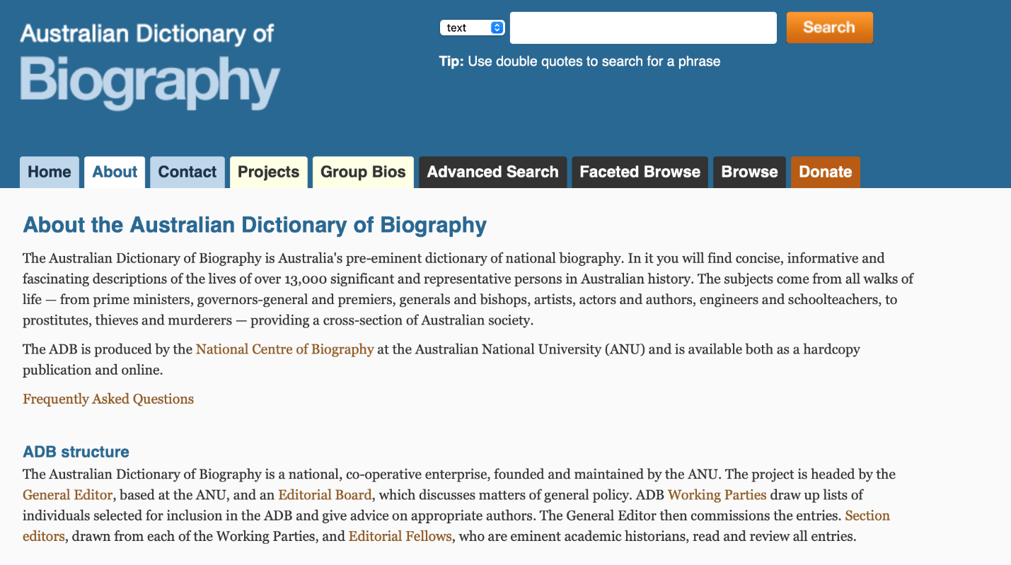
Australian Dictionary of Biography
What can you identify here?
Why might this source be useful or supportive to someone studying Australian History?
Notes:
Teacher to discuss the ADB – the fact that this is a trustworthy source regarding the History of Australia (this could potentially have been introduced in a lesson prior to this one)

Slide 8
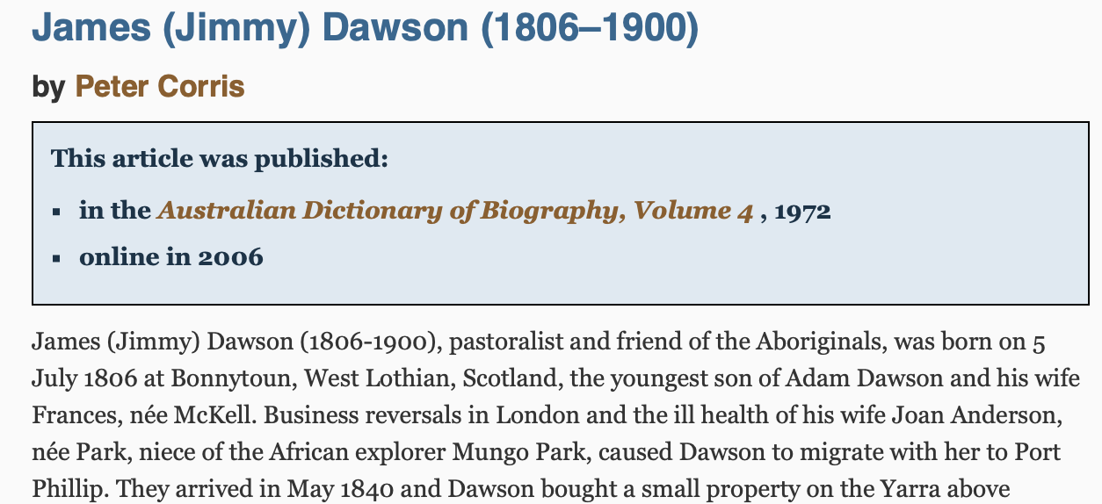
James Dawson
What does the Australian Dictionary of Biography tell us about James Dawson? What does it suggest about his role in colonial Australia?

Slide 9
James Dawson
What can we INFER about James Dawson from this information?
James (Jimmy) Dawson was born in Linlithgow in 1806
Migrated to Australia in 1840, and worked as a pastoralist and in gold
Settled in Western Australia in Camperdown where he lived the remainder of his days
Appointed as ‘Protector of the Aboriginals’ and in 1877 presented evidence to the Royal Commission on their condition
1881 he published a book detailing the lives of Aboriginal people
Later in the 1880s, he collected money from settlers to establish a memorial for Aboriginal people who had been murdered.
AS YOUR TEACHER IS TALKING
Summarise Dawson in the section of your worksheet
Label the location where his research focuses on
Notes:
Teacher can then introduce James Dawson to the class. Will present for 3-4 mins about who he was, his history and his role. Probing questions could be used to ensure students are engaged in discussion to encourage students to think about why Dawson may have a different view / opinion towards the Aboriginal people in comparison to other counterparts.
Could mention also that his daughter spoke the languages of some of the Aboriginal groups.
Teacher should remind pupils of language they use when filling out tables
Teachers may want to give trigger warning about distressing content in Section 4 in particular.

Slide 10
Sources
Today we are going to use a PRIMARY source to investigate Dawson’s attitude towards Aboriginal people in Australia
As historians, we need to be CRITICAL about the origins of different sources
Look at the PROVENANCE of the source below
What is the TIMING of the source? Why might this help us answer the question?
What is the TYPE of source? Why might this help us answer the question?
Who us the AUTHOR of the source? Why might this help us answer the question?
Extracts from James Dawson’s Australian Aborigines: the languages and customs of several tribes of Aborigines in the Western district of Victoria, 1881
Extracts from James Dawson’s Australian Aborigines: the languages and customs of several tribes of Aborigines in the Western district of Victoria, 1881
Timing
Type
Author

Slide 11
Main task
You are going to investigate 5 key quotes from Dawson’s published research on the Aboriginal people.
Your task is to…
Read the information
Interpret what it means
Explain what this tells us as historians about his attitudes towards the Aboriginal people
Source Content | Put into your own words (interpret what this means) | What does this REVEAL to us about attitudes towards Aboriginal people
Great care has been taken in this work not to state anything on the word of a white person; and, in obtaining information from the aborigines, suggestive or leading questions have been avoided as much as possible
All information contained in this book has been obtained from the united testimony of several very intelligent aborigines, and every word was approved of by them before being written down
I found my previous good opinion of the natives fell far short of their merits. Their general information and knowledge of several distinct dialects – in some instances four, besides fair English – gratified as well as surprised me, and naturally suggested a comparison between them and the lower classes of white men
Indeed, it is very questionable if even those who belong to what is called the middle class, notwithstanding their advantages of education, know as much of their own laws, of natural history… as the aborigines;
It must be borne in mind, also, that many of their present vices were introduced by the white man, whose contact with them has increased their degradation, and will no doubt ultimately lead to their extinction
In censuring customs and practices which we may regard as repugnant to our notions and usages, we should bear in mind that these may appear right and virtuous from the stand point of the aborigines

Slide 12
What does Dawson’s report reveal to us about colonial attitudes towards the Aboriginal peoples?
Summary of James Dawson
THE QUESTION IS ASKING ME TO…
Extracts from James Dawson’s Australian Aborigines: the languages and customs of several tribes of Aborigines in the Western district of Victoria, 1881
Timing
Type
Author
Source Content | Put into your own words (interpret what this means) | What does this REVEAL to us about attitudes towards Aboriginal people
Great care has been taken in this work not to state anything on the word of a white person; and, in obtaining information from the aborigines, suggestive or leading questions have been avoided as much as possible
All information contained in this book has been obtained from the united testimony of several very intelligent aborigines, and every word was approved of by them before being written down
I found my previous good opinion of the natives fell far short of their merits. Their general information and knowledge of several distinct dialects – in some instances four, besides fair English – gratified as well as surprised me, and naturally suggested a comparison between them and the lower classes of white men
Indeed, it is very questionable if even those who belong to what is called the middle class, notwithstanding their advantages of education, know as much of their own laws, of natural history… as the aborigines;
It must be borne in mind, also, that many of their present vices were introduced by the white man, whose contact with them has increased their degradation, and will no doubt ultimately lead to their extinction
In censuring customs and practices which we may regard as repugnant to our notions and usages, we should bear in mind that these may appear right and virtuous from the stand point of the aborigines

Slide 13
Extended writing task – answer the question
Dawson was... (find at least 3 points about him in Australia)
He wrote…
His attitude/view towards Aboriginal people was…
This was different to most settlers because…

Slide 14
Plenary
Is the Australian Dictionary of Biography right to call James Dawson a friend of the Aboriginal people? ​
On your printed sheet, write your answer with evidence from today's lesson in at least 50 words...

Slide 15
FOR THE TEACHER

Slide 16
What does Dawson’s report reveal to us about colonial attitudes towards the Aboriginal people?
Purpose: | To understand attitudes towards the Aboriginal people in Australia by the settler Scots, and give examples of moments of respect and compassion towards them. While also understanding why the authorship of positive accounts is important in the retelling of the colonisation of Australia (eg Dawson’s role as Protector of the Aboriginal People)
Objective: | The learning in this lesson links to the syllabus by giving students an example of a settler Scot in Australia who worked to improve relations with the Aboriginal people. This can allow students to have a deeper understanding of the nuance of settler colonialism whilst also having a solid example which they can use in their exam to answer an exam question (by explaining in detail) What is the takeaway? That although the impact of settlers in Australia was overwhelmingly negative for the Aboriginal people, there were times that settler Europeans communicated positively with them, and a genuine interest was displayed by some settler Europeans. Students should think about the significance of the role played by James Dawson as well as the publication of the book showing his findings (including the language displayed within it)
Outcome: | Pupils will demonstrate their ability to answer the Enquiry Question by being able to articulate to some extent the nuance of Dawson being supportive of the First Nations people but also that he was a product of the British Empire and that internally he may still have held prejudiced, settler viewpoints towards them (due to his indoctrination of growing up under the British Empire)
Time | Teacher is… | Pupils are… | Checking learning
0-5 mins | Starter task. Students get title and date into their jotters. Students are given a quote from his obituary in 1900. They have to explain what they can INFER about Dawson from this quote from the Camperdown Chronicle – Article the Passing of the Pioneers. ‘The appointment of Pro- tector of Aboriginal was conferred upon Mr. Dawson, and a better friend to the natives it would have been impossible to find.’ | Getting focused and ready to learn. Using their inference skills to complete the settler or linking to their previous knowledge and backing up what the statement means with own knowledge | Discussion led by teacher to ensure students are going into the lesson with a general view on how Dawson was perceived at the time, to build upon this in task 3.
5-10 | Break down the enquiry question. Ask students to write into their jotter and clarify what they will be learning about and how they can apply their previous knowledge/learning to the question. Teacher will guide students towards the nuance that will be explored within the lesson | Summarising what they need to do in the box on the worksheet That we will use a source to understand what some attitudes towards Aboriginal people were (sympathetic/empathetic/supportive) That we are aware that this was not the norm, and link to previous learning that this is a complex history with nuance, and that Dawson was a product of his time, and the only reason he was appointed as protector was through the crown | Teacher to check worksheets by walking round to ensure students are on the right lines regarding what the focus of the lesson is
Notes:
Printable table

Slide 17
Time | Teacher is… | Pupils are… | Checking learning
10-15 mins | Context of Dawson – talk through who he was and what his role was Show the front over of the book he published. Ask students to think about what might be shown/recorded within this | Students add notes to the section of the worksheet about James Dawson. At least 3 key points to be added to help give students context about his role. | Students write a summary of Dawson onto their worksheet. Ask students key points about Dawson (with targeted questioning, eg, WHY was he in Australia in the first place? What does this suggest to us about Dawson? How do we know that he was different to other Scots settlers?)
15-25 mins | The source can be found here: https://trove.nla.gov.au/newspaper/article/26107815?searchTerm=James%20Dawson Discuss the PROVENANCE of the source. Explain what provenance is, and why it is important when looking at historical documents. Discuss why TIMING, TYPE of source and AUTHOR can impact how we might interpret the content of a source. Discuss and identify the pros and cons of using a source by James Dawson and his role, and link to the wider historical picture of the empire and why the timing might impact the content. Teacher to use cold calling and probing, open questioning to ensure all students are contributing to discussion | After discussion about each of the steps, students are given time in pairs to complete this section of their worksheet | Students work together to complete this section of the worksheet together Checking learning once they have been given time to complete with shoulder partner
25-35 mins outline task | Introduce source and read through key points. Teacher draws out meaning of words from students through probing questioning Discuss overall attitude displayed by Dawson (at first glance from the quotes from the book) | Annotating key words/phrases as teacher talks through the source and defines key words. | Definition of key words on board. Access to dictionaries if necessary

Slide 18
Time | Teacher is… | Pupils are… | Checking learning
35-45 mins – MAIN TASK | Students read through sections of the source on the worksheet. Teacher models an example on the board EXTENSION – A longer extract of Dawson’s work is available on the project webpage on the SATH website, in the PDF of historical sources. Ask students if finished to read through this and have a general overview of what was portrayed in the book | Students read through the selected quotes from Dawson’s work. They copy the quote, then interpret what it means (key historical skill). Then they will make a judgement on what this tells us about Dawson’s attitude toward; Aboriginal people | Complete an I do, we do, you do task so students are familiar with the process. Then draw answers from students through discussion
45-50 mins | PLENARY – Students will see through the main task that although Dawson’s depiction of the Aboriginal people is overwhelmingly positive and supportive, there are still hints at his European superiority in his language. | Students use the worksheet to summarise the nuance in the two bubbles. Teacher can refer back to the obituary from the starter if required | Teacher collects these as exit tickets and can check learning / address misconceptions next lesson

Slide 19
James Dawson’s report on Aboriginal peoples

