Slide 1
Notes:
Two resources to familiarise yourself with the topic and issues before teaching, both featuring Aunty Dr Doris Paton
1. https://www.youtube.com/watch?v=86um5GONPWQ
2. 462670722_oa.pdf

Slide 2
How might economic motivations or racial prejudices impact Scots settler accounts?

Slide 3
STARTER TASK
How can we tell if
historical sources are trustworthy?
Task: In pairs, discuss and come up with three ways we can check if a historical source is trustworthy.

Slide 4
How can we tell if historical sources are trustworthy?
Author: Know who wrote/made it.
When it was written: Primary (from the time) or Secondary (written after the event).
Purpose: Why was this source created?
Context: Understand the time period.
Check Multiple Sources: If many sources agree, it is likely to be true.
Consistency: Look for errors or contradictions.
Experts: See what historians or people with lived experience say.
Trusted Sources: Use well-researched archives/museums/websites.
Critical Thinking: Always analyse and question.
Notes:
Students could discuss and if needed take some examples from this slide.
This lesson will focus on PURPOSE

Slide 5
How do economic motivations or racial prejudice impact Scots’ historical accounts?
Learning intentions
Success criteria
To better understand Scottish impact in Australia
and develop critical thinking.
I can make my own conclusions about the motivations of Angus McMillan and back it up with evidence.
Notes:
Students should copy down enquiry question: HOW DO ECONOMIC MOTIVATIONS OR RACIAL BIAS IMPACT HISTORICAL ACCOUNTS?

Slide 6
When and where?
You will read a source detailing an event that involving Scottish settlers in Australia,
in the 19th century
(28th December 1840)
in a place called Gippsland (modern day Victoria)
You will find out who wrote the source at the end!
The British began colonising Australia in 1788 when the First Fleet arrived at Sydney Cove.
Over the next few decades, they established more settlements, spreading their influence across the continent.
By 1840, British colonisation had significantly shaped Australia's early history.
During this time, Aboriginal people suffered greatly, losing their land, facing violence, and experiencing cultural suppression.

Slide 7
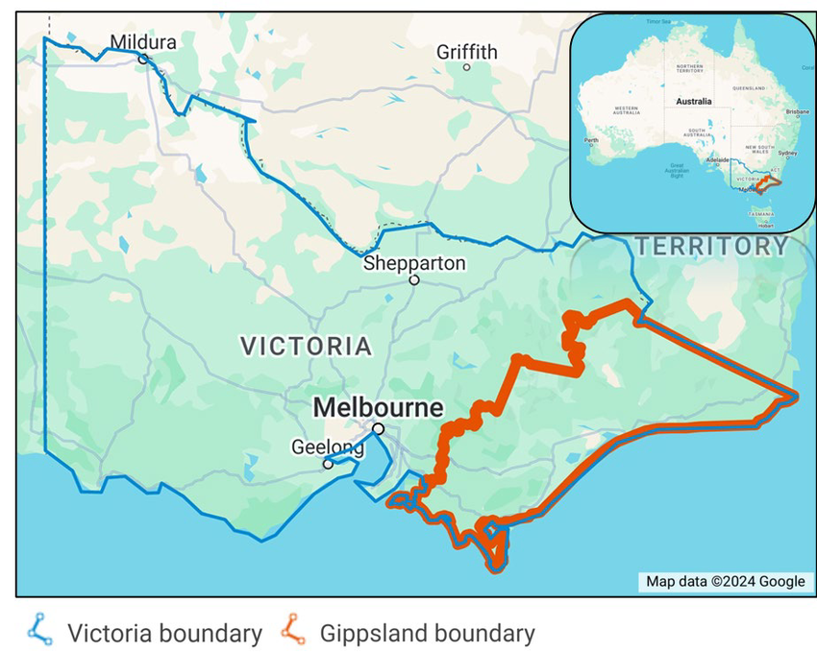
Map of Gippsland, in Victoria, Australia
Notes:
https://www.researchgate.net/figure/Map-showing-the-approximate-boundary-of-the-Gippsland-region-in-relation-to-the-state-of_fig1_384312983

Slide 8
A note on language:
The source we are looking at uses a derogatory and racist term for Aboriginal peoples (the Indigenous peoples of Australia).
When we look at old documents or sources, they might use words for races or groups of people that we don’t use today. That’s because language changes over time.
Even though we can understand what those words mean, we should use modern, respectful words when we talk or write about it ourselves. When referring to people of a particular ethnic or racialised group use the most specific term possible.

Slide 9

Glossary
Aboriginal peoples: Preferred term for Indigenous peoples in Australia
Gunaikurnai people: Aboriginal people of south-east Australia
Colonising: the act of sending settlers to (a place) and establish political control over it.
Pastoralism: taking care of animals like sheep, cows, or goats to use for things like milk, meat, or wool
These Historical sources contain racial slurs
Natives/Blacks: An outdated term for Aboriginal people in Australia which would be considered an insult today
Savages​: Literally meaning ‘uncivilised or primitive people’. This was an assumption from the settler's perspective and is generally used negatively.
Notes:
https://www.youtube.com/watch?v=86um5GONPWQ pronunciation is included in the introduction and the historical overview section
462670722_oa.pdf
Indigenous – people originating in a particular area. The word ‘native’ was previously used but it has pejorative, colonial overtones.

Slide 10
Task (in pairs)
Collect a printed table to complete
Collect a paper sheet or read from the board
Person 1 reads Section 1.
  Together - summarise the section in 2-3 bullet points in your table
  (pay attention to the parts in bold).
  Extension (thoughts/feelings) – what points jump out at you from this section/what questions do you have/what assumptions can you make
Person 2 reads Paragraph 2.
  Together - summarise the section in 2-3 bullet points in your table
  (pay attention to the parts in BOLD)
  Extension (your feelings) – what points jump out at you from this section/what questions do you have/what assumptions can you make
Keep going until you've covered all 5 sections.
You have 5 minutes per source.
Notes:
Teacher will model Section 1
Teacher should remind pupils of language they use when filling out tables
Teachers may want to give trigger warning about distressing content in Section 4 in particular.

Slide 11
Section | Summary (2-3 points) | Extension
1
2
3
4
5
Notes:
Printable table

Slide 12
Section 1
We call the particular attention of parties who have friends and relatives in the neighbourhood of Port Phillip (Australia) … It appears quite clear that murder has been committed, and perhaps the publication of the list of property found may assist in identifying the murdered party. The letter was placed in our possession several days since, but was unfortunately mislaid…
Started from our station to discover a road to the coast …[we] came upon the camp of twenty-five black natives, chiefly women, who all ran away on our near approach, leaving everything they had behind them excepting some of their spears.

Slide 13
Section | Summary (2-3 points) | Extension: what do you notice in this section?
1 | A murder has happened near Port Phillip, Australia. A list of found property might help identify the victim. The letter with this information was lost for a few days before being published.
2
3
4
5
Notes:
Printable table

Slide 14
Section 2
We then searched their camp, where we found European articles as underneath described. Several check-shirts, cord and moleskin trousers, all be-smeared with human blood; one German frock, two pea-jackets, new brown Macintosh cloak, also stained with blood; several pieces of women's wearing apparel, namely, prints and merinos; a large lock of brown hair, evidently that of a European woman, one child's white frock with brown velvet band, five hand towels, one of which was marked R. Jamieson No. 12, one blue silk purse, silver tassels and slides, containing seven shillings and sixpence British money, one woman's thimble, two large parcels of silk sewing thread, various colours, 10 new English blankets perfectly clean, shoemakers awls, bees' wax,
Notes:
Teacher should remind pupils of language they use when filling out tables

Slide 15
Section 3
blacksmith's pinchers and cold chisel, one bridle bit, which had been recently used, as the grass was quite fresh on it; the tube of a thermometer, broken looking glass, bottles of all descriptions, two of which had castor oil in them, one sealskin cap, one musket and some shot, one broad tomahawk, some London, Glasgow, and Aberdeen newspapers, printed in 1837 and 1838. One pewter two gallon measure, one ditto hand basin, one large tin camp kettle, two children's copy books, one bible printed in Edinburgh, June 1838, one set of the National Loan Fund regulations respecting policies of Life insurance, and blank forms of medical man's certificate for effecting the same.

Slide 16
Section 4
Enclosed in three kangaroo skin bags we found the dead body of a male child about two years old, which Dr. Arbuckle carefully examined professionally, and discovered beyond doubt its being of European parents; parts of the skin were perfectly white, not being in the least discoloured.
We observed the men with shipped spears driving before them the women, one of whom we noticed constantly looking behind her, at us, a circumstance which did not strike us much at the time, but on examining the marks and figures about the largest of the native huts we were immediately impressed with the belief that that unfortunate female is a European—a captive of these ruthless savages.
Notes:
Teachers may want to give trigger warning about distressing content in Section 4 in particular

Slide 17
Section 5
The blacks having come across us the next day in numbers, and our party being composed of four only, we most reluctantly deemed it necessary to return to the station without being enabled to accomplish our object. This was the more painful to our feelings, as we have no doubt whatever but a dreadful massacre of Europeans, men, women and children, has been perpetrated by the aborigines in the immediate vicinity of the spot, whence we were forced to return without being enabled to throw more light on this melancholy catastrophe, than what I have detailed above.

Slide 18
Angus McMillan (1810-1865)
Angus McMillan migrated from Scotland to Australia in 1838 and began managing livestock in New South Wales.
In 1839, he explored Gippsland in search of new pastures, naming the region Caledonia Australis and establishing stations such as Bushy Park and Nuntin Run.
He played a major role in opened the region for pastoralism by cutting tracks, driving cattle south, and securing trade routes.
McMillan’s exploration led to the naming of many rivers and mountains in Gippsland, preserving Scottish place names at the expense of Aboriginal ones.
Honoured as a pioneer, he was later elected as the first representative for South Gippsland in the Victorian Parliament.
Notes:
Check understanding of some key terms: pastoralism
Adapted from: Biography - Angus McMillan - Australian Dictionary of Biography

Slide 19
Colonial frontier massacres
During this period, there was considerable violence between colonisers such as Angus McMillan and Aboriginal people, leading to conflicts and resistance that caused suffering for both groups.
This map demonstrates the occurrences of frontier violence, gathered from both primary and secondary sources, and is regularly updated.
https://c21ch.newcastle.edu.au/colonialmassacres/map.php
Research task: find the incident mentioned in the source online.
Take note of the URL/types of website / source of information
Notes:
If students do not have access to iPads, teacher can demonstrate on board.

Slide 20
Map of Gippsland, in Victoria, Australia
Notes:
https://www.researchgate.net/figure/Map-showing-the-approximate-boundary-of-the-Gippsland-region-in-relation-to-the-state-of_fig1_384312983

Slide 21
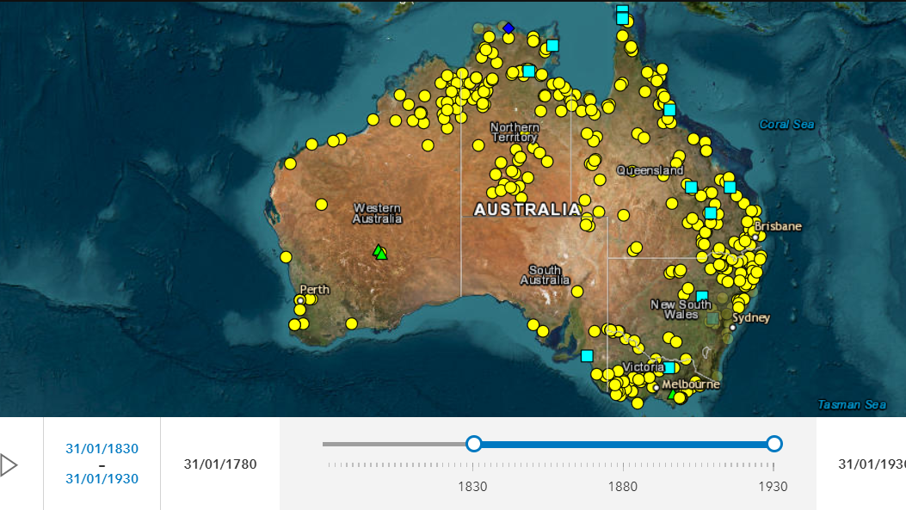
Notes:
This incident is not included in this map because there is historical debate about whether or not it actually occurred

Slide 22
There is historical debate about whether the events that Angus McMillan wrote about here in the
Sydney Morning Herald actually occurred.
This is why you could not find it on the map.
This is not to say it did not happen, but it can't be verified.
Other incidences of violence, such as the Warrigal Creek massacre led by Angus McMillan, have been backed up by various different sources so are included in the map.
Notes:
Check understanding of the word verified.

Slide 23
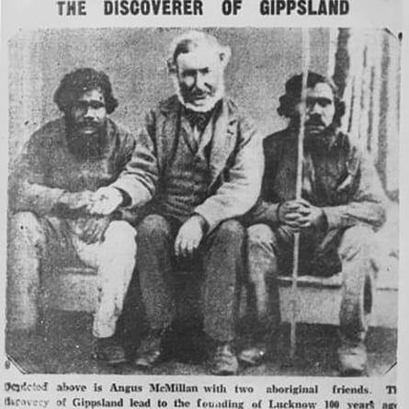
Angus McMillan
Look at the image. According to the caption, it shows Angus McMillan
with two other men.
What does the text say?
Are there visual clues as to the relations between the men?
Notes:
Angus McMillan sitting with two Aboriginal men described as ‘friends’ in the accompanying text.
Historian’s have identified them as likely to be massacre survivors.
Years later this image was used on a postcard in the early 1900s.
Photograph: State Library of Victoria

Slide 24
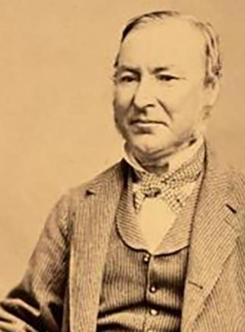
Angus McMillan
Angus McMillan (1810–1865) was a Scottish explorer who played a key role in colonising Gippsland, Victoria, Australia.
His expeditions opened the region for pastoralism but resulted in violence, including the 1843 Warrigal Creek Massacre, where 80–200 Gunaikurnai people were killed.
Discuss: does this change how you feel about the source? Note any thoughts in extension column.
Notes:
Check understanding of some key terms: colonising, pastoralism, Gunaikurnai

Slide 25
Who was Angus McMillan?
From the 1970s onwards historians such as Peter Gardner and Don Watson argued McMillan led the Highland Brigade, a group of Scotsmen who carried out violent attacks against the Gunaikurnai people.
The Warrigal Creek Massacre (1843) where 80–200 Gunaikurnai people were killed was one of several conflicts that have been linked to McMillan in this area.
McMillan’s reports of a kidnapped European woman sparked violent searches in Gippsland, leading to further deaths, despite a lack of evidence.
In recent years, there have been calls to rename places, remove plaques, and take down commemorative cairns honouring McMillan due to his role in frontier violence.
Notes:
Check understanding of some key terms: Gunaikurnai
Adapted from: Biography - Angus McMillan - Australian Dictionary of Biography

Slide 26
So, why did McMillan write the source?
We have read through the article, looked at the WHEN?, WHERE? and WHO? Now we must ask WHY?
Discuss your ideas with your partner.
Here are some suggestions of his motivations:
McMillan may have written the source to provide a truthful record of events as he saw them, accurately reporting what had happened.
He could have lied in his writing to anger readers about the supposed violence of the Aboriginal people - and excuse the violence that may be perpetrated against the Indigenous people in this period.
McMillan may have mixed truth with exaggeration, either to make himself seem more heroic or to justify controversial actions in a way that suited his own interests
e.g. taking land from Aboriginal people.
McMillan may have written the source to provide a truthful record of events as he saw.them,
accurately reporting what had happened as he perceived it.
Notes:
Exaggeration of detail

Slide 27
How do economic motivations or racial prejudice
impact contemporary accounts?
Copy and complete these sentences :
Angus McMillan reported that he discovered evidence of violence by Aboriginal people against settlers.
This account has not been verified by other sources.
It is possible that McMillan either exaggerated or invented
this narrative because.......

Slide 28
For the teacher

Slide 29
Section | Summary (2-3 points) | Extension – does anything jump out at you from this section?
1
2
3
4
5

Slide 30
Section | Angus McMillan, ‘Supposed outrage by the Blacks’, Sydney Morning Herald, 28 December 1840.
1 | We call the particular attention of parties who have friends and relatives in the neighbourhood of Port Phillip (Australia) … It appears quite clear that murder has been committed, and perhaps the publication of the list of property found may assist in identifying the murdered party. The letter was placed in our possession several days since, but was unfortunately mislaid. …Started from our station to discover a road to the coast …[we] came upon the camp of twenty-five black natives, chiefly women, who all ran away on our near approach, leaving everything they had behind them excepting some of their spears.
2 | We then searched their camp, where we found European articles as underneath described, Several check-shirts, cord and moleskin trousers, all be-smeared with human blood; one German frock, two pea-jackets, new brown Macintosh cloak, also stained with blood; several pieces of women's wearing apparel, namely, prints and merinos; a large lock of brown hair, evidently that of a European women, one child's white frock with brown velvet band, five hand towels, one of which was marked R. Jamieson No. 12, one blue silk purse, silver tassels and slides, containing seven shillings and sixpence British money, one woman's thimble, two large parcels of silk sewing thread, various colours, 10 new English blankets perfectly clean, shoemakers awls, bees' wax,
3 | blacksmith's pinchers and cold chisel, one bridle bit, which had been recently used, as the grass was quite fresh on it; the tube of a thermometer, broken looking glass, bottles of all descriptions, two of which had castor oil in them, one sealskin cap, one musket and some shot, one broad tomahawk, some London, Glasgow, and Aberdeen newspapers, printed in 1837 and 1838. One pewter two gallon measure, one ditto hand basin, one large tin camp kettle, two children's copy books, one bible printed in Edinburgh, June 1838, one set of the National Loan Fund regulations respecting policies of Life insurance, and blank forms of medical man's certificate for effecting the same.
4 | Enclosed in three kangaroo skin bags we found the dead body of a male child about two years old, which Dr. Arbuckle carefully examined professionally, and discovered beyond doubt its being of European parents; parts of the skin were perfectly white, not being in the least discoloured. We observed the men with shipped spears driving before them the women, one of whom we noticed constantly looking behind her, at us, a circumstance which did not strike us much at the time, but on examining the marks and figures about the largest of the native huts we were immediately impressed with the belief that that unfortunate female is a European—a captive of these ruthless savages.
5 | The blacks having come across us the next day in numbers, and our party being composed of four only, we most reluctantly deemed it necessary to return to the station without being enabled to accomplish our object. This was the more painful to our feelings, as we have no doubt whatever but a dreadful massacre of Europeans, men, women and children, has been perpetrated by the aborigines in the immediate vicinity of the spot, whence we were forced to return without being enabled to throw more light on this melancholy catastrophe, than what I have detailed above.
Notes:
SUPPOSED OUTRAGE BY THE BLACKS.
Author: Angus McMillan
Date: 28th December 1840
Type: a newspaper article published in Sydey Morning Herald
https://trove.nla.gov.au/newspaper/article/28652865

Slide 31
Enquiry Question HOW MIGHT ECONOMIC MOTIVATIONS OR RACIAL PREJUDICE IMPACT HISTORICAL ACCOUNTS?
Purpose: | If a pupil asks, ‘Why do I need to know this?’, what will you reply? To help you understand what really happened in the past and develop your critical thinking
Objective: | The learning in this lesson links to the syllabus by Migration and Empire – Section 3 – Impact of Scots Abroad What is the takeaway? Pupils are provided with a nuanced account of the Scots' impact on indigenous communities with an aim to deepens students' understanding of historical events but also enhancing their skills in analysing and interpreting sources.
Outcome: | Pupils will demonstrate their ability to answer the Enquiry Question by… Pupils will demonstrate their ability to answer the Enquiry Question by analysing sources, cross-referencing information, identifying bias, and drawing their own conclusions about historical sources.
Time | Teacher is… | Pupils are… | Checking learning
0-5 | Asking the question: How can we tell if historical sources are trustworthy? (Aim for 3 ways) | Discussing with a partner 0-2 talking through with a shoulder partner 2-3 documenting in their jotter 3-5 feeding back (may take longer) with list of talking points (SLIDE 2) | Verbal feedback or digital element e.g. mentimeter, Socrative, Class Notebook
5-7 | Introducing the language that will be used in the lesson – should be setting a respectful tone in the classroom | Listening | Check for questions
8-10 | Introduce the WHERE and WHEN before introducing the main task looking at the SOURCE | Collecting a printed table SOURCE can be presented in the PowerPoint, on a QR code or a Printed Sheet | Students will fill out the table
10-15 | Read through Section 1 Give students time to discuss, fill out table and give feedback Show scaffolded table with main points | Listening to the source Summarising what is happening Feeding back as a class

Slide 32
15-35 | Students have 5 minute per section Teacher should be circulating and addressing any questions particularly around language SECTION 4 - Teachers may want to give trigger warning about distressing content in Section 4 in particular ALL SECTIONS – Teachers should remind students about appropriate language when filling out tables. Students should be encouraged to use modern day terms. | In pairs: Person 1 reads Section 1. Together - summarise the section in 2-3 bullet points in your table (pay attention to the parts in BOLD) . Extension (your feelings) – what do you notice in this section/what questions do you have/what assumptions can you make Person 2 reads Paragraph 2. Keep going until you've covered all 5 sections. Students have 5 minutes per source. | Students will fill out the table
35-37 | Teacher introduces Angus McMillan and introduces students to his pastoral work |  | Teacher led
37-42 | Colonial Frontiers map https://c21ch.newcastle.edu.au/colonialmassacres/map.php Lead a discussion on why this incident is not included in this map Highlight that there was incidents on both sides but proportionally more violence against indigenous people | If students have devices – ask them to find this on the map (its not there) then ask them to look at the other frontier massacres that happened in the same area around the same time e.g. Warrigal Creek | Class discussion
42-45 | Teacher RE-introduces Angus McMillan and includes the violence he perpetrated against Indigenous communities before summarising. | Students should discuss: Does this change how you feel about the article? Students should note any thoughts in extension column. | Check for understanding
45-50 | Back to enquiry question: HOW DO ECONOMIC MOTIVATIONS OR RACIAL BIAS IMPACT HISTORICAL ACCOUNTS? Students are given 3 possible answers to the enquiry question but they are encouraged to draft their own answer based off the evidence they have seen. Highlight that it is okay to come to different conclusions – this is what historiography is, as long as you can back up your conclusions Students need to answer the question and provide an explanation | Students answer the question: I think the reason why Angus McMillan wrote this Historical account was _____________________ (explain your answer in relation to our enquiry question) | Final mindmap can be done digitally e.g. mentimeter
Home learning options: Could ask student to do their own research task on one of the massacres that happened in Australia using the map – this could feed into mark schemes for the SQA and next lesson could be ETU. A lot of the information feeds into this question type. Or students could look at Thicker than Water, an account about McMillan’s life from a relative.

Slide 33
Angus MacMillan: how might economic motivations or racial prejudices impact historical accounts?

