Slide 1
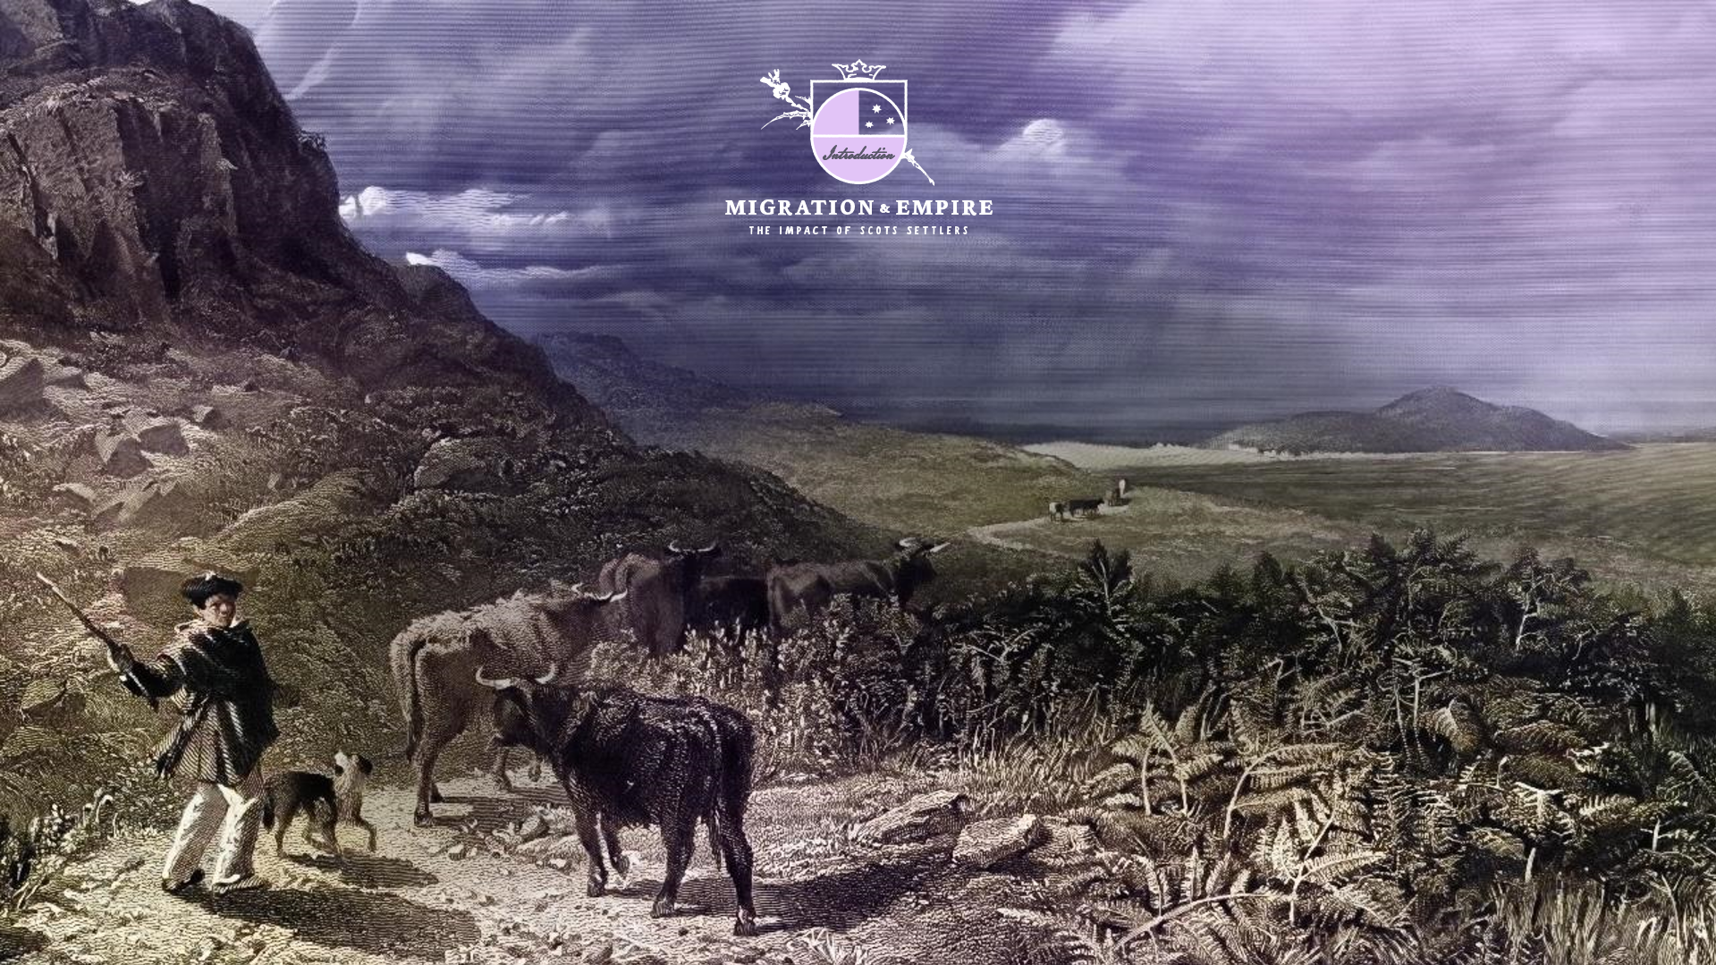
LANGUAGE AND REPRESENTATION
How to address colonial source language and imagery

Slide 2


“IN THE END, WE WILL REMEMBER NOT THE WORDS OF OUR ENEMIES, BUT THE SILENCE OF OUR FRIENDS.”
-Martin Luther King Jr.

Slide 3
GENERAL GUIDANCE-LANGUAGE
BE SPECIFIC
CAPITALISE
When referring to people of a particular ethnic or racial group. Use the most specific term possible.
Aboriginal and Torres Strait Islander peoples
Indigenous communities
Māori
First Nations
UMBRELLA TERMS
When the specific group of people is unknown you can use the umbrella term Indigenous peoples. However, there are different preferences by country and region. For specifics see Glossary.
USE ADJECTIVES OVER NOUN FORMS
‘white settlers’ rather than ‘whites’
‘Aboriginal peoples’ rather than ‘Aborigine’*
AVOID POSSESSIVES
Canada’s First Nations people
* considered offensive

Slide 4

PASSIVE AND ACTIVE LANGUAGE
Primary sources will use varying racial and ethnic terms that are no longer in use. Language is dynamic and changes over time.
Though we will understand the meaning of source vocabulary use contemporary alternatives when actively speaking or writing.

Slide 5
IMAGERY
DRAWINGS, PICTURES AND ADVERTISEMENTS CAN SEND IMPLICIT MESSAGES THAT SHOULD BE ADDRESSED
DEHUMANISING NARRATIVES PERSISTS
Challenge the dehumanising elements of any source. What are the dangers of dehumanisation?
Be sure to unpick any stereotypes present in imagery.
This applies to all groups.
How are white settlers represented?
How are Indigenous groups represented?
Who is missing in the picture?
What story is being told?
Is this a realistic representation? From who’s view?
“Dehumanization is viewed as a central component to intergroup violence because it is frequently the most important precursor to moral exclusion, the process by which stigmatized groups are placed “outside the boundary in which moral values, rules, and considerations of fairness apply.”
(Goff et al, 2008)

Slide 6
Before teaching:
Consider your own positionality and your relationship to the vocabulary.
Consider your audience. Who is in the room?
Reflect on the purpose of the text. Is it necessary?
Consider the amount of dehumanising material young people may see including images. For example, address how Black and Indigenous people are depicted and positioned when they are pictured.
Collaborate with colleagues and discuss.

Slide 7
In class:
Create a classroom contract for how to deal with dehumanising language.
Invite learners to contribute to the approach.
Be cautious with terms you read out loud.
Model respectful language, behaviour, reflection and the on-going process of learning.
Emphasise that studying the material is not an endorsement of the content.
Reflect on the historical reality of people’s lives.
Consider using trigger warnings and cautionary notes.
Talk about race and racism generally. Keep an open conversation so there is less room for misunderstanding and misinformation.

Slide 8
Content that contains sexual violence
Give options around engagement. For example:
-Offer to speak to any pupils concerned
-Offer to tell concerned pupils/ all pupils exactly what the reference is so they aren’t shocked
-Let pupils know when this section will be discussed to enable them to make an informed decision about whether they feel able to attend the class
-Reassure pupils that you won’t be singling anyone out to speak about this topic
-Offer a space for support after the class
-Offer signposting to local and national support options.
Let learners know beforehand that there will be content about sexual violence.
Be specific about where it is referenced text, page, paragraph.
Include this information in the classroom contract for how to deal with dehumanising content.
Refer to key principles about trauma informed practice
Safety, trustworthiness, choice, collaboration, empowerment, cultural consideration

Slide 9
CRITICAL LITERACY another way to approach primary sources is to use critical literacy which can be summarised as:
Understand that neutrality is a myth
Critical literacy can be redefined continuously
Know your learners - be culturally responsive
Critical literacy is a community practice
Link past and present (Hall and Piazza, 2010)
Events in the past are not discrete - look for patterns and complex historical dynamics
Read both with and against a text
How is the text positioned and working in position with the reader? (Janks, 2019).

