Slide 1
Donald Gollan's letters and the environment of New Zealand

Slide 2
This lesson will address what the letters written by Scots merchant Donald Gollan reveal about settler attitudes towards the environment and the peoples of Australia and New Zealand

Slide 3
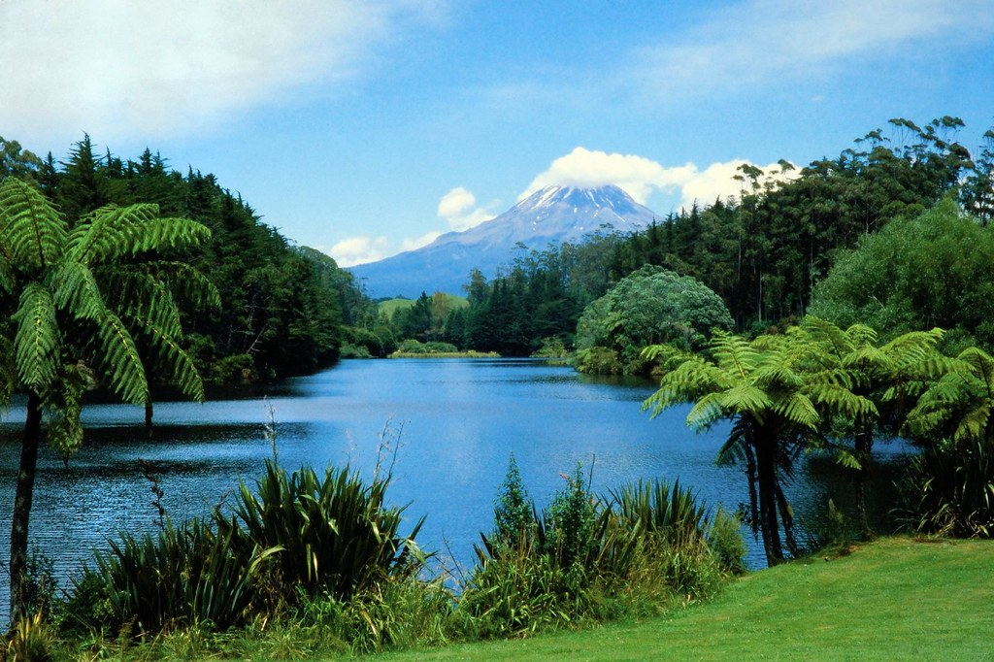
STARTER TASK
What do you think of when you look at this picture?
How would you feel arriving at this place?
How might Scottish settlers in the 19th century have felt?
Mount Egmont, New Zealand. Photo taken by JD Lasica

Slide 4
Lesson Enquiry Question:
What excited Donald Gollan about the environment he found in Australia and New Zealand, and why?

Slide 5
Learning Intention:
To analyse sources and investigate the aims of a Scottish settler (Donald Gollan) in New Zealand.
Success Criteria:
I can explain the aims of Donald Gollan in New Zealand, supported by evidence.

Slide 6
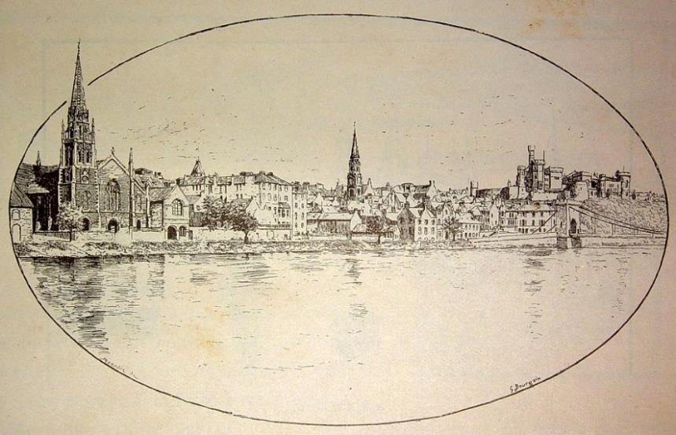
Donald Gollan
Born 1811 in Inverness
Educated in Edinburgh, training as an engineer and a surveyor
Emigrated to New Zealand
Died 1887
Inverness, 19th century (Paul Villars, public domain)

Slide 7
Donald Gollan
The Gollans had been members of Clan Chattan, supporters of the Jacobites and fought for them at the Battle of Culloden, 1746.
Many clans and families within Clan Chattan lost land, and leadership changes across the Highlands would have had an impact on Donald Gollan’s family.

Slide 8
Discussion Questions
What might his background tell us about him?
What might you expect an engineer and surveyor to be doing in New Zealand?

Slide 9
Source Analysis Task
The sources come from a letter written by Gollan while on his journey aboard
The Clydeside ship from Greenock to New Zealand, via Australia.
Read through the sources in Worksheet 1, and then Worksheet 2.
Consider what Gollan thinks about the new places he is seeing.
Highlight words he is using to describe the area, plants and animals.
Answer the questions.

Slide 10
Lesson Enquiry Question
What excited Donald Gollan about the environment he found in Australia and New Zealand?

Slide 11
Lesson Enquiry Question
The reason Donald Gollan was excited by the environment he found in Australia and New Zealand was because …
Evidence for this can be seen where he says …
This is supported where he says …
We can see more evidence of this when he says…
This shows that …

Slide 12
Pair Discussion
Is this a useful source for studying settler colonialism in Australia and New Zealand?
Why / why not?
What type of person do you think Donald Gollan was?
How important do you think profit was to settler colonialism in Australia and New Zealand?
What do you think happened to Donald Gollan?
Be ready to share your thoughts.
Make sure to be able to justify your answers.

Slide 13
Plenary – Recap
Tell me…
3 ways Donald Gollan thought
money could be made in
Australia / New Zealand?

Slide 14
Lesson Plan

Slide 15
Lesson Level Enquiry Question What excited Donald Gollan about the environment he found in Australia and New Zealand?
Purpose: | Do not link to syllabus If a pupil asks, ‘Why do I need to know this?’, what will you reply? To gain an understanding of the objectives of some settlers who went to New Zealand.
Objective: | The learning in this lesson links to the syllabus by What is the takeaway? That many settlers were motivated by money and profit, over protection of the land or the wellbeing of Indigenous peoples.
Outcome: | Pupils will demonstrate their ability to answer the Enquiry Question by… Analysing sources and drawing conclusions about aims of the author.
Time | Teacher is… | Pupils are… | Checking learning
0-5 | Asking students to match words to definitions Teacher could ask students to read sentences aloud. | Matching exercise with vocabulary (‘colonialism’, ‘settler’, ‘settler colonialism' | Students could use mini white boards, or teacher visually check jotters
5-9 | Showing Learning Intentions / Success Criterion. Showing students a picture of Mount Egmont. Asking students about their thoughts. | Considering what they think about the area in the photo, how they would feel if they arrived there, and how settlers may have felt arriving there. (image is copyright free obtained from https://search.creativecommons.org/) | Ask students to share their thoughts
9-11 | Explaining the enquiry question, and what all students will be expected to have achieved by the end of the lesson | Listening to the teacher | Question students for understanding. E.g. What do we hope to achieve by the end of the lesson?
11-15 | Introducing Donald Gollan; explaining where he was from, where he left from, when he sailed to Australia/New Zealand. Explain the students will be reading extracts from a letter he wrote to his contact in Scotland. Ask students what they expect to find out about from the sources. Give thinking/discussing time, then ask some students to share. | Discussing, what they may see in the letter. Then share answers with the class if asked. | Questioning students in the class.
15-25 | Circulating the room as students read, highlight and answer questions. Teacher can give appropriate prompts. Ask students to consider as well what Gollan’s aims are, and what does he not consider. Also, what type of person they think Donald Gollan might be. | Read through the sources on worksheet 1, highlighting and answering questions which relate to aims/objectives of Donald Gollan. Drawing conclusions about the character of Donald Gollan. | Teacher monitors what students are writing, asking questions to encourage deeper thinking.
25-30 | Ask students to consider the provenance of the source and how reliable it might be. Teacher then takes answers for discussion. | Read through the sources on worksheet 2, highlighting and answering questions which reveal more about the aims/objectives of Donald Gollan. Seeing if their conclusions about the character of Donald Gollan have changed. | Teacher questions students on why they believe the source to be reliable, or not.
30-40 | Return to the enquiry question What do the sources tell us about the aims of Donald Gollan in New Zealand? Teacher can model part of the answer if necessary. Students asked to answer the enquiry question by writing a paragraph. | Students use scaffolding to write a paragraph explaining the aims of Donald Gollan and why they arrived at this conclusion. | Teacher can check students’ work.
40-45 | Introduce pair discussion task. Tell students to be ready to share answers with the class. | Discussing questions from the slides, sharing answers with class when asked. | Listening to students’ responses.
45-50 | Recap activity with notes away. Could use white boards, post it notes etc. | Students write down 3 ways that Donald Gollan thought money could be made in Aus/NZ. | Read students responses.
Home learning: (if necessary/ appropriate)

Slide 16
Worksheets and resources
(and possible answers)

Slide 17
Discussion Questions: Possible Answers
What might his background tell us about him?
Likely coming from wealth (as educated in Edinburgh)
His family may have suffered after the Battle of Culloden (65 years earlier) and the Highland Clearances.
What might you expect an engineer and surveyor to be doing in
New Zealand?
An engineer: going to work in planning and construction
A surveyor: going to assess the land (including resources, suitability for further settlement).

Slide 18
Source 1
The space between the foot of the mountains and the sea is one immense level plain of rich alluvial soil, covered with trees and bushes of all sizes. The trees and the grasses are of a greyish colour. In this extensive plain there are innumerable saltwater creeks abounding with fishes all kinds in great abundance. Beautiful wild ducks are also found in these creeks without number. In the forests there is a great variety of birds with the most beautiful plumage. The plains and marshes abound with quails, water hens, wild turkey, wild geese and ducks.
Source 3
The first sight we had of New Zealand was … Mount Egmont 14000 feet high above the highest clouds and covered with cloud snows. Benevis and Benlomond are mere molehills compared to this mountain of mountains…
The bay is actually swarming with excellent fish such as salmon, trout, cod, ling and sometimes herring.
Inquiry Question
What excited Donald Gollan about the environment he found in Australia and New Zealand?
Activity
Write down any ideas you have about what excited Donald Gollan.
Questions
1. What are your impressions of the areas that Gollan is describing?
2. What adjectives does Gollan use to describe the area and wildlife?
3. What does Gollan think of the area?
Questions
6. What are your impressions of this area, according to Gollan’s description?
7. What do you think he thought when he saw these mountains?
Source 2
The land generally speaking is good. I saw the finest wheat and barley growing here that I ever saw. Turnip and cabbage grow to a prodigious size. We saw a single cabbage that weighed 28 lbs!
Source 4
There is abundance of fresh water in all parts of excellent quality. The birds are beautiful creatures, generally of bluish green or red plumage.
Questions
4. What do you think Gollan’s feelings are about the food he found growing there?
5. Why might he have felt this way?
Questions
8. What is Gollan’s opinion of the area and wildlife he sees here?
Worksheet 1

Slide 19
Source 1
The space between the foot of the mountains and the sea is one immense level plain of rich alluvial soil, covered with trees and bushes of all sizes. The trees and the grasses are of a greyish colour. In this extensive plain there are innumerable saltwater creeks abounding with fishes all kinds in great abundance. Beautiful wild ducks are also found in these creeks without number. In the forests there is a great variety of birds with the most beautiful plumage. The plains and marshes abound with quails, water hens, wild turkey, wild geese and ducks. In this country the sportsman will find plenty of good and cheap amusement.
Source 3
The first sight we had of New Zealand was by no … inviting. It was Mount Egmont 14000 feet high above the highest clouds and covered with cloud snows. Benevis and Benlomond are mere molehills compared to this mountain of mountains. We were sadly disappointed with the prospect before us.
The bay is actually swarming with excellent fish such as salmon, trout, cod, ling and sometimes herring. Were a fisherman to come here I am convinced they would make a fortune in a year or two, by curing fish and exporting them to the Australian colonies.
Inquiry Question
What excited Donald Gollan about the environment he found in Australia and New Zealand?
Activity
Have your opinions on what excited Donald Gollan changed, looking at the sources more fully?
Note down how and why they have changed?
Source 2
The land generally speaking is good. I saw the finest wheat and barley growing here that I ever saw. Turnip and cabbage grow to a prodigious size. We saw a single cabbage that weighed 28 lbs!
Question Source 3
2. Why might Gollan have thought the mountainous area was ‘uninviting’ and ‘disappointing’?
3. What is the reason why Gollan was excited by the number of fish in the area?
Source 4
There is abundance of fresh water in all parts of excellent quality. The birds are beautiful creatures, generally of bluish green or red plumage.
In this part of the island there is very little land cultivated yet.
Question (Source 1 and 2)
1. What are the reasons why Gollan is excited by the area and wildlife?
Question Source 4
4. What might Gollan be planning for this area?
Worksheet 2

Slide 20
Inquiry Question
What excited Donald Gollan about the environment he found in Australia and New Zealand?
Questions
What are your impressions of the areas that Gollan is describing?
Beautiful, wild, lots of wildlife, nice nature.
2. What adjectives does Gollan use to describe the area and wildlife?
Beautiful, immense, rich, greyish
3. What does Gollan think of the area?
Some students may repeat answers from Q1 and 2. Others may think that he sees this from a perspective of profit.
Questions
6. What are your impressions of this area, according to Gollan’s description?
Dramatic, beautiful, huge, lots of fish
7. What do you think he thought when he saw these mountains?
Impressed
Activity
Bullet point down any ideas you have about what excited Donald Gollan.
Expect students to talk about the beauty of the land and animals, the quality of the land and food, the abundance of animals/water etc.
Some students may pick out that this excitement came from wanting to settle there or make money.
Questions
8. What is Gollan’s opinion of the area and wildlife he sees here?
Beautiful, excellent quality of land and water. Abundance
Questions
4. What do you think Gollan’s feelings are about the food growing there?
It is of good quality and size.
5. Why might he have felt this way?
Students may answer that he believes it would be a good place to settle due to the available food, others may see the profit motive.
Worksheet 1 – Possible Answers

Slide 21
Inquiry Question
What excited Donald Gollan about the environment he found in Australia and New Zealand?
Question (Source 1 and 2)
1. What are the reasons why Gollan is excited by the area and wildlife?
Expect students to begin to see Gollan intended the land to be used – exploited - for sport / pleasure / business.
Activity
Have your opinions on what excited Donald Gollan changed, looking at the sources more fully?
Note down how and why they have changed?
Expect students to have gone from believing Gollan was excited by the beauty of the nature and wildlife, to understanding that he was motivated by making money.
Question Source 3
2. Why might Gollan have thought the mountainous area was ‘uninviting’ and ‘disappointing’?
The land couldn’t be easily settled / farmed / used.
3. What is the reason why Gollan was excited by the number of fish in the area?
Money could be easily made.
Question Source 4
What might Gollan be planning for this area?
Cultivating / farming / using for profit.
Worksheet 2 – Possible Answers

Slide 22
Teaching Notes about Donald Gollan
Donald Gollan, born Inverness, educated at Edinburgh Academy as surveyor and engineer. Emigrated to NZ under the New Zealand Company and settled in Hawkes Bay in 1854 on the Maungatarata Run. Represented the Wairarapa and Hawkes Bay in Wellington Provincial Council. 1864 was Captain of Napier Militia. Founder of the Agricultural and Pastoral Association. In 1859 he married Frederica, the widow of Charles de Pelichet. She died shortly after the birth of their son Spenser Herbert Gollan (1860-1934). See Dictionary of New Zealand Biography / Scholefield Volume 1 p 306; `Early stations of Hawke's Bay' by Miriam Macgregor, p 115; Early NZ engineers by F W Furket, p 176.
Source – National Library of New Zealand
Donald Gollan arrived in New Zealand under engagement to the New Zealand Company on the ship “Clydeside”, 1841
Engineer and surveyor.
Sat in the Wellington Provincial Council for the East Coast.
Commenced sheep farming on Mangatarara Station, Waipukurau, 1851.
Divided the station with his brother Kenneth in the 1860s whose share was named “The Oaks”.
Donald’s son Spencer inherited the station in 1887, but his half-brother Louis ran the farm which was sold in 1908
East Coast representative for the Wellington Electoral Committee.
Married the widow of Charles de Pelichet with her two children, Louis Gibbon de Pelichet (1853-1913) and Georgina Marie de Pelichet (1855-1913)
Source – Hawke’s Bay Digital Archive Trust

