Slide 1
Donald Gollan’s attitudes to Indigenous peoples

Slide 2
This lesson will analyse what the letters of Glaswegian-born Donald Gollan reveal about Scots settler attitudes towards the lands and peoples of Australia and New Zealand

Slide 3
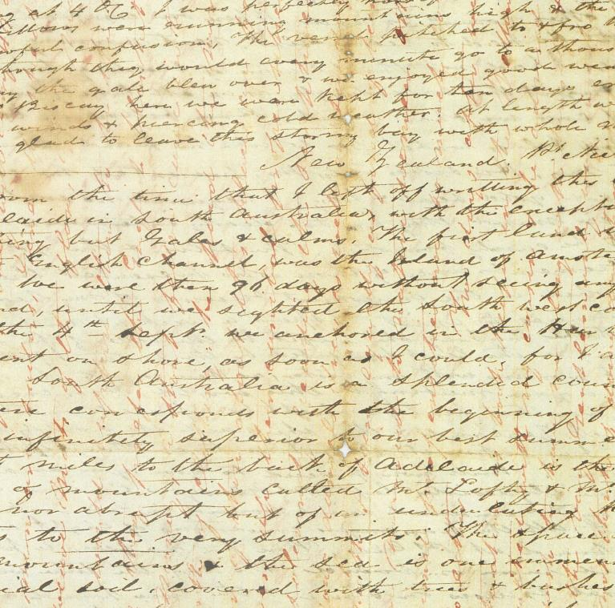
Starter Activity
MS-Papers-3271
Collect your starter sheet from the materials station
Answer the questions in sentences
You have 3 minutes!
*Remember to explain your thinking!
National Library of New Zealand MS-Papers-3271 (copy free from copyright)

Slide 4
Enquiry question:
What does Gollan’s letter show about Scots settler attitudes towards the exploitation of Indigenous lands and peoples?

Slide 5
  Learning Intentions:
  To understand Scots settler attitudes towards Indigenous peoples and lands in Australia and New Zealand.
  Success Criteria:
  I can identify patterns of social inequality between Scots settlers and Indigenous communities.

Slide 6
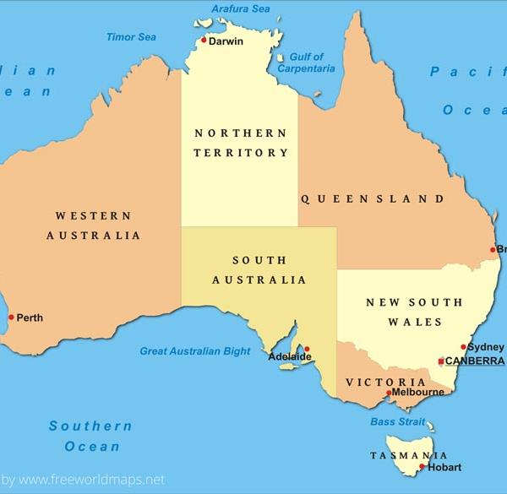
Source context
Donald Gollan – born in Glasgow.
In November 1841 he sailed from Greenock to Adelaide, (South Australia), and later Wellington (New Zealand), where he settled and became a merchant.
(free from copyright)

Slide 7

Be Mindful:
This lesson will use primary sources which have various racial and ethnic terms that are no longer in use.
Be mindful of this and ensure that the contemporary language you are presented with is used instead during both speaking and writing.

Slide 8
Be Mindful:
There will be discussion of power and ability from a colonial and racialised perspective and how they persist today.
We do not condone the language or perspectives of the sources, and these harmful views are here to be questioned.
Maturity and care are essential.

Slide 9
Historical Context
Late 1830s and early 1840s were a period of active settlement in South Australia. In just 4 years, between 1836 and 1840, the colony grew from 839 to 14,600 people.
One major idea behind colonial settlement was the idea of ‘civilisation’.
Europeans considered that they had a duty to share European ways of life with Indigenous peoples, who they considered to be ‘primitive’. The expectation that Indigenous peoples needed to abandon their cultures and adopt European norms reflects outdated and racist views.

Slide 10

Glossary
Key Words | Definitions
Racism | The belief that different races possess different characteristics or qualities to try and make groups inferior or superior to one another
Settler Colonialism | A system of oppression based on genocide and colonialism, which displaces a population of a nation (its Indigenous peoples) and replaces it with a new settler population.
Exploitation | Making use of and benefiting from resources, or individuals, for personal gain.
Dehumanisation | The process of erasing positive human qualities from a person or group.

Slide 11
Extract 1
(letter written by Donald Gollan, started on board the ‘Clydesdale’ in November 1841, and continued in Port Nicholson, Wellington in March 1842. MSDL-1259. ATL-Group-00791: Manuscripts & Archives. National Library of New Zealand)
My dear Grieve
New Zealand, Pt Nicholson 8 Nov
(…) South Australia is a splendid country. The time we were there corresponds with the beginning of our spring but the weather was infinitely superior to our best summer weather in Scotland. Eight miles to the back of Adelaide is the foot of that great range of mountains called Mt Lofty & Mt Barker. They are not high nor abrupt but of an undulating kind & covered with trees to the very summit. The space between the foot of the mountains & the sea is one immense level plain of rich alluvial soil, covered with tree & bushes of all kinds & sizes. The trees & the grasses are of a greyish colour. In this extensive plain there are innumerable saltwater creeks abounding with fishes all kinds in great abundance. Beautiful wild ducks are also found in these creeks without number. In the forests there is a great variety of birds with the most beautiful plumage. The plains & marshes abound with quails, water hens, wild turkey, wild geese & ducks. In this country the sportsman will find plenty of good & cheap amusement. (…)
The land generally speaking is good. I saw the finest wheat & barley growing here that ever I saw. Turnip & cabbage grow to a prodigious size. We saw a single cabbage that weighed 28 lbs! The city of Adelaide is distant 8 miles from the port. It is built on rather elev[ate]d ground. It looks more like a scattered village than a city. There is only one stone building in the town. (…)
I never saw such fine clear weather at home as we had in Australia. (…)
The city of Wellington is situated at the foot of a range of hills facing the Bay. In this bay there is very good ancorage [sic] & it is nearly land locked. The bay is actually swarming with excellent fish such as salmon, trout, cod, ling & some times herrings, were a fisherman to come here I am convinced they would make a fortune in a year or two, by curing fish & exporting them to the Australian colonies, where there is a great demand & high prices. At present there are no person here who knows anything of curing fish.
Source Word | Definition
Alluvial | Fertile [soil]
Anchorage (‘ancorage’) | An area off the coast suitable for a ship to drop anchor
Plumage | The feathering of a bird
Prodigious | Immense, huge
Undulating | Smoothly rising and falling

Slide 12
Source Analysis – Task 1
Read Extract 1 from Gollan’s letter.
Highlight, in green, his descriptions of the Australian environment
Answer question 1 on your source analysis sheet. Remember to justify your thinking!
Highlight, in blue, the comparisons he makes to Scotland.
Answer question 2 on your source analysis sheet. Give evidence in your reasoning.
Gollan becomes a merchant in the colonies. A merchant is someone who buys and sells goods for a profit.
6. Answer question 3 on your source analysis sheet. Remember to justify your thinking!

Slide 13
Profit
Gollan’s history is one case out of many, demonstrating a system of gaining profit – or exploiting – Indigenous resources.
Gollan makes no reference to the Indigenous peoples that lived in the area, failing to acknowledge that part of the reason the land was so bountiful, was because they worked as part of a larger eco system to protect it.

Slide 14
Extract 2
In this colony there are a great many Scots. The people are altogether a different class from those we met at Auckland. A great part of the people at Adelaide are runaway convicts from Sidney or convicts that served their time & left the place where they were known. The Australian natives are a miserable set. They have no huts but live entirely in the open air. (…) In colour they are entirely black. (…) They go about naked carrying their children & dogs on their backs.

Slide 15
Source Analysis – Task 2
Read Extract 2 from Gollan’s letter.
Answer the questions on the activity sheet to help you analyse the source.
You have 10 minutes to complete this task.

Slide 16
Extract 3
Disease has been communicated to them by profligate Europeans & they have communicated it in turn to their husbands. The consequence is that both sexes are in a most miserable condition with this disease & by & by the whole race will be entirely cut off with it. The men are rather better looking than the women. They are from five feet to six feet in height, stout & well made. They are an exceedingly indolent with the exception of occasionally felling a tree. They will do no work in the neighbourhood of Adelaide. They are harmless but in the interior they are beginning to be troublesome. (…) Since I came here I have embraced every opportunity of acquiring the native tongue. It is a beautiful language & easily learnt. With what I have learnt of it I can do a little business with the natives. They are clear headed people & are making rapid strides towards civilisation. Farewell!
Source Word | Definition
Civilisation | A colonial idea about bringing ‘progress’ (political, scientific, religious, cultural) to settler colonies, which was often forced onto Indigenous populations
Indolent | Lazy
Profligate | Morally corrupt, immoral

Slide 17
Source Analysis – Task 3
Read Extract 2 from Gollan’s letter.
Answer the questions on the activity sheet to help you analyse the source.
You have 10 minutes to complete this task.

Slide 18
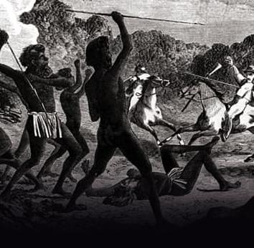
Indigenous resistance
Throughout the colonies, there were many examples of actions and strategies used by Indigenous peoples to oppose, challenge, and survive the impact of settler colonial violence and control.
Mitchell Library, State Library of New South Wales (free from copyright)

Slide 19
Plenary Discussion
How does the sentence ‘they are harmless but in the interior they are beginning to be troublesome’ from Gollan’s letter connect to ideas of Indigenous resistance?
Take 2 minutes to discuss this with your shoulder partner.
Share your thoughts with the class.
Mitchell Library, State Library of New South Wales (free from copyright)

Slide 20
Conclusion
Scottish colonisation of Australia and New Zealand was driven by the desire to conquer and control land and goods.
It established a racial hierarchy and social control which resulted in a forced marginalisation of Indigenous peoples.
Indigenous peoples were represented as ‘uncivilised’ ‘savages’ by the white settlers during colonial conflicts. This was an attempt to justify control and atrocities.

Slide 21
For the Teacher
Worksheets and Resources
(and potential answers)

Slide 22
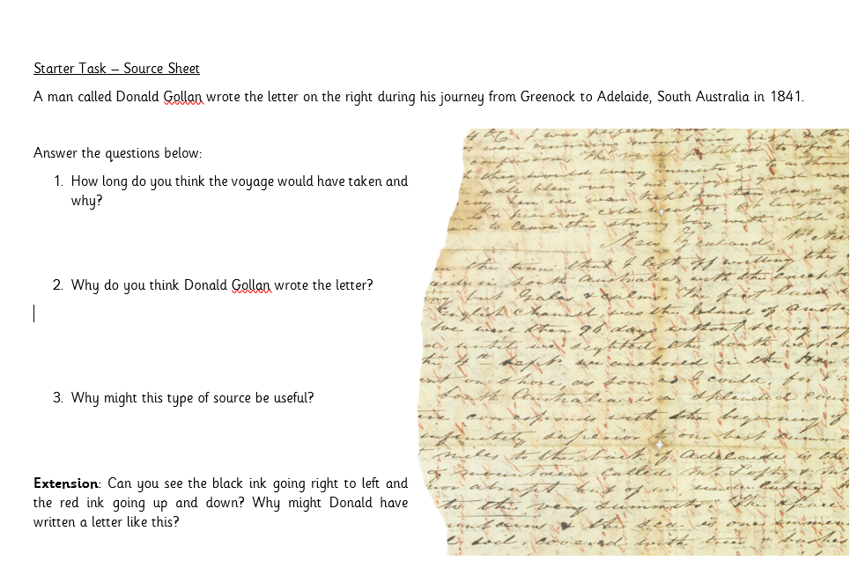
MS-Papers-3271

Slide 23
Teacher answers
MS-Papers-3271
Students should show an understanding that the voyage would have taken a considerable amount of time without modern advancements.
Students should identify that Gollan might have been more free with his thoughts because it was a letter or that he might have tried to advertise the voyage in a more positive light to encourage other settlers to migrate.
The letter is actually two letters, written three months apart, on a single piece of paper.
National Library of New Zealand MS-Papers-3271 (copy free from copyright)

Slide 24
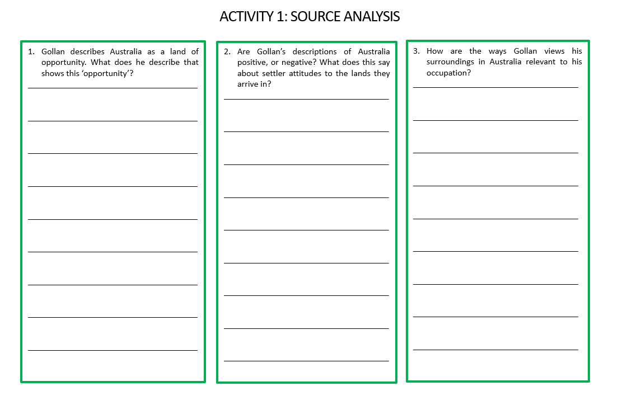

Slide 25
Activity 1 – Teacher
Gollan identifies opportunities for farming and hunting in the first paragraph. This would be in the interest of making profit from western capitalist ideas of farming and sport in hunting/fishing wildlife.
His descriptions of Australia are mostly positive: ‘…infinitely superior to our best summer in Scotland’, ‘…rich alluvial soil’, ‘…abounding with fish in great abundance’, ‘The bay is actually swarming with excellent fish…’. This shows that settlers viewed the land as something to exploit and make money from.
Gollan refers to each aspect of the environment in a way that he could profit from it, i.e. how the land could be farmed, where people could hunt, opportunities for fishing and exporting them.

Slide 26
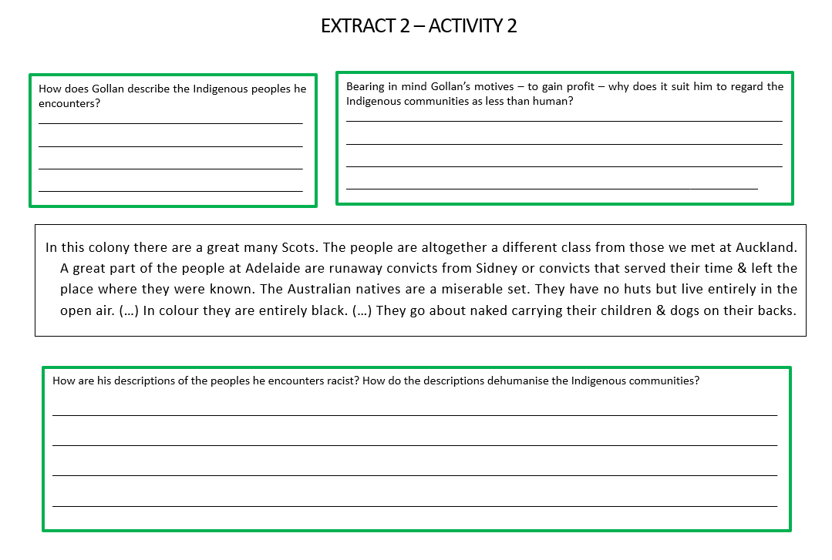

Slide 27
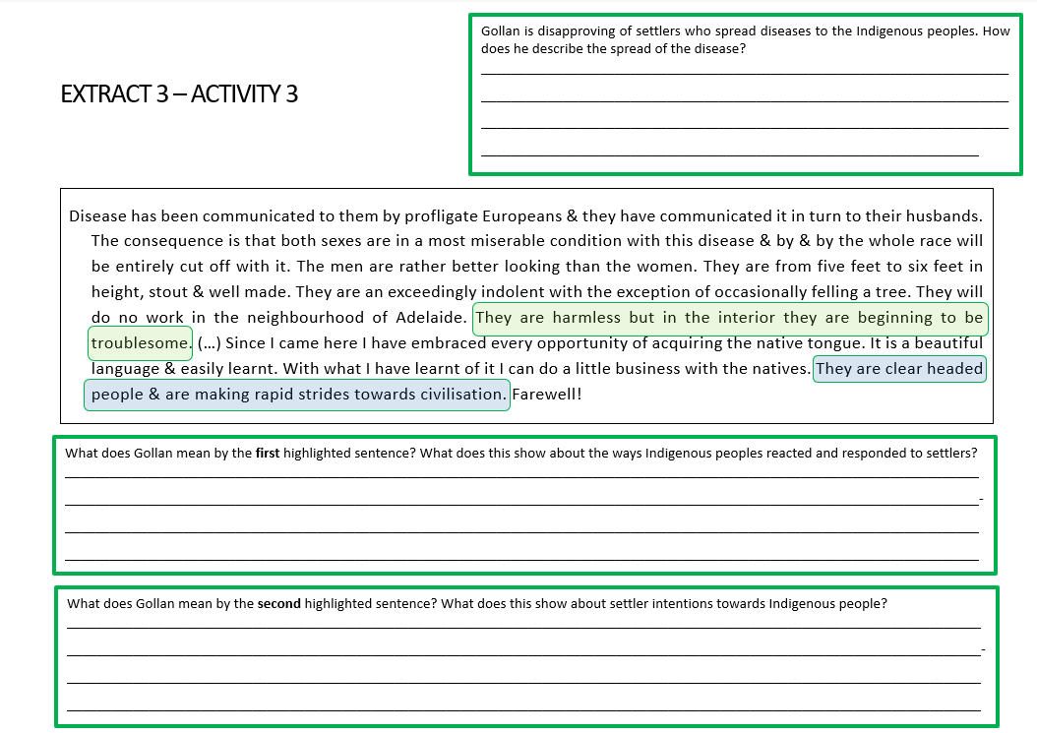
Notes:
Overall impressions of the letter
This source shows different ways in which settlers make Indigenous peoples suffer:
Taking over/taking control of land which belonged to Indigenous peoples.
Viewing the natural world, and exploiting it, as resources (birds, fish, crops).
Spreading new diseases, leading to a decrease of Indigenous population.
The exploitation of Indigenous peoples:
Dehumanising Indigenous communities – why is it convenient for a settler to view Indigenous peoples in racist and dehumanised ways?
Doing business with Indigenous communities – how were Indigenous peoples exploited financially?
This treatment and these views are presented as ‘civilisation’ and ideas of ‘progress’ – ‘making rapid strides towards civilisation’. How and why are such beliefs harmful?

Slide 28
Activity 2 & 3 – Teacher
  This source shows different ways in which settlers make Indigenous peoples suffer:
  Taking over/taking control of land which belonged to Indigenous peoples.
  Viewing the natural world, and exploiting it, as resources (birds, fish, crops).
  Spreading new diseases, leading to a decrease of the Indigenous population.
  Financial exploitation of Indigenous communities (seen, for example, in Gollan learning ‘the native tongue’ to ‘do a little business with the natives’ referred to in the letter).

Slide 29
For the Teacher
Homework task

Slide 30


HOMEWORK task:
Chilli Challenge
Pick one of the questions below to answer. The colours correspond to how difficult/spicy the question it.
How were Indigenous peoples exploited financially?
Why is it convenient for a settler to view Indigenous peoples in racist and dehumanised ways?
The treatment and these views are presented as ‘civilisation’ and ideas of ‘progress’ – ‘making rapid strides towards civilisation’. How and why are such beliefs harmful?

