Slide 2
Impact of Scots Settlers on the Mi’kmaq First Nation

Slide 3
Starter: How well do you know Canada?
What percentage of Canada’s population today is Indigenous?
a) 0.5% | b) 5% | c) 25%
How many Indigenous groups are there in Canada today?
a) 1 | b) 6 | c) 600
Have an educated guess. Be prepared to explain your choice!

Slide 4
Starter: How well do you know Canada?
What percentage of Canada’s population today is Indigenous?
 | b) 5%
According to the 2021 Census, more than 1.8 million people in Canada identify as Indigenous, which represents 5% of Canada's total population.
How many Indigenous groups are there in Canada today?
 |  | c) 600
There are three distinct groups of Indigenous Peoples - First Nation, Métis and Inuit. The largest group is the First Nations, which includes over 600 bands each with their own language, culture, history and traditions.

Slide 5
What motivated Bishop Fraser to write a letter to John Young about First Nation communities in Canada?

Slide 6
Learning Intentions
Success Criteria
To examine and understand the motivations and attitudes of a Scots settler towards a First Nation Community in Canada.
I can describe the attitude of Bishop Fraser towards the Mi’kmaq First Nation.
I can analyse a historical source to answer an enquiry question.

Slide 7
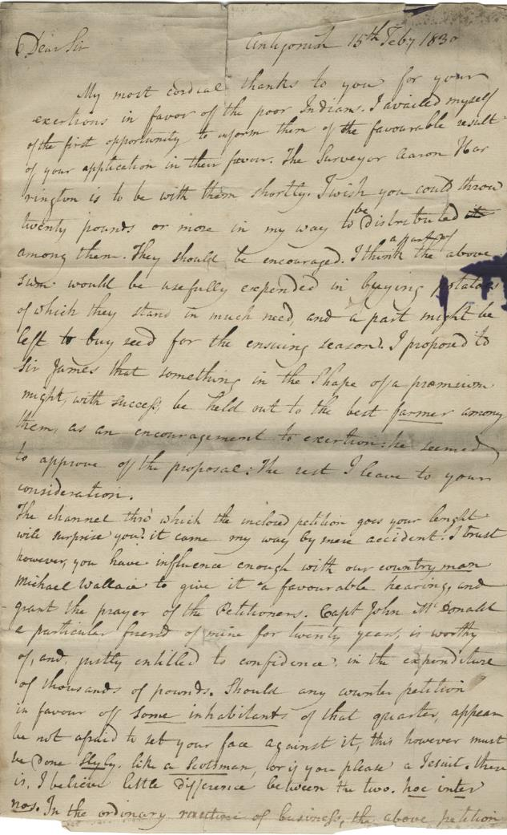
Speculate
The letter on the left was written in 1830 by William Fraser, a Scot living in Canada, to John Young, another Scot living in Canada.
In today’s lesson we will be studying this lesson in more detail.
Before we start…
Think – Why might they have written to each other?

Slide 8
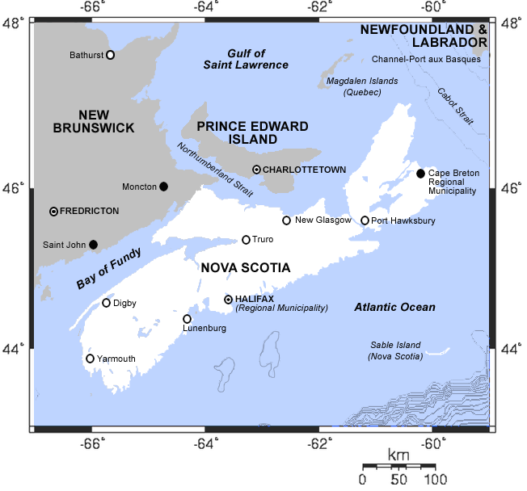
Where – Antigonish, Nova Scotia, Canada. The original inhabitants of this area were the Mi’kmaq Nation. Scots settlers encountered these people when they arrived in the area.
Sender – William Fraser, Bishop of Arichat. He was born in Glen Cannich, Scotland. He later became Bishop of Halifax
Recipient – John Young, an MP in the Nova Scotia House of Assembly. He was born in Falkirk, Scotland. He came to Scotland as a merchant and then moved into politics
Notes:
Find out more about William Fraser here: https://www.biographi.ca/en/bio/fraser_william_8E.html
Find out more about John Young here: https://www.biographi.ca/en/bio/young_john_1773_1837_7F.html

Slide 9
Antigonish 15th Feb.y 1830
Dear Sir,
My most cordial thanks to you for your exertions in favor of the poor Indians…I wish you could throw twenty pounds or more in my way to be distributed among them. They should be encouraged. I think a part of the above sum would be usefully expended in buying potatoes of which they have much need, and a part might be left to buy seed for the ensuing season.
I remain My Dear Sir
yrs unalterably
William Fraser
Think!
Why might Fraser have thought Young was a good person to send this letter to?
Your teacher will give you a worksheet to work through this letter

Slide 10
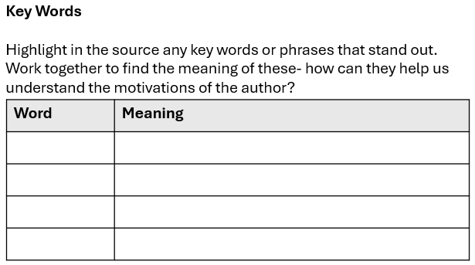
Task 1: Clarifying Key words
Clarifying key words helps you recognise when you don’t understand parts of the source. It helps you better understand the meaning and purpose of the whole source.
Highlight any key words, ideas or phrases (at least 2). These can also be words you don’t understand.
As a group find the meaning of these words. What resources can you use?

Slide 11
Recap Task 1
Antigonish 15th Feb.y 1830
Dear Sir
My most cordial thanks to you for your exertions in favor of the poor Indians…I wish you could throw twenty pounds or more in my way to be distributed among them. They should be encouraged. I think a part of the above sum would be usefully expended in buying potatoes of which they have much need, and a part might be left to buy seed for the ensuing season.
I remain My Dear Sir
yrs unalterably
William Fraser
Did you pick out any of these phrases? Which other phrases did you pick out?
What does the letter tell us about Indigenous people?
What does the letter tell us about Fraser’s motivations?

Slide 12
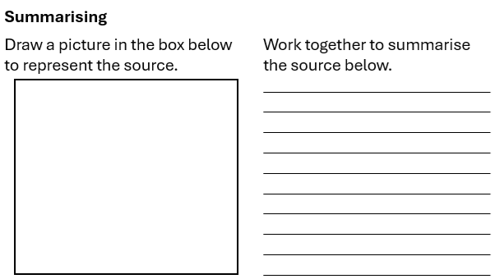
Task 2: Summarising
Summarising a source means picking out the main ideas/ content and leaving out what is not essential for your question.
Read through the source and decide what the main points are.
As an individual: draw a picture representing these points.
As a group: write a short summary of the source.

Slide 13
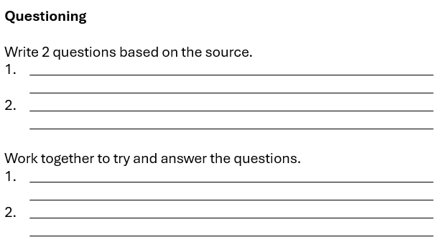
Task 3: Questioning
Asking questions about a source helps you deepen your understanding by making inferences about a source.
Write 2 questions based on the source. Think about what the source doesn’t tells us, what the impact of it is, why it is happening…
Work with your group to try and answer the questions- this will be difficult, and you may have different opinions.
Inference = thinking about what might be the case based on evidence and reasoning

Slide 14
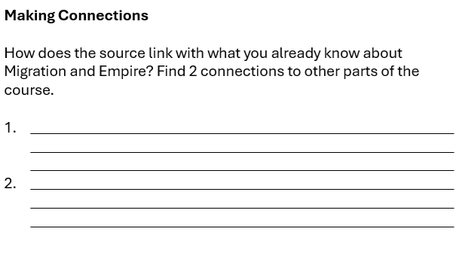
Task 4: Making Connections
Making connections with prior learning helps you to fully understand the source and its context.
Find 2 connections to other parts of the course. Think about Scots attitudes to other Indigenous communities, the impact of Scots on First Nation peoples, the impact of Scots on Canada…

Slide 15
Answering the Enquiry Question
What motivated Bishop Fraser to write to John Young about First Nation communities in Canada?
Bishop Fraser was motivated to write to John Young because…
We know this because… (include a piece of evidence)
He felt Young was a good person to write to because….

Slide 16
Plenary – Critical Thinking Pyramid
Describe the problem that Fraser saw.
2. Explain why he wrote to Young.
3. What might Fraser have considered when thinking of his response?

Slide 18
Worksheet/Handouts
(and possible answers)

Slide 19
Key Words
Highlight in the source any key words or phrases that stand out.
Work together to find the meaning of these- how can they help us understand the motivations of the author?
Summarising
Draw a picture in the box below to represent the source.
Work together to summarise the source below.
__________________________________________________________________________________________________________________________________________________________________________________________________________________________________________________________________________________________________
Word | Meaning
Questioning
Write 2 questions based on the source.
______________________________________________________________________________________________________________________
______________________________________________________________________________________________________________________
Work together to try and answer the questions.
______________________________________________________________________________________________________________________
______________________________________________________________________________________________________________________
Making Connections
How does the source link with what you already know about Migration and Empire? Find 2 connections to other parts of the course.
_________________________________________________________________________________________________________________________________________________________________________________
_________________________________________________________________________________________________________________________________________________________________________________
Notes:
Worksheet to print

Slide 20
Key Words
Highlight in the source any key words or phrases that stand out.
Work together to find the meaning of these- how can they help us understand the motivations of the author?
Summarising
Draw a picture in the box below to represent the source.
Work together to summarise the source below.
Bishop Fraser is writing a letter to his local politician, John Young. He is asking for £20 to give to the Mi’kmaq First Nation community. He wants them to buy potatoes and seeds. He feels sorry for them and wants to help them, but also thinks they need motivation to improve their situation
$$$
Word | Meaning
Poor Indians | Feeling sympathy towards the Mi’kmaq
Throw £20 | Carelessly give money, like it doesn’t matter
Encouraged | Suggesting the Mi’kmaq need to be motivated
Much need | The Mi’kmaq need help, are struggling to survive
Questioning
Write 2 questions based on the source. (these are just examples)
Why did the Mi’kmaq need help?
Why was Bishop Fraser there?
Work together to try and answer the questions.
Their land had been taken away and had been changed due to European/Scottish farming so their traditional way of living was damaged.
Many Scots travelled to Nova Scotia for new opportunities, and religious people wanted to build new Christian communities.
Making Connections
How does the source link with what you already know about Migration and Empire? Find 2 connections to other parts of the course.
Impact on other Indigenous peoples (e.g. in Australia, New Zealand), depending on previous study.
Other religious impacts on countries/Canada e.g. building of schools
Notes:
Possible answers for worksheet

Slide 21
Lesson Plan

Slide 22
Lesson Level Enquiry Question What motivated Bishop Fraser to write to John Young about First Nation communities in Canada.
Purpose: | To learn how to analyse historical sources and to understand the attitudes of some Scots settlers towards First Nation Communities.
Objective: | Links to the syllabus: Migration and Empire- Issue 3- The impact of Scots emigrants on the empire (Canada). For pupils to analyse the motivations of a Scots settler and explain how these attitudes impacted First Nation Communities.
Outcome: | Pupils will demonstrate their ability to answer the Enquiry Question by analysing a source through completion of a reciprocal reading task- by clarifying, summarising, question generating and making connections.
Time | Teacher is… | Pupils are… | Checking learning
0-5 | Starter Task – What do we know? Present the students with questions (slide 3 – questions appear on the presented slide first, answers appear via animation). | Answering questions- pupils are not expected to already know these answers. Engaging in whole class discussion of answers. | Show me boards
5-10 | Setting the scene- why do people write letters (leading discussion), putting source into context. | Engaging in discussion of why someone writes a letter, listening to the teacher explain the context of the source. | Discussion responses
10-15 | Read through source and discuss why John Young received it. | Listening to teacher, engaging in whole class discussion. | Discussion responses
15-20 | Clarifying key words- introducing task, facilitate pupil engagement, lead brief discussion. | Pupils to highlight key words/phrases and find their meaning (in groups/pairs/individual). | Completion of reading mat
20-25 | Summarising- introducing task, facilitate pupil engagement, lead brief discussion. | Pupils to draw a picture to represent the source and then briefly summaries its contents. | Completion of reading mat
25-30 | Questioning- introducing task, facilitate pupil engagement, lead brief discussion. | Pupils to create 2 questions they would like to ask based on the source and in groups try and answer them. | Completion of reading mat
30-40 | Links to prior learning- introducing task, facilitate pupil engagement, lead brief discussion. | Pupils to find 2 connections to other parts of the course (could be impacts on other indigenous groups, impacts of religion, other impacts on Canada). Can work in groups/pairs/ as an individual. | Completion of reading mat
35-45 | Re-introduce the enquiry question and provide structure for answer. Lead brief discussion. Provide the whole source (slide 14) for students to answer enquiry question. | Using learning/discussion to write an answer to the enquiry question. | Written answers
45-50 | Plenary – critical thinking pyramid. Lead whole class discussion of responses. | Answer the prompts in the pyramid- differentiation built in (more difficult as work through pyramid) | Show me boards
Home learning: (if necessary/ appropriate)

