Slide 2
What role did Residential Schools play in the colonisation of Canada?

Slide 3
What role did Residential Schools play in the colonization of Canada?
Learning intentions
Success criteria
To understand how Residential Schools were used in the colonisation of Canada and the role Scottish settlers played in this.
To assess the impact Residential Schools had on Indigenous communities
Use two primary sources relating to Residential Schools to identify the coloniser's purpose for them, and their impact on Indigenous people.
Plot an empathy map using an Indigenous person's account of their experience in a residential school.

Slide 4
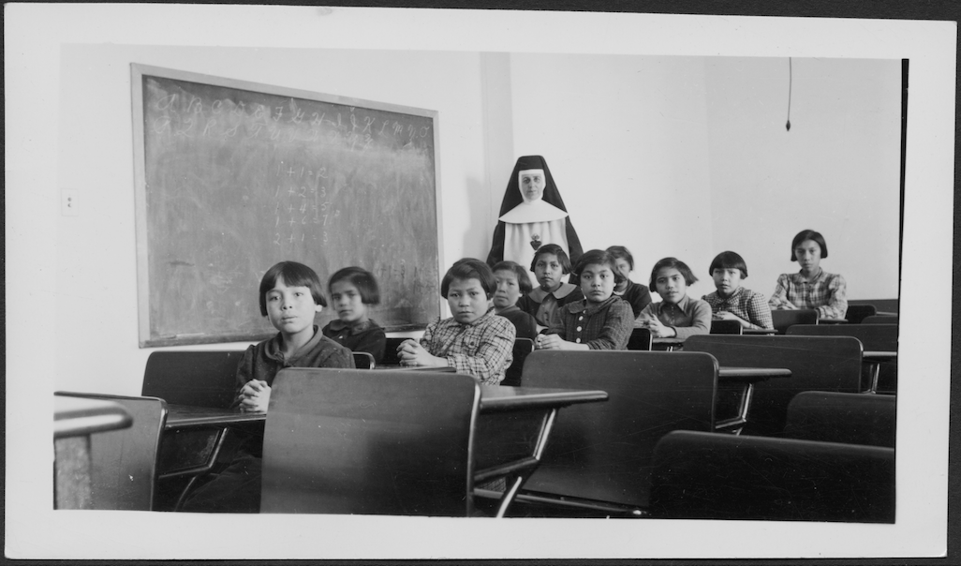
Starter: Who, what, where, why?
Notes:
Starter aim: to get pupils thinking about who this lesson will be about – indigenous children in Canada (will need guidance on this if first lesson on indigenous people). Pupils may notice the positioning of the nun behind the pupils, perhaps a sense of authority over the children. Pupils could also point out that the children all have the same haircut.
The why part is what is to be answered throughout the lesson – settlers wiping indigenous culture and attempting to assimilate indigneous children into European cultures.
Photo from: https://facingtoday.facinghistory.org/topic/residential-schools
Group of female students and a nun (Sister Antoine) in a classroom at Cross Lake Indian Residential School, Cross Lake, Manitoba, February 1940.
Credit: Canada. Dept. Indian and Northern Affairs / Library and Archives Canada / e011080274 (no copyright).

Slide 5
Terminology
  Assimilation – The view that Indigenous people should forget their traditions and fit in with European ways of life, usually because these were presumed to be superior.
Indigenous Peoples: Indigenous Peoples are the original inhabitants of a land, with deep cultural, historical, and spiritual connections to their environment. In older documents, the word 'Indian' is sometimes used, but it is not acceptable to use that term today.
First Nations, Métis, and Inuit: three legally-recognised Indigenous populations in Canada.
Settler colonialism: where foreign settlers come to a land and take control by force, establishing new communities and political orders. This process has catastrophic effects on the Indigenous people, land and culture.
Residential Schools: Government-funded, church-run boarding schools for Indigenous children across Canada to enforce assimilation policies, the last of which closed in 1997. More recently they have been in the news due to the discovery of unmarked school cemeteries.

Slide 6
Background:
Residential Schools

Slide 7
Scottish settlers
Many Scots migrated to Canada in search of land, work, and future opportunities. Although individual Scots did not realise it, their arrival was part of a pattern of settler colonialism in which new political arrangements were introduced, and Indigenous ways of life were disrupted or destroyed.
Scots (and more broadly European settlers in general) interacted with Indigenous communities in Canada in various ways, but the consequences of one of the darkest legacies of Scottish settlers are still being felt today in many Indigenous communities, through the Residential School system.

Slide 8
Residential Schools
Residential schools were government-funded, church-run boarding schools for Indigenous children across Canada to enforce assimilation policies, the last of which closed in 1997.
Indigenous children were either sent by, or forcibly removed from, their families to these residential boarding schools.
These residential schools attempted to eradicate indigenous culture; children were banned from their community's cultural practices and instead had to communicate in English or French and convert to Christianity.
Many residential schools have a dark history of violence, oppression and abuse.
We are going to engage in some source analysis to find out what the purpose of these schools were and what were they like for the children who had to experience them.

Slide 9
Scots and Residential Schools

Slide 10
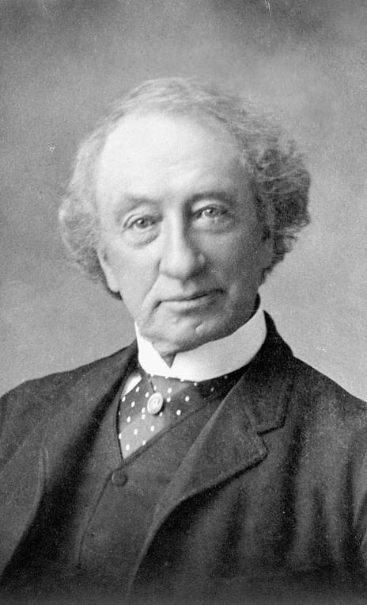
What is the Scottish connection to residential schools?
Sir John A. Macdonald – first Prime Minister of Canada, born in Glasgow 1815, moved with family to Canada in 1820.
In 1883, Macdonald authorised the establishment of residential schools in the West. In 1884, official 'Indian Residential Schools' (residential type schools did exist prior to this) were funded and operated by the Government of Canada and Roman Catholic, Anglican, Methodist, Presbyterian, and United churches.
Sir John A. Macdonald (c.1875).
Credit: Library and Archives Canada (no copyright)

Slide 11
ACTIVITY 1
What does Prime Minister John A. Macdonald's speech on the introduction of residential schools to Canada tell us about how Scots felt Indigenous people should assimilate?
Copy this table into your jotter
You are going to read an excerpt from a speech delivered by John A. Macdonald to the House of Commons in Canada. Use this to complete the table.
Please be aware that the source contains derogatory and offensive language when describing Indigenous people.
How Indigenous People are Described | The Purpose of Residential Schools | Language of Authority & Control

Slide 12
Source 1
“When the school is on the reserve the child lives with its parents, who are savages; he is surrounded by savages, and though he may learn to read and write his habits, and training and mode of thought are Indian. He is simply a savage who can read and write. It has been strongly pressed on myself, as the head of the Department, that the Indian children should be withdrawn as much as possible from the parental influence, and the only way to do that would be to put them in central training industrial schools where they will acquire the habits and modes of thought of white men.”
Prime Minister Sir John A. Macdonald, Official report of the debates of the House of Commons of the Dominion of Canada,
9 May 1883
Notes:
http://education.historicacanada.ca/files/103/ResidentialSchools_Printable_Pages.pdf

Slide 13
Discussion
What does Prime Minister John A. Macdonald's speech on the introduction of residential schools to Canada tell us about how Scots felt Indigenous people should assimilate?

Slide 14
ACTIVITY 2
What can we learn about the impact of Scottish settlers on Indigenous peoples in Canada from a survivor's testimony of their experience in a residential school?
You are going to read an excerpt from a survivor's testimony of their experience in a residential school.
Please be aware that the source contains upsetting content.

Slide 15
Copy the empathy map below into your jotter and complete it as you read Vera’s testimony
Felt
Saw
What Vera...
Feared
Heard

Slide 16
Source 2
We were locked up by a white authority figure and so learned, like those in most reserves, that 'white' was 'right.' The children' s hair was cut off; their clothes exchanged for unfamiliar clothing… We learned early not to cry, not to draw attention to ourselves, so we wouldn't get a strapping... We learned cultural self-hate and shame through messages like: it's wrong to sit on the ground to eat, sit at a table and be 'civilized' - don't be like your parents... We learned to be ashamed of being Indian
Vera Martin, Description of residential schools and a survivor's experience, from the National Centre for Truth and Reconciliation (NCTR) Archives
Notes:
http://education.historicacanada.ca/files/103/ResidentialSchools_Printable_Pages.pdf

Slide 17
Discussion
What can we learn about the impact of Scottish settlers on Indigenous peoples in Canada from a survivor's testimony of their experience in a residential school?

Slide 18
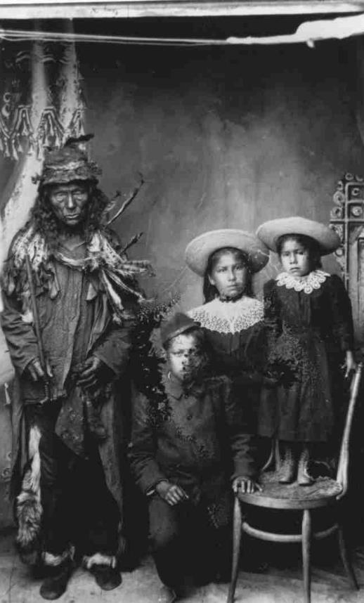
Plenary: look at the image and think about the following questions:
This image, titled "Quewich and his children“, from c.1900 was used by the Department of Indian Affairs.
What does this photograph suggest about the policy of assimilation? What can you learn from the differences between the parent and children?
Why do you think the Department of Indian Affairs wanted to display this photograph? What message were they trying to send?
Quewich and his children, or Unidentified man with children from the QuAppelle Industrial School, ca. 1900. Provincial Archives of Saskatchewan, R-A22202 (free from copyright)
Notes:
http://education.historicacanada.ca/files/103/ResidentialSchools_Printable_Pages.pdf

Slide 20
LESSON PLAN

Slide 21
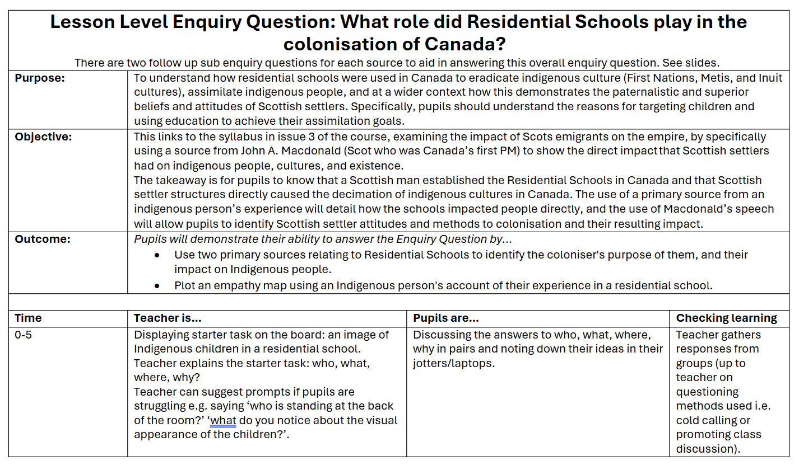

Slide 22
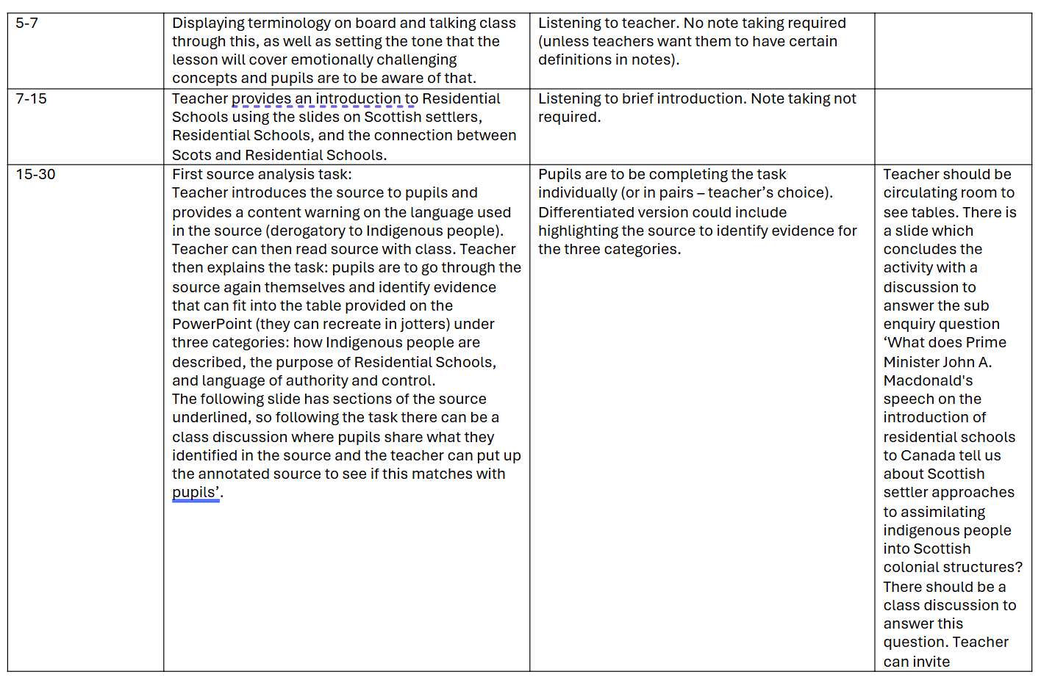

Slide 23
