Slide 2
Robert MacDougall
and the First Nations
of Canada

Slide 3
STARTER TASK
Answer the questions below:
Why do people move from their own country? Give three reasons.
What does ‘Indigenous’ mean?
Notes:
War; poverty; join family in another country; adventure.
Indigenous: originating in a particular place; sometimes referred to as ‘native’ although this is best avoided because of pejorative, colonial overtones.

Slide 4
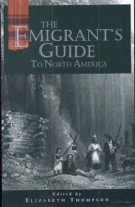
Enquiry question:
How does Robert MacDougall’s perspective as a Gaelic speaker influence the way he saw Indigenous Canadians?
Success criteria:
I can describe Robert MacDougall’s view of the Indigenous peoples of Canada.
I can explain how Robert MacDougall’s background as a Highland Scot might have influenced his view.
Notes:
Cover of MacDougall, R. and Thompson, E.H. (1998) The Emigrant’s Guide to North America. Toronto: Natural Heritage Books.

Slide 5
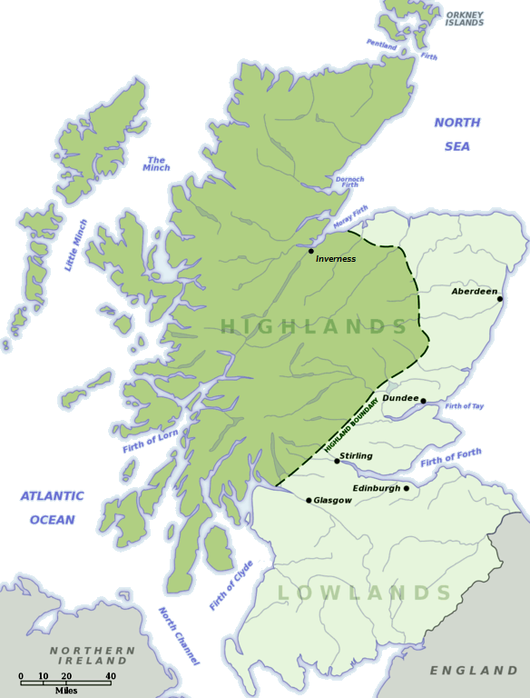
Background
Before 1755 over half the people of Scotland lived in the Highlands.
Most Highlanders spoke Gaelic, a language similar to Irish. Their culture and traditions were different from those of people in Lowland Scotland.
Many Highlanders belonged to clans. Clan members gave their support to their chief in return for protection and leadership.
Most Highlanders lived in stone cottages or 'blackhouses' with a small patch of arable land known as a ‘croft’.
‘Crofters’ were tenant farmers, meaning that they paid rent to a landlord for the use of the croft.

Slide 6
Task: Read the source below and write down any reasons why Highland Scots might want to emigrate.
I have not the slightest hesitation in declaring, that it appears to me as plain as the sun at noonday, that a farmer in Scotland, occupying a farm that does not pay him, distressed as he must be, struggling from morning to night with mental anxiety and worrying pressure upon his mind and yet after all quite unable to support his family or better their circumstances – I say that a farmer continuing to remain in Scotland even when unemployed while so much land lies in Canada to occupy acts the part of an insane person. In a short time there will be no cheap land to be procured about these parts. The best way for my brother to lay out their money here is in buying land which is every year rising in value.
William Blackwood (1834) The Quarterly Journal of Agriculture, Volume 4.

Slide 7
Why did Scots migrate?
Unable to support family
Increasing value of land abroad
I have not the slightest hesitation in declaring, that it appears to me as plain as the sun at noonday, that a farmer in Scotland, occupying a farm that does not pay him, distressed as he must be, struggling from morning to night with mental anxiety and worrying pressure upon his mind and yet after all quite unable to support his family or better their circumstances – I say that a farmer continuing to remain in Scotland even when unemployed while so much land lies in Canada to occupy acts the part of an insane person. In a short time there will be no cheap land to be procured about these parts. The best way for my brother to lay out their money here is in buying land which is every year rising in value.
Unemployment
Lots of land abroad
Cheap land abroad

Slide 8
Who was Robert MacDougall?

Slide 9
Robert MacDougall moved to Canada from Scotland in 1836 at the age of twenty-three, with his father and half-sister.
Two of his older brothers had emigrated three years previously and settled in Goderich township in the Huron Tract. MacDougall returned to Scotland in 1839 and remained there for two years before emigrating to Australia in 1841.
In the years before he emigrated to Australia, MacDougall wrote The Emigrant's Guide to North America. The Emigrant's Guide was written in Gaelic (titled Ceann-Iuil an Fhir Imrich) which was still spoken in Scotland at that time, although the signs of impending decline were already evident.
The Guide was aimed at those living in the Highlands, to give them a perspective of life in Canada. It was hoped this guide would show Highlanders that there were commonalities between the Indigenous Canadians, and Highland Scots, and to reassure them there was no threats.
Notes:
FURTHER QUESTIONING – discuss with the students the purpose of this source, would this impact the reasons why it was written and what was said?

Slide 10
Task: Read the quotations provided from Chapter 6 of MacDougall’s book.
Highlight key words / phrases that stick out to you.
Answer the questions down either side for each of the quotes.
Think about the purpose of MacDougall’s book – do you think this would have changed the opinion of Highland Scots?

Slide 11
Challenge question:
How does Robert MacDougall’s perspective as a Gaelic speaker influence the way he saw Indigenous Canadians?

Slide 12
Learning Intention:
We are learning about the impact of Scots emigrants on Canada. Specifically, we aim to understand the link between Highland Scots and their views of Indigenous people.
Success Criteria:
I can describe Robert MacDougall’s view of the Indigenous peoples of Canada
I can explain how Robert MacDougall’s background as a Highland Scot might have influenced his view.
Plenary:
1. Why could we trust Robert MacDougall’s account of Indigenous peoples in Canada? Give one reason.
2. Why might we not fully trust Robert MacDougall’s account of Indigenous peoples in Canada? Give one reason.

Slide 13
FOR THE TEACHER

Slide 14
Lesson Level Enquiry Question How does Robert MacDougall’s perspective as a Gaelic speaker influence the way he saw Indigenous Canadians?
Purpose: | To make learners aware of the impact of Scottish settlers on Indigenous communities in Canada. | To make learners aware of the impact of Scottish settlers on Indigenous communities in Canada.
Objective: | To look at Gaelic Scottish settlers' views of Indigenous peoples in Canada, and see how they compare themselves to these groups. | To look at Gaelic Scottish settlers' views of Indigenous peoples in Canada, and see how they compare themselves to these groups.
Outcome: | Pupils will demonstrate their ability to answer the Enquiry Question by… | Pupils will demonstrate their ability to answer the Enquiry Question by…
Time | Teacher is… |  | Pupils are…
0-10 | Starter Task - Questions… Why do people move from their country? What does Indigenous mean? |  | Answering starter task on their whiteboards
10-15 | Who was Robert MacDougall? An introduction to Highland migration and Scottish experience moving to Canada. |  | Listening to background Reading a paragraph and identifying reasons why Scots moved
15-35 | Guided Reading Task instructions |  | Reading the quotes, highlighting key words / phrases Completing Guided reading task looking at the 2 key questions for each quote;... What does this quote tell us about Scottish settler’s view of Indigenous Peoples? How does this sound like or link back to life in the Highlands? MacDougall’s book was meant to dispel rumours and inaccuracies about the colonies – do you think his unique perspective would have changed the views Gaelic speaking / Highland Scots already had? Why / why not?
35-45 | Going over the answers to the guided reading - talking about the main key questions & the view of Scots. |  | Answering the challenge question on their whiteboards.
45-50 | Plenary task |  | Answering question on their whiteboards using their previous knowledge from evaluating the usefulness of a source 1. Why could we trust Robert MacDougall’s account of Indigenous peoples in Canada? Give 1 reason. 2. Why might we not fully trust Robert MacDougall’s account of Indigenous peoples in Canada? Give 1 reason.
Home learning: (if necessary/ appropriate) Evaluate the Usefulness Question

Slide 15
What does this quote tell us about Scottish settlers' view of Indigenous peoples? | Highlight key words and phrases that stand out to you | Why might this sentence reassure a Highlander who is considering emigration?
 | “With that the emigrant can see the type of people the Indians are … I do not ever expect to see men who are more respectful towards others”.
 | “They have a soft, slow, pleasant speech, merely a branch of the Gaelic language and if those who first wrote it down had been well acquainted with Gaelic, the two languages would be remarkably similar.”
 | “For these foreigners served as a means of bringing many of them from darkness into light…”
 | “They have done this outwardly, at any rate, for many of them have now abandoned the hunting, and every old custom that was unprofitable, and have begun building permanent homes in the same place”
 | “The minister and the schoolmaster are always situated in their midst, so that they are close at hand to each and every family.”
 | “Many of them have a godly look, and I would like to believe the situation is not without hope, even though they were strangers to the commonwealth of Israel, and strangers to the covenants of promise, without hope, and without a God in the world”
MacDougall’s book was meant to dispel rumours and inaccuracies about the colonies. Do you think his unique perspective would have changed the views Gaelic-speaking / Highland Scots already had? Why / why not?

Slide 16
With that the emigrant can see the type of people the Indians are, commanding valiant men, but I do not ever expect to see men who are more respectful toward others. They have a slow, soft, pleasant speech, merely a branch of the Gaelic language, and if those who first wrote it down had been well acquainted with Gaelic, the two languages would look remarkably similar. But if one or two travelling preachers were sent out from England, through the mountains to learn Gaelic, and if after they had scarcely begin to acquire it, they gave themselves permission to write it down, and put it in print, it would be just as difficult to understand as the Indian language, and much more difficult for me to read.
But although their language has been spoiled by the foreigners, their intelligence has not been destroyed by them, for these foreigners served as a means of bringing many of them from darkness into light, inasmuch as they cast off the old man, along with his works, in two senses, I hope. They have done this outwardly, at any rate, for many of them have now abandoned the hunting, and every old custom that was unprofitable, and have begun building permanent homes in the same place. They do not cultivate large areas within a few years, as many other people do in America, but they have enough crops to provide food for themselves and their families. The minister and the schoolmaster are always situated in their midst, so that they are close at hand to each and every family. Many of them have a godly look, and I would like to believe that they situation is not without hope, even though they were recently strangers to the commonwealth of Israel, and strangers to the covenants of promise, without hope, and without a God in the world.
Notes:
Full source, taken from Chapter 6: ‘Indians, &c’, from Robert MacDougall’s Ceann-iùil an fhir-imrich do dh'America mu-thuath ; or The Emigrant’s Guide to North America. Glasgow: J. & P. Campbell [Eng. trans., ed. Elizabeth Thompson, Toronto: Natural Heritage Books, c1998] pp. 39-40

