Slide 1
Sir Donald McLean’s impact on the Indigenous peoples of New Zealand

Slide 2
Sir Donald McLean’s impact on the Indigenous peoples of
New Zealand

Slide 3
Vocabulary
Assimilation: The view that Indigenous people should forget their traditions and fit in with European ways of life, usually because these were presumed to be superior.
Indigenous Peoples: Indigenous Peoples are the original inhabitants of a land, with deep cultural, historical, and spiritual connections to their environment. In older documents, the word 'Indian' is sometimes used, but it is not acceptable to use that term today.
Settler colonialism: A form of colonial control in which foreign settlers come to a land and take control by force, establishing new political orders. Settler colonialism is dependent on power and economic and political domination. This process often involves displacement, violence, and attempts to suppress Indigenous identities and rights.

Slide 4
Starter Task – Pair Discussion
How do you think European settlers were viewed by Indigenous populations?
Challenge Question: How might we know?

Slide 5
Today's Learning
Learning Intention
We are developing our knowledge and understanding on the treatment of Māori peoples by colonial administrators.
Success Criteria
I can explain who Sir Donald McLean is and his role in the NZ colonial administration
I can analyse different historical sources to assist with an enquiry.

Slide 6
Lesson Enquiry Question:
Did people living in New Zealand agree about Sir Donald McLean's treatment of Indigenous people?

Slide 7
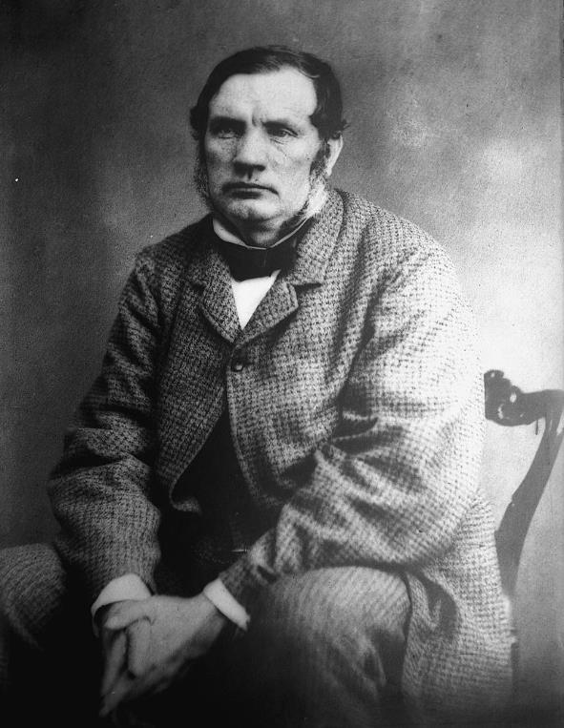

Who is Sir Donald McLean?
Task
Create a fact file on Sir Donald McLean. Include information on the following:
Where was he born?
When he moved to New Zealand? And why?
What jobs did Sir Donald McLean have for the colonial Government?
Scan the QR code to find out the information.
Extension: Why might events in Scotland at this time explain his move to the colonies?
Sir Donald McLean (c.1870). No copyright.
Notes:
https://nzhistory.govt.nz/people/donald-mclean - link to the website for the pupils to gather information on Sir Donald McLean.

Slide 8

Who is Sir Donald McLean?
A Scottish Highlander born on Tiree (Inner Hebrides) in 1820
He migrated first to Australia (1838) then to NZ (1840).
He first worked in the timber trade, then (through influence of fellow Scot Andrew Sinclair, colonial secretary) was appointed Protector of Aborigines in 1844.
Protector of Aborigines:
A role in the colonial government that involved the supervision and supposed care over all matters impacting the Aboriginal peoples, protecting them from injustices.

Slide 9
Sir Donald McLean and Māori peoples
McLean gained standing among Māori for his fluency in their language, and respect for Māori traditions.
Why might this be important?
Key actions taken to ‘benefit’ Māori:
Drafted the Native Land Act of 1873, which required all Māori landowners to be named on certificates of title (this helped to reduce fraud and the theft of Māori land)
Oversaw establishment (in 1867) of state-controlled Native Schools and four Māori seats in parliament.
Increased Māori involvement in public works, sheep-farming, and local government.
YET:
Like many people at the time, McLean was a social Darwinist – this meant that he believed the Māori were a ‘weaker race’ than Europeans, and were likely to ‘die out’, and that those who did not should ‘assimilate’ (learn to fit in) with European culture. He opposed the movement to create a unified Māori King, which would strengthen the Māori voice in politics
Sir Donald McLean (c.1870). No copyright.

Slide 10

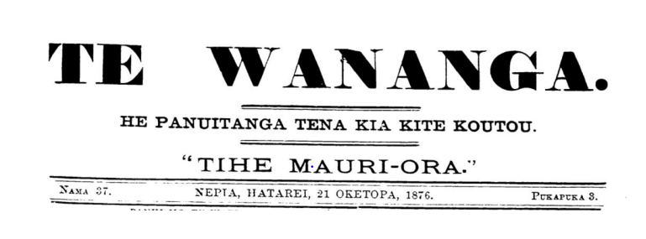
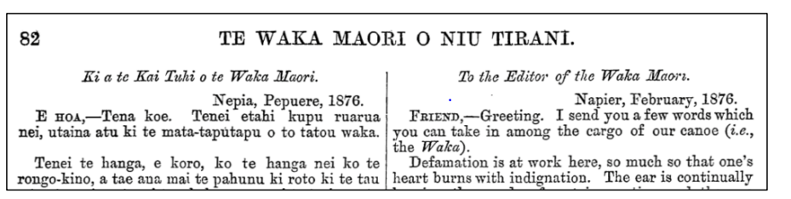
What are the potential strengths and weaknesses of using newspapers as sources of information?

Slide 11
Source 1 Analysis Task
Working in pairs, read through Source 1, which appeared in a government-funded Māori newspaper reporting on a speech from Colonel Whitmore in Parliament about the retirement on Sir Donald MacLean.
Whitmore was a military man and had control of the colonial forces – leading them into several battles with the Māori.
Work together to answer the questions in your jotter. Make sure to use full sentences.
Be prepared to feedback to the class.

Slide 12
Source 2 Analysis Task
Secondly, read through Source 2 which also appeared in a government-funded Māori newspaper.
This source is a printed response, by a Māori who is named as C.W. Hadfield, to the previous one and directly challenges what is being said by Colonel Whitmore in his speech to Parliament.
Work together to answer the questions in your jotter, make sure to use full sentences.
Be prepared to feedback to the class.

Slide 13
Source Analysis - Discussion
In your groups of four – discuss the following questions:
What were the differences between the sources? (think about language used, the tone, information etc.)
2. Were there any similarities?

Slide 14
Plenary
Did people living in New Zealand agree about Sir Donald McLean's treatment of Indigenous peoples? Use the sentence starters below to write an answer to this question.
"Overall, people did/did not agree about the treatment of Indigenous peoples by Sir Donald McLean.
"Evidence for this can be found...
"This shows that...

Slide 15
For the Teacher
Worksheets and Resources
(and potential answers)

Slide 16
Step 1
Read through the source and highlight and define any words you do not know.
Source 1 – Te Wananga, Saturday October 21st, 1876.
From Col. Whitmore’s Address to Parliament on the resignation of Sir Donald McLean.
“…Sir, when the colony will no longer be able to pay the Natives to keep the peace: and when the restraint to which the colony is no longer able to beat is removed, we shall find the Natives in precisely the same position as they were before. But it will then be apparent that the lavish expenditure of money on the Natives has had bad results: we shall have in our midst a lot of lazy good-for-nothing Natives, who will do a great deal of harm by their connection with the other Natives throughout the Colony.
…
In what state does Sir Donald McLean leave the Native question in New Zealand? I say that he leaves it in the most unsatisfactory condition, and that we shall have to go back to the first principles of the great law of England, which has always been quite sufficient to manage any race or creed it has been our duty to govern…I hail the retirement of the honourable gentleman with satisfaction, because I think it will give us a chance of returning to proper principles”
How does Col Whitmore view Indigenous peoples? How do we know – can you find evidence in the source?
What do you think Col. Whitmore’s biggest criticism of Sir Donald McLean is?
What might the writer mean by ‘proper principles?' Are they 'proper' for everyone?
What do you think is meant by the terms ‘manage’ and ‘duty’? What does it suggest about the relationship between colonists and Māori peoples?

Slide 17
Step 1
Read through the source and highlight and define any words you do not know.
Source 1 – Te Wananga, Saturday October 21st, 1876.
From Col. Whitmore’s Address to Parliament on the resignation of Sir Donald McLean.
“…Sir, when the colony will no longer be able to pay the Natives to keep the peace: and when the restraint to which the colony is no longer able to beat is removed, we shall find the Natives in precisely the same position as they were before. But it will then be apparent that the lavish expenditure of money on the Natives has had bad results: we shall have in our midst a lot of lazy good-for-nothing Natives, who will do a great deal of harm by their connection with the other Natives throughout the Colony.
…
In what state does Sir Donald McLean leave the Native question in New Zealand? I say that he leaves it in the most unsatisfactory condition, and that we shall have to go back to the first principles of the great law of England, which has always been quite sufficient to manage any race or creed it has been our duty to govern…I hail the retirement of the honourable gentleman with satisfaction, because I think it will give us a chance of returning to proper principles”
How does Col Whitmore view Indigenous peoples? How do we know – can you find evidence in the source?
Whitmore uses terms like ‘lazy’ ‘good-for-nothing’ ‘Natives’, who ‘will do a great deal of harm’, labelling the Indigenous peoples as a threat, as less than human. Whitmore is openly racist and prejudiced in his views.
What do you think Col. Whitmore’s biggest criticism of Sir Donald McLean is?
Whitmore believes the funds spent on improving living conditions for Indigenous peoples were a waste.
What might the writer mean by ‘proper principles?' Are they 'proper' for everyone?
It points to a ‘proper’ set of rules to be followed, in which the Indigenous communities are treated as inferior, and the British colonisers position themselves as superior. The principles are based in continued oppression, and a fear of equality. A ‘return’ to ‘proper principles’ also connects to other global British colonisation projects, which were similarly based on control, dominance, and oppression.
What do you think is meant by the terms ‘manage’ and ‘duty’? What does it suggest about the relationship between colonists and Māori peoples?
It is a relationship of superiority and domination, not one of equals. These terms point to control and oppression, labelling it the colonisers’ ‘duty’ to ‘manage’ those he sees as beneath him.

Slide 18
Source 2 – From Te Waka Maori o Niu Tirani
(The Māori Canoe of New Zealand), February 1876
“Defamation is at work here, so much that one’s Heart burns with indignation. The ear is continuously hearing the words of certain parties, and the eye seeing letters also which are sent to be printed in the Wananga, condemning, Sir Donald McLean, their friend and guardian, as I in my simplicity call him, for I am convinced he is the friend and guardian of the Māori tribes of this island. Now hearken, my friends, to some of the benefits which I have seen that our parent Sir Donald McLean has conferred upon the Native race.
Prisoners taken in war were spared and returned to their homes by the Government of Sir Donald McLean.
The telegraph and railways were constructed by the Government of Sir Donald McLean.
Schools were established and roads made in Native Districts by the Government of Sir Donald McLean.
Native members were introduced into parliament by the Government of Sir Donald McLean.
Tawhiao and his Hau Hau followers (King of the Māori) are peaceable disposed towards us through the instrumentality of the Government of Sir Donald McLean.
Now, my friends, do not slander our parent Sir Donald McLean; seek not his downfall by subterfuge and detraction… in my simple opinion, if any man were to rise up after Sir Donald McLean, he will have nothing to do; he will find that Sir Donald McLean has finished the work in connection with the Māori race”
From your friend in love, C. W. HADFIELD, a Māori.
What does the term ‘parent’ suggest about the relationship between settlers and Indigenous peoples?
Why do you think the letter writer used a list for this section?
Some historians think that this letter was actually written by Sir Donald McLean! Why might he have done this? What evidence is there to suggest this is the case?
Notes:
Source 2 – Questions for discussion:
What does the term ‘parent’ suggest about the relationship between colonist’s and indigenous peoples?
What do you think about the way this has been listed?
Could Sir Donald McLean have wrote this piece of work? What evidence is there to suggest this is the case?

Slide 19
Source 2 – From Te Waka Maori o Niu Tirani
(The Māori Canoe of New Zealand), February 1876
“Defamation is at work here, so much that one’s Heart burns with indignation. The ear is continuously hearing the words of certain parties, and the eye seeing letters also which are sent to be printed in the Wananga, condemning, Sir Donald McLean, their friend and guardian, as I in my simplicity call him, for I am convinced he is the friend and guardian of the Māori tribes of this island. Now hearken, my friends, to some of the benefits which I have seen that our parent Sir Donald McLean has conferred upon the Native race.
Prisoners taken in war were spared and returned to their homes by the Government of Sir Donald McLean.
The telegraph and railways were constructed by the Government of Sir Donald McLean.
Schools were established and roads made in Native Districts by the Government of Sir Donald McLean.
Native members were introduced into parliament by the Government of Sir Donald McLean.
Tawhiao and his Hau Hau followers (King of the Māori) are peaceable disposed towards us through the instrumentality of the Government of Sir Donald McLean.
Now, my friends, do not slander our parent Sir Donald McLean; seek not his downfall by subterfuge and detraction… in my simple opinion, if any man were to rise up after Sir Donald McLean, he will have nothing to do; he will find that Sir Donald McLean has finished the work in connection with the Māori race”
From your friend in love, C. W. HADFIELD, a Māori.
What does the term ‘parent’ suggest about the relationship between settlers and Indigenous peoples? A paternalistic relationship. This can be based on feelings of protection, but is also not a relationship of equals: there is a dominant person in a position of authority, and a vulnerable, weaker person, who relies on the other for protection/help.
Why do you think the letter writer used a list for this section? Such a bulleted list might be intended to convince the readers, by outlining multiple ‘facts’ in order to prove the author’s point. The article is probably meant to persuade.
Some historians think that this letter was actually written by Sir Donald McLean! Why might he have done this? What evidence is there to suggest this is the case? McLean may have written this to challenge Whitmore’s remarks in Parliament and save his reputation. The author gives high praise to McLean, positioning him above the Indigenous peoples (he is ‘guardian’, ‘parent’). The author’s name is likely a pen name (first name omitted, last name not Māori).
Notes:
Source 2 – Questions for discussion:
What does the term ‘parent’ suggest about the relationship between colonist’s and indigenous peoples?
What do you think about the way this has been listed?
Could Sir Donald McLean have wrote this piece of work? What evidence is there to suggest this is the case?

Slide 20
Plenary Potential Answers
Did people living in New Zealand agree about Sir Donald McLean's treatment of Indigenous peoples? Use the sentence starters below to write an answer to this question.
The sources do not actually outwardly disagree about how he treated the Indigenous people. Source 1 is very critical of McLean for treating them ‘kindly’, as Whitmore claims it is a waste of money and has not been of a benefit to the colonial government, whereas source 2 is very complimentary of some of the same things identified in source 1 as well.

Slide 21
For the Teacher
Lesson plan

Slide 22
Lesson Level Enquiry Question: Did people agree about McLeans treatment of Indigenous people?
Purpose: | To show the disagreements between colonists in dealing with the Māori Indigenous peoples.
Objective: | This links to the syllabus through looking at the impact of Scottish settlers on the indigenous peoples of New Zealand. The takeaway will look at the legacy of Sir Donald Mclean and how he is viewed as a colonial administrator. They will engage in sources that are making the same arguments but with differences in outcome and reception and discuss why this may be the case. Overall, they will gain an understanding of how Indigenous peoples were viewed by colonial administrators.
Outcome: | Pupils will demonstrate their ability to answer the Enquiry Question by…Through engaging in an analysis of the sources and drawing conclusions based on the contents to assist in answering the EQ. By cross-referencing sources and identifying bias.
Time | Teacher is… | Pupils are… | Checking learning
0-5 | Explaining the enquiry question and the LI and SC for the lesson Facilitating a discussion on how pupils perceive Indigenous thoughts towards colonists – use of questioning (was it all negative? Did some people do good things? Etc) | Getting ready for the lesson by getting pencils/jotters and resources. Listening to the teachers instructions and then engaging in the starter activity. Starter Activity – Think -Pair -Share | Points raised through discussions and followed up with questioning.
5-10 | Introducing Sir Donald McLean and his links to Empire. Explain where he was from, why he went to NZ. | Listening and discussing key questions relating to the importance of certain aspects of Sir Donal McLeans life – ie his highlander roots etc | Questioning the students in the class.
10-25 (source 1) | Source 1 – Māori perspective on Sir Donald McLean and the main takeaways of that. Source 2 – Col Whitmore's reflections on the retirement of Sir Donald McLean | Reading the source and completing the task associated with it. Two levels of differentiation will be provided and pupils choose option best suited to them. Extrapolating information from the sources to examine the legacy and the effectiveness of Sir Donald McLean as a colonial administrator. | Answering the specific questions for each of the sources – the source will be given with drip feeding questions
40-45 | Discussions and reflections on the sources. Talking about the origins of the sources and discussing the reliability of the sources and why they may have different information. | Discussion on the key points raised about Donald McLean and discussing the similarities and differences in the sources. | Through discussion.
45 – 50 | Return to the overall enquiry question of the lesson | Students will engage in a written piece of work to answer the enquiry question. | Teacher checks
Home learning: Comparison Activity

Slide 23
For the Teacher
Homework task

Slide 24
Comparison Q – Sources A and B are about the resignation of Sir Donald McLean
Source A
"In what state does Sir Donald McLean leave the Native question in New Zealand? I say that he leaves it in the most unsatisfactory condition, and that we shall have to go back to the first principles of the great law of England, which has always been quite sufficient to manage any race or creed it has been our duty to govern…I hail the retirement of the honourable gentleman with satisfaction, because I think it will give us a chance of returning to proper principles”
Source B
“Defamation is at work here, so much that one’s Heart burns with indignation. The ear is continuously hearing the words of certain parties, and the eye seeing letters also which are sent to be printed in the Wananga, condemning, Sir Donald McLean, their friend and guardian, as I in my simplicity call him, for I am convinced he is the friend and guardian of the Māori tribes of this island. Now hearken, my friends, to some of the benefits which I have seen that our parent Sir Donald McLean has conferred upon the Native race. Now, my friends, do not slander our parent Sir Donald McLean; seek not his downfall by subterfuge and detraction…in my simple opinion, if any man were to rise up after Sir Donald McLean, he will have nothing to do; he will find that Sir Donald McLean has finished the work in connection with the Māori race”
From your friend in love, C. W. HADFIELD, a Maori.
Compare the views of sources A and B about the legacy of Sir Donald McLean
(Compare the sources overall and/or in detail)
Notes:
Takeaway Task

