Slide 2
What can we learn about colonial attitudes from the story of William Duncan and Metlakathla?

Slide 3
William Duncan and story of Metlakathla
Learning Intention:
I will be able to assess the impact of colonisation on Indigenous Peoples.
This lesson is in three parts:
Who was William Duncan and where was Metlakathla?
Who is Arthur McCallum and why did he write a letter about Duncan?
Exploring Arthur McCallum’s letter
MET – LA – KATH – LA
Sound out the name

Slide 4
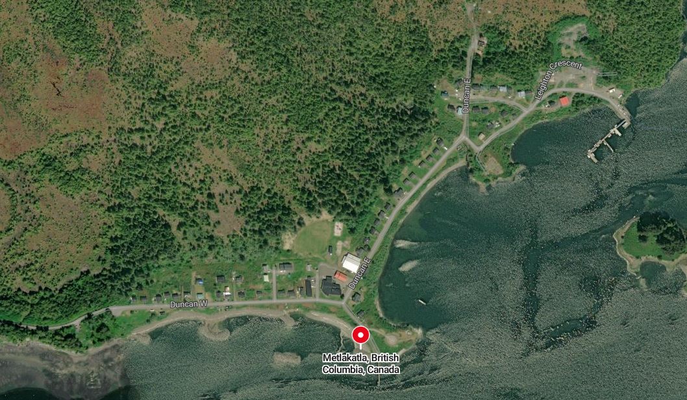
Metlakathla is a small town in Canada. Look at the satellite photo below and the statistics. With your partner, what do you think has happened to it?
Population in
1879
1,100
Population in
2016
85
Duncan West St
Duncan East St
Notes:
Note: Duncan's role was so prevalent that he makes up the major street. Today the area is mostly unsettled and the population continues to fall.

Slide 5
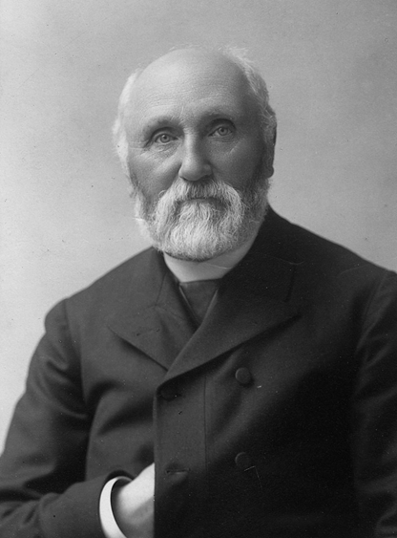
Use this information to complete Task 1 on your worksheet
William Duncan (1832–1918) was an English missionary who worked with the Tsimshian people in Canada. Missionaries were Christians who went around the world to spread Christianity and 'civilize' other places to be like Europe. He believed the Tsimshian should give up their traditional ways and live like British Christians.
After a smallpox epidemic in 1862, Duncan led around 800 Tsimshian people to build a new Christian village called Metlakatla. He made strict rules: no alcohol, no gambling, no traditional ceremonies. These mirrored the strict Victorian ideals Duncan was used to back home.
Later, Duncan fell out with his church and moved about 800 people again to New Metlakatla in Alaska. He stayed there until he died in 1918.
https://commons.wikimedia.org/w/index.php?curid=33803836
Notes:
'Duncan in 1902' By Unknown author; presumably either Asahel Curtis or Edward S. Curtis from "Curtis, Seattle" in the filename. - File:William Duncan, 70 years old. Curtis, Seattle. - NARA - 297274.jpg, Public Domain, https://commons.wikimedia.org/w/index.php?curid=33803836

Slide 6
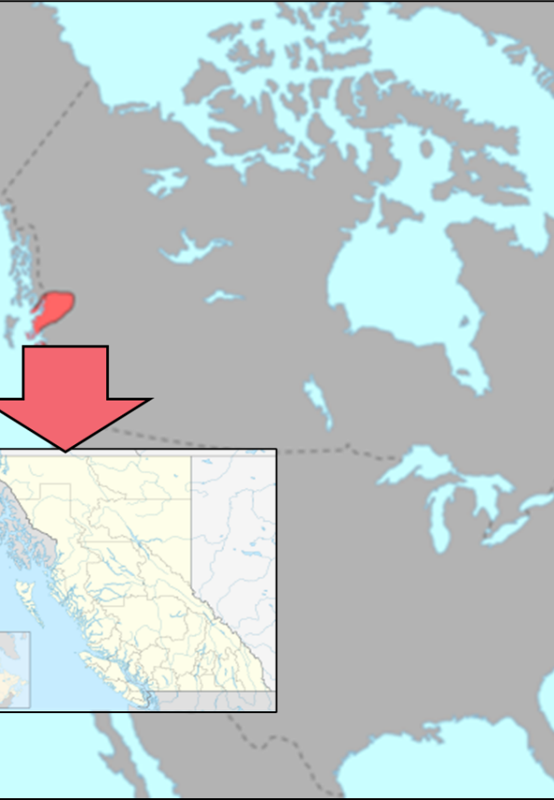
The settlement of Metlakathla
The name derives from Tsimshian Maaxłakxaała meaning "saltwater pass."
Traditionally, this site has been the collective winter village of the "Nine Tribes". This is where tribes would come together to share resources over the cold of winter.
Settlements encouraged people to stay in the same place. European settlers thought that this was superior to Indigenous ways of life because it was what they were used to in Europe.

Slide 7
Duncan’s Rules for Metlakathla
Discussion: These rules show us what was important to Christian Missionary, William Duncan.
1- Which rules reveal his religious bias?
2- Which rules suppress Tsimshian culture?
To work hard
To be peaceful
To be honest in trade
To build neat houses
To pay the village tax
To give up their 'Indian devilry'
To cease calling in 'magicians' when sick
To cease gambling
To cease painting their faces
To cease drinking alcohol
To rest on the Sabbath
To attend religious instruction
To send their children to school
To be clean
Notes:
Discussion Points:
1- Rules that reveal religious bias include: giving up devilry, rest on the Sabbath, attend religious instruction. These reflect the Victorian Christian ideals preached in the UK.
2- Rules that suppress culture: arguably all of these rules as they assume a European superiority - 'be like we are in Britain'. All of these assume

Slide 8
Check Point – True or False
Metlakatla was a new settlement created by Duncan and the Tsimshian people.
Duncan believed that the Tsimshian should keep all their traditional ceremonies.
One of Duncan’s main goals was to convert Indigenous people to Christianity.
The Canadian government forced Duncan to set up Metlakatla.

Slide 9
Check Point – True or False
Metlakatla was a new settlement created by Duncan and the Tsimshian people.
TRUE
2. Duncan believed that the Tsimshian should keep all their traditional ceremonies.
FALSE
3. One of Duncan’s main goals was to convert Indigenous people to Christianity.
TRUE
4. The Canadian government forced Duncan to set up Metlakatla.
FALSE

Slide 10
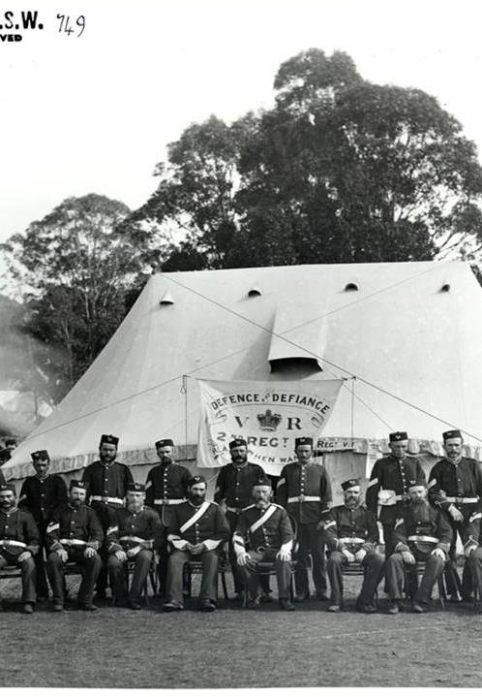
Who was Arthur McCallum?
We will now read a letter by a man named Arthur McCallum who was a retired soldier from the British Army. As a soldier, he had been involved in military action to suppress violent resistance by Indigenous people.
He is writing to an organisation called the Aborigines’ Protection Society. The society had been founded in 1837 to try to ensure the health and well-being and the sovereign, legal and religious rights of the indigenous peoples.
In his letter, McCallum talks about the Indigenous people of Metakathla, the work Duncan has done with them and his fear that the settlers might provoke a war with them.
NB – These sources refer to Indigenous Canadians as ‘Indians’. This term is considered offensive today. They also contain racist attitudes.
This Photo by Unknown Author is licensed under CC BY-SA-NC

Slide 11
Source Part 1
Victoria, British Columbia
22nd October 1886
My dear Mr Chesson,
Next week the H.M.S. 'Cormorant' will leave this for Metlakathla mission station to coerce the indians there. They demand a legal enquiry into the rights of their case in stopping the surveying party from the survey of their lands [for a new railway]....
They are now to have force backed by gunpowder in place of justice, and this injustice will naturally in the indian nature breed revenge… When injustice is resisted (if it be resisted) I presume the authorities here will more or less with equal injustice hold Mr Duncan responsible, so I write before the event.
Letter Section 1
Q1= What do the Indigenous people want?
Q2= What does McCallum fear will happen?

Slide 12
Source Part 1
Victoria, British Columbia
22nd October 1886
My dear Mr Chesson,
Next week the H.M.S. 'Cormorant' will leave this for Metlakathla mission station to coerce the indians there. They demand a legal enquiry into the rights of their case in stopping the surveying party from the survey of their lands [for a new railway]....
They are now to have force backed by gunpowder in place of justice, and this injustice will naturally in the indian nature breed revenge… When injustice is resisted (if it be resisted) I presume the authorities here will more or less with equal injustice hold Mr Duncan responsible, so I write before the event.
Letter Section 1
Q1= What do the Indigenous people want?
Q2= What does McCallum fear will happen?
Here McCallum is showing the racist attitude of his time – suggesting that the Indigenous Canadians are more prone to revenge than other groups of people.

Slide 13
Source Part
Letter Section 2
I have recently been at 'Metlakathla' more than once, and I speak from direct knowledge of the circumstances. The indians believe they have the legal right to expel trespassers from their reserve in a legal manner… [it is a] special reserve to these particular indians inside of which no white man can intrude… [without their permission]…
The indian reserve upon Victoria harbour has recently... been [taken] over by the local railway company, and the indians on the mainland at Metlakathla who know [about] this may reasonably expect that the survey party who wish to survey their reserve… may at a future date, act in like manner towards themselves.
Q3= What does McCallum say the Indigenous people believe about their land?
Q4= What has happened to Indigenous land in Victoria? Why might this make the people of Metlakthla worried?

Slide 14
Source Part
Letter Section 2
I have recently been at 'Metlakathla' more than once, and I speak from direct knowledge of the circumstances. The indians believe they have the legal right to expel trespassers from their reserve in a legal manner… [it is a] special reserve to these particular indians inside of which no white man can intrude… [without their permission]…
The indian reserve upon Victoria harbour has recently... been [taken] over by the local railway company, and the indians on the mainland at Metlakathla who know [about] this may reasonably expect that the survey party who wish to survey their reserve… may at a future date, act in like manner towards themselves.
Q3= What does McCallum say the Indigenous people believe about their land?
Q4= What has happened to Indigenous land in Victoria? Why might this make the people of Metlakthla worried?

Slide 15
Source Part3
Letter Section 3
These indians of the Duncan mission are thoroughly civilised.[Before] Mr Duncan live dog devouring and other abominations were in full swing amongst them. They now follow various trades besides cultivating and live in two story cottages and are clothed as decently as the whites. In indirect taxation on the goods and stuff they buy they pay the government probably not less than £5 five pounds a head per annum. They are able to conduct their own simple church service themselves in their own language and the harmonium in their church is played by no less than three different indians at times. The place is the chief focus of indian civilization in these parts.
Q5= What evidence does McCallum give that Duncan has ‘civilised’ the Indigenous people of Metlakthla?
Q6= Is there a phrase in particular that shows McCallum is using 'European eyes'?

Slide 16
Source Part3
Letter Section 3
These indians of the Duncan mission are thorghly civilised.[Before] Mr Duncan live dog devouring and other abominations were in full swing amongst them. They now follow various trades besides cultivating and live in two story cottages and are clothed as decently as the whites. In indirect taxation on the goods and stuff they buy they pay the government probably not less than £5 five pounds a head per annum. They are able to conduct their own simple church service themselves in their own language and the harmonium in their church is played by no less than three different indians at times. The place is the chief focus of indian civilization in these parts.
Q5= What evidence does McCallum give that Duncan has ‘civilised’ the Indigenous people of Metlakthla?
Q6= Is there a phrase in particular that shows McCallum is using 'European eyes'?

Slide 17
Source Part3
Letter Section 3
The next thing the dammed indian will want when you have civilized him and appropriated his territory within the Canadas will be a vote. This sort of thing must be nipped in the bud so send blue jackets with rifles to improve this opportunity, throw all the responsibility on the Revd Duncan and if there be bloodshed place him at the bar and try him for conspiracy with the natives against the government.
[I write with] a sincere feeling of regret, and when future telegrams reach you as to the course events take, then use this letter as you please.
Yours truly
Arthur Ewd McCallum
This section of the source is very tricky!
The paragraph in italics is irony. This means that he is imagining what people who support war with Indigenous people will say.
You have to imagine that he is saying it in a mocking tone.
McCallum wants to avoid a war, but he is pretty certain that the actions of the settlers will provoke one and that Duncan will be blamed.

Slide 18
What happened next?
The year after the letter was written, in 1887, Duncan abandoned Metakatla. He went with over 800 Metlakatla Tsimshians on an epic canoe journey to found the new community of "New" Metakatla in Alaska.
After Duncan's departure, the 100 or so remaining residents of "Old Metlakatla," as it was now sometimes known, were left in the hands of William Ridley, an Anglican Bishop who had long thought that Duncan had been too kind to the Indigenous people.
Duncan, therefore, had a huge effect on the Tsimshians. First, by encouraging them to settle in towns and adopt Christianity, and later by moving them completely in the face of increasing colonization by settlers.
Even though he was a settler, he, too, was forced to move by the forces of colonization.

Slide 19
On your post it note:
1. Give at least 1 impact Duncan and colonisers had on the Indigenous Peoples.
2. Why did Duncan believe he needed to make changes in Canada?

Slide 20
Lesson plans and Worksheets

Slide 21
William Duncan and the story of Metlakathla.
Learning Intention: | I will be able to assess the impact of colonisation on Indigenous Peoples.
Objective: | The learning in this lesson links to the syllabus by giving students an example of a settler Scot in Canada who worked to improve relations/the lives of the Indigenous People. This can allow students to have a deeper understanding of the nuance of settler colonialism whilst also having a solid example which they can use in their exam to answer an exam question (by explaining in detail) What is the takeaway? That the impact of settlers in Canada was chiefly negative for the Indigenous people. There were times that settler Europeans communicated positively with them, and that actions were taken with good intentions, but ultimately with the lens of Eurocentric morality. Students should think about the significance of the role played by William Duncan while reviewing a source written by a Scot, revealing 'European eyes'.
Outcome: | Pupils will demonstrate their learning by completing a 1-page information sheet which can be used later as a study guide for SQA examinations.
Materials Needed: | Printed copies of Slide 1, ideally A3. Post it notes, 1 per student. (Optional) Printed copies of the Source sections- slides 11, 13 and 15
Time | Teacher is… | Pupils are… | Checking learning
5 mins | Starter task. Teacher reveals the modern map of Metlakathla (pointing out pronunciation) and points out the population numbers. Set a timer. | Getting focused and ready to learn. Noticing the largest population drop and the lack of housing. Students should talk to their partner. | Discussion led by teacher to ensure students are going into the lesson with a note that this region has suffered over time and that Duncan is a major character in this story.
10 mins | Who was William Duncan? Side 4- Teacher tells the story of Duncan and points out particularly the sections in bold. Teacher directs students to Task 1 on the information sheet and the Key words which will need filled in. | Students should review and fill the relevant boxes in on their sheets- Task 1 and the selection of Key Words. | Students should fill in the boxes on task 1. The required information is in bold. The discussion point about 'European eyes' should be explained as Duncan believing his culture was more important than the that of Indigenous Peoples.
5 mins | Context of Metlakatla – Slides 5 to 8..These stlides relate to Task 2. Students should be encouraged to discuss and talk about the information given. Particularly slide 6 should be focused on and repeating the point re: European eyes.
5 mins | Checkpoint- Slide 8 and 9. Teacher uses the check point to check the story of Metlakathla has been understood. This need not be written but can be done as a thumbs up/thumbs down. | Students read the statements and indicate if they believe they are true or false. | Teacher can use this formatively to double check the story has been understood thus far.
15 –20 mins | Who was Arthur McCallum and the Source Questions-Slides 10 to 17. Teacher reads and explains who McCallum was, focusing on the fact he was PRO Indigenous peoples and trying to arn the government against taking violent actions. | Engaging with the source bit by bit, completing the questions in the blank spaces provided. | Teachers should call students to read answers, double checking the key words. Students should have fully completed information sheets which are ready to be checked over.
5 mins | Plenary- Slide 18. Teacher gives 1 post it note per student and asks for names to be put on. Slide 18 is shown and post its are collected before students leave the room. | Students provide 2 answers, showing the impact on these communities and explaining why Duncan felt he was changing things. | Post it notes are checked at the end of the lesson and reviewed at the start of the next lesson.

Slide 22
William Duncan and the Story of Metlakathla
Who was William Duncan?
Key Words | Meaning for our topic
Missionary
Metlakathla
Tsimshian
Christianity
'European Eyes'
Winter Village
'civilised'
Aborigines’ Protection Society
Three rules Duncan enforced on the Tsimshian were:
Why did he enforce these rules?
TASK 1
Q1=
Q2=
Q3=
Q4=
Q5=
Q6=
SOURCE SECTION 1
SOURCE SECTION 2
SOURCE SECTION 3
Notes:
It is suggested this sheet is printed in A3 to ensure there is enough space for writing.

